Slide 1
Modelling Multi-Objective
Trajectory Optimisation
ESR: Elisabetta Iorfida
Supervisors: Prof Phil Palmer, Prof Mark Roberts
Surrey Space Centre, University of Surrey, UK
First Astronet-II Training School
Rome "Tor Vergata" University – 14th-17th January 2013

Slide 2
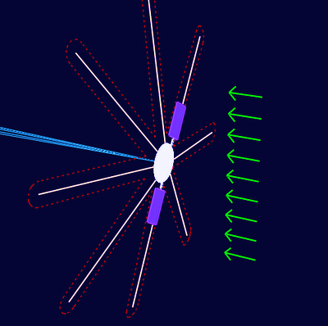
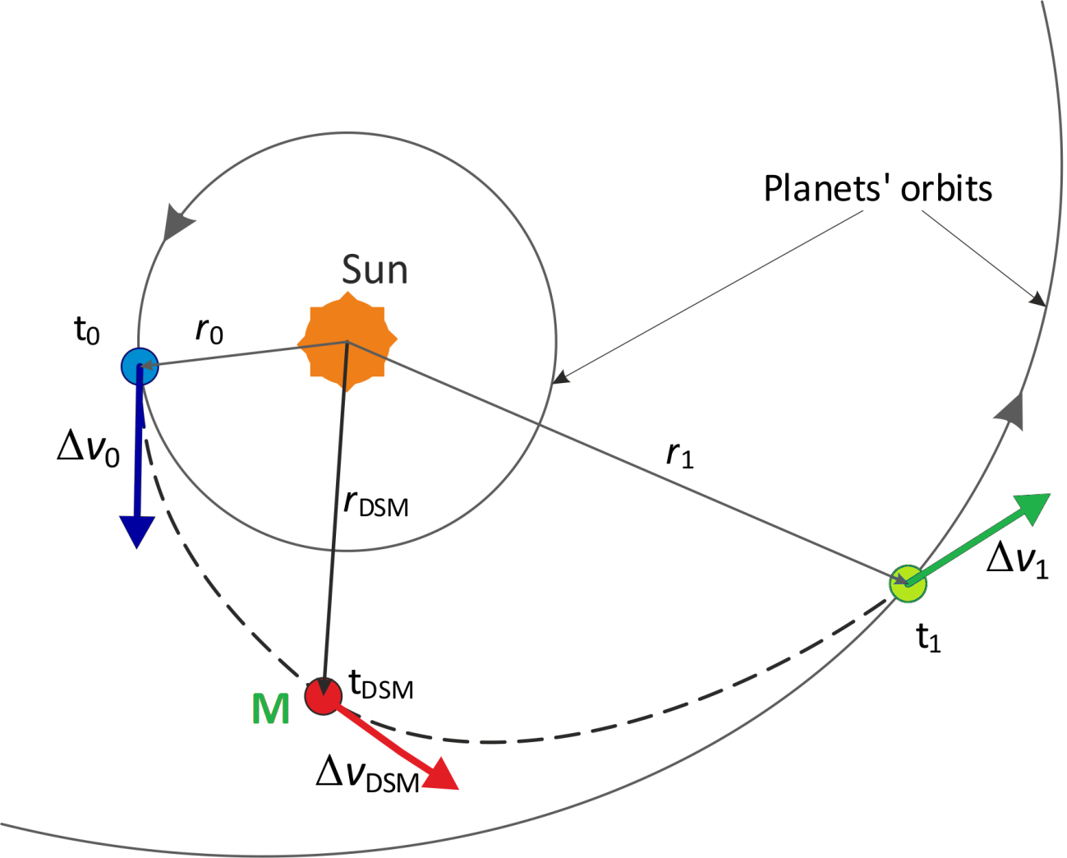
Personal Background
Bachelor’s degree (Laurea triennale), 2007
Aerospace Engineering, University of Pisa
Thesis: “Orbit models of electric sail space vehicles”
Master's degree (Laurea specialistica), 2011
Aerospace Engineering, University of Pisa
MSc Thesis Project
Astrodynamics & Satellite missions dept.
Delft University of Technology
“Preliminary Design of Interplanetary Trajectories with Deep Space Manoeuvres”

Slide 3
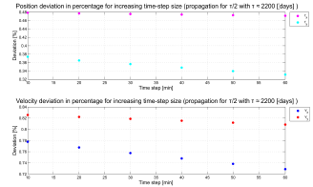

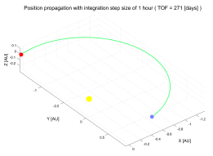
Personal Background
project (TU Delft Astrodynamics toolbox)
Delft University of Technology
“Tudat: a modular and robust astrodynamics Toolbox”
5th ICATT 2012, International Conference on Astrodynamics Tools and Techniques, 29 May – 1 June 2012, ESA/ESTEC, Noordwijk, The Netherlands

Slide 4
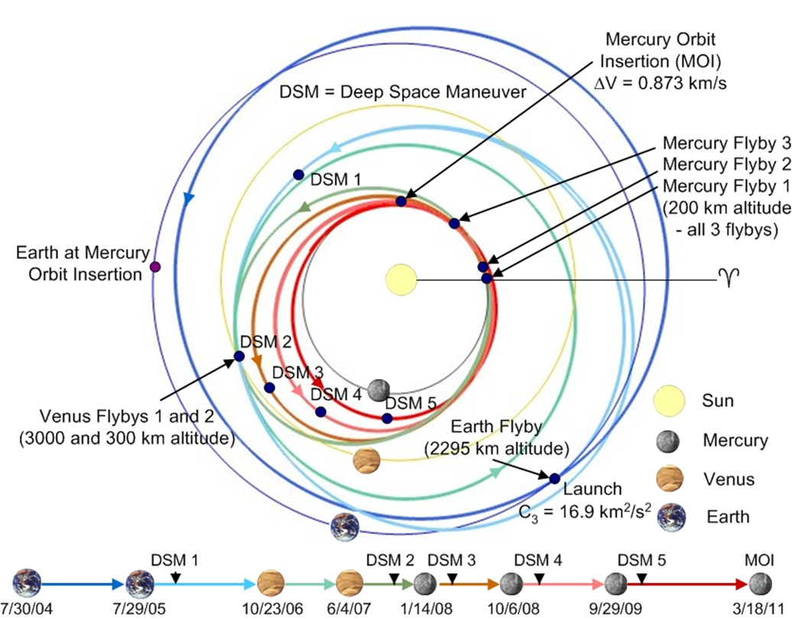
ESR Project
PhD Researcher
Surrey Space Centre, University of Surrey (April 2012 – Present)
Messenger mission
PROs
Complex scenario, commonly used to optimise the mission.
CONs
Difficult to be modeled;
Solution search space complexity increases.

Slide 5
ESR Project
Multi-objective interplanetary trajectory optimisation
Modelling of science return and cost functions (2 and 3 body problems)
Robustness of mission designs
General outline
of the project
Mid-course impulse optimisation methods
Variational analysis approach
Current state
of the art
Non-linearized solutions
Complex scenarios, e.g. addition of fly-bys
Pareto front solutions
Future
work

Slide 6
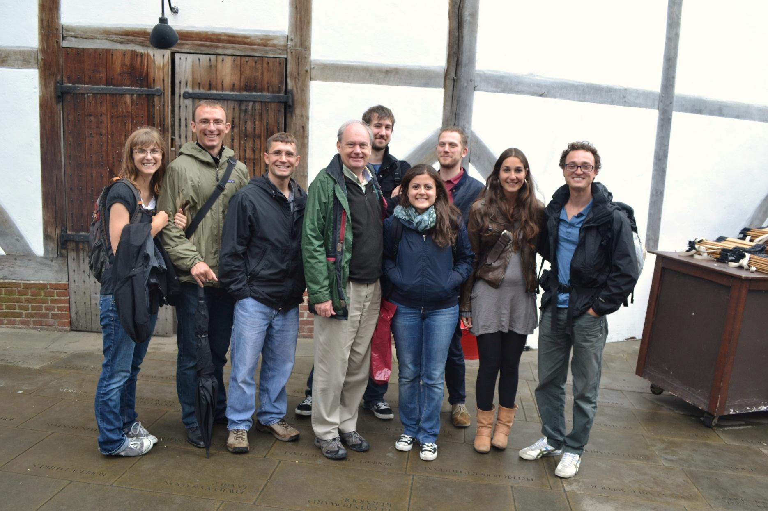
Thank you for your attention!
Astrodynamics Research Group, Surrey Space Centre

