Slide 1
Advanced topics on Algorithms
Luciano Gualà
www.mat.uniroma2.it/~guala/

Slide 2
Beyond Worst-Case Analysis
Episode IV
(the final one)

Slide 3
Robust distributional analysis
cost(A,z):
amount of resources algorithm A consumes for input z
- e.g., running time, space, I/O operations, cost of a solution
Worst-case analysis:
max cost(A,z)
z
Average-case analysis (w.r.t. a distribution D over inputs):
E [cost(A,z)]
z∼D
Issues of average-case analysis:
uncertainty about D
overfitting algorithm to D
goal: can we find a sweet spot in between?

Slide 4
Smoothed analysis
- an adversary picks an input
- nature slightly perturbs it (add a small random perturbation)
When useful?
- bad inputs should be “fragile”
- usually for running time
Smoothed complexity:
worst-case analysis
σ =0
sup
E [cost(A, z+r(σ))]
z
r(σ)
≈ average-case analysis
σ >>0
r(σ): perturbation
σ : size of the perturbation
goal: prove a good complexity as function of n and 1/σ

Slide 5
Smoothed Analysis of Pareto Curves

Slide 6
the knapsack problem
Input:
n objects
object i has value v_{i} and weight w_{i}
a knapsack capacity W
Feasible solution:
Σ
w_{i} ≤ W
a subset S ⊆ {1,2,...,n} of the objects such that
i∈S
measure (max):
Σ
v_{i}
value of S :
i∈S

Slide 7
Definition
A solution S dominates a solution T if:
the total value of S is at least the value of T;
the total size of S is at most the size of T;
at least one of these two inequalities is strict.
Obs: S renders T moot (T can be safely pruned without regret)
Pareto Curve of a Knapsack instance: set of all undominated solutions
Pareto points
value
dominated points
weight

Slide 8
A Knapsack algorithm:
Generate the Pareto curve.
(if multiple solutions have identical total value and total weight, an arbitrary one of them is retained.)
Among all solutions in the Pareto curve with total weight at most the knapsack capacity W, return the one with the largest total value.
PC_{i}: Pareto curve of the first i items
PC₀ = empty set
PC_{i} can be computed from PC_{i-1} in time O(|PC_{i}|)
Exercise: figure it out
Σ
running time: O( )
|PC_{i}|
= n min{2^{n}, n w_{max} , n v_{max}}
i
if weights/value are integrals

Slide 9
fact: The size of the Pareto curve can be exponential in the worst case
Theorem [Beier & Vocking, 2006]
In smoothed Knapsack instances (see next slide), the expected size of the Pareto curve is O(n²/σ), where σ is a measure of “perturbation size”.
the Knapsack algorithm has expected running time of O(n³/σ)
(polynomial if 1/σ is bounded by a polynomial function of n)

Slide 10
model of perturbation
W.l.o.g. assume values and weights are in [0,1]
- values v_{i} are adversarial
- each weigh w_{i} is drawn independently according to a density function
f_{i}: [0,1] → [0, 1/σ] which is not “too spiky”
σ ∈ (0,1] is a measure of “perturbation size”
3
1/σ
1
1
1
weight uniform on [0,1]
weight uniform on [1/3,2/3]

Slide 11
model of perturbation
W.l.o.g. assume values and weights are in [0,1]
- values v_{i} are adversarial
- each weigh w_{i} is drawn independently according to a density function
f_{i}: [0,1] → [0, 1/σ] which is not “too spiky”
σ ∈ (0,1] is a measure of “perturbation size”
1/σ
1/σ
1
1/2
x
weight ½+ Gaussian perturbation of mean 0 and variance σ²
weight with value concentrated around x

Slide 12
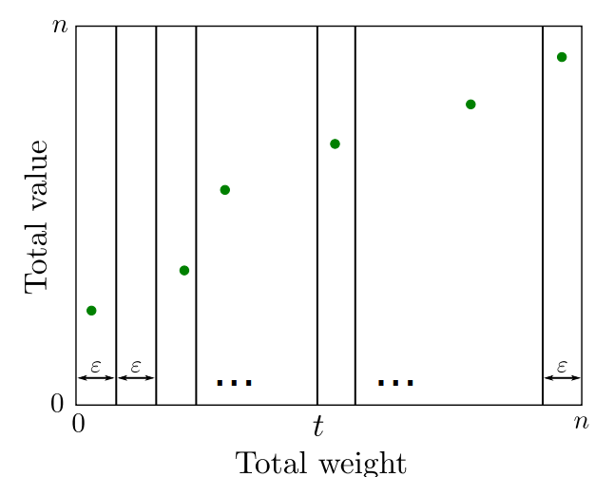
N: number of Pareto points
goal: bound the expected value of N
idea: decompose N into simpler random variables that are easier to
relate to the hypothesis that the item weights are random
- each solution is a point in the [0,n]x[0,n] box
- decompose the box into n/ε vertical "slices" each of width ε
- ε is a parameter internal to the analysis (it will not appear in the final bound)
- choose ε such that probability of having two points in the same slice ≈ 0
(e.g., inverse doubly exponential in n)

Slide 13
warm-up analysis
P_{t}: max-value solution with weight at most t
(t: slice boundary)
V_{t}: value of P_{t}
S_{t}: min-weight solution with value greater than V_{t}
N_{t}: indicator r.v. =1 if weight of S_{t}∈(t,t+ε)
Σ
claim:
N_{t} ≥ N
(with probability 1)
t
fix a Pareto point S
t= slice boundary to the left of S
value of S > V_{t}
N_{t} =1

Slide 14
analysis
P_{ti}: max-value solution not including item i with weight at most t
V_{ti}: value of P_{ti}
S_{ti}: min-weight solution including item i with value greater than V_{ti}
N_{ti}: indicator r.v. =1 if weight of S_{ti}∈(t,t+ε)
Σ
Σ
claim:
N_{ti} ≥ N
(with probability 1)
proof
t
i
fix a Pareto point S
t= slice boundary to the left of S
value of S > value of P_{t}
there is i∈S\ P_{t}
P_{ti} = P_{t}
S = S_{ti}
value of S > V_{ti}
N_{ti} =1

Slide 15
analysis
goal: E[N] ≤ n²/σ
Σ
Σ
claim:
N_{ti} ≥ N
t
i
it suffices to show that:
Lemma: E[N_{ti}] ≤ ε/σ for each i,t
proof
fix i and t, and condition on all of the random weights except for w_{i}
P_{ti} and hence V_{ti} are now fixed
consider all the set including i and order them by total size
such relative ordering is now fixed
S_{ti} is fixed and its (random) weight is W+w_{i} for some fixed W
E[N_{ti}] = Pr[N_{ti}=1] = Pr[weight of S_{ti}∈(t,t+ε)] ≤ ε/σ (since f_{i}(x) ≤ 1/σ)

