Slide 1
Advanced topics on Algorithms
Luciano Gualà
www.mat.uniroma2.it/~guala/

Slide 2
Approximation algorithms
Episode II

Slide 3
minimum Steiner Tree problem

Slide 4
minimum Steiner Tree problem
Input:
undirected graph G=(V,E) with non-negative edge costs
subset of required vertices R⊆V; V-R are called Steiner vertices
Feasible solution:
a tree T containing all the required vertices and any subset of Steiner ones
measure (min):
Σ
c(e)
cost of T :
e∈E(T)

Slide 5
12
2
3
9
4
5
2
3
5
11
: required vertices
: Steiner vertices

Slide 6
12
2
3
9
4
5
2
3
5
11
a Steiner tree of cost 20
: required vertices
: Steiner vertices

Slide 7
12
2
3
9
4
5
2
3
5
11
a better Steiner tree of cost 17
: required vertices
: Steiner vertices

Slide 8
12
2
3
9
4
5
2
3
5
11
a better Steiner tree of cost 12
special case: R=V
: required vertices
- Minimum Spanning Tree (MST) problem
- poly-time solvable
: Steiner vertices

Slide 9
minimum Steiner Tree problem
Input:
undirected graph G=(V,E) with non-negative edge costs
subset of required vertices R⊆V; V-R are called Steiner vertices
Feasible solution:
a tree T containing all the required vertices and any subset of Steiner ones
measure (min):
Σ
c(e)
cost of T :
e∈E(T)
metric Steiner tree problem:
- G is complete, and
- edge costs satisfy the triangle inequality
for every u,v,w : c(u,v)≤c(u,w)+c(w,v)

Slide 10
Theorem
There is an approximation factor preserving reduction from the Steiner tree problem to the metric Steiner tree problem.
proof
let I be an instance of the ST problem consisting of graph G=(V,E) and required vertices R.
in poly-time
instance I’ of metric ST problem:
G’=(V,E’) complete; c’(u,v) in G’= cost of any u-v shortest path in G
R’=R
since for every (u,v)∈E, c’(u,v)≤c(u,v),
OPT(I’)≤OPT(I).
any steiner tree T’ of I’ can be converted in poly-time into a steiner tree T of I of at most the same cost:
replace each edge (u,v) of T’ with the shortest path in G
pick any spanning tree T of the obtained subgraph of G
cost(T)≤cost(T’)

Slide 11
Algorithm
output a Minimum Spanning Tree (MST) of the subgraph of G induced by R
5
3
5
3
3
5
: required vertices
: Steiner vertices

Slide 12
Algorithm
output a Minimum Spanning Tree (MST) of the subgraph of G induced by R
OPT=9
5
3
5
returned tree T has cost: 10
3
3
5
: required vertices
: Steiner vertices

Slide 13
Theorem
The algorithm is a 2-approximation algorithm for metric ST problem.
proof
let T be an optimal Steiner tree of cost OPT, and M the MST on R.
double the edges of T obtaining an Eulerian graph of cost 2 OPT
consider an Eulerian tour of cost 2 OPT
C
T
obtain a Hamiltonian cycle C on R by traversing the Eulerian tour and “shortcutting” Stainer vertices and previously visited vertices of R
by triangle inequality: cost(C)≤2 OPT
Since C is a spanning subgraph of G[R]: cost(M)≤ cost(C)

Slide 14
tight example
n+1 vertices
returned solution has cost 2(n-1)
OPT=n
edges incident to the Steiner vertex have cost 1
all the other edges have cost 2

Slide 15
Steiner Tree: state of the art
2
[Takahashi & Matsuyama, J.of Math. Jap, 1980]
11/6= 1.834
[Zelikovsky, Algorithmica 93]
1.746
[Berman & Ramaiyer, SODA 92]
1+ln 2+ε=1.693
[Zelikovsky, Tech. Rep. 96]
5/3+ε = 1.667
[Promel & Steger, STACS 96]
1.644
[Karpinski & Zelikovsky, JOCO 97]
1.598
[Hougardy &. Promel, SODA 99]
1+(ln 3)/2+ε=1.55
[Robins & Zelikovsky, SODA 2000]
ln 4 +ε =1.39
[Byrka et al., STOC 2010]

Slide 16
Traveling Salesman Problem
(TSP)

Slide 17
Traveling Salesman Problem
Input:
undirected complete graph G=(V,E) with non-negative edge costs
Feasible solution:
a cycle C visiting every vertex exactly once
measure (min):
Σ
c(e)
cost of C :
e∈E(C)
12
5
6
4
4
11

Slide 18
Traveling Salesman Problem
Input:
undirected complete graph G=(V,E) with non-negative edge costs
Feasible solution:
a cycle C visiting every vertex exactly once
measure (min):
Σ
c(e)
cost of C :
e∈E(C)
12
5
a tour of cost 33
6
4
4
11

Slide 19
Traveling Salesman Problem
Input:
undirected complete graph G=(V,E) with non-negative edge costs
Feasible solution:
a cycle C visiting every vertex exactly once
measure (min):
Σ
c(e)
cost of C :
e∈E(C)
12
5
a better tour of cost 32
6
4
4
11

Slide 20
Traveling Salesman Problem
Input:
undirected complete graph G=(V,E) with non-negative edge costs
Feasible solution:
a cycle C visiting every vertex exactly once
measure (min):
Σ
c(e)
cost of C :
e∈E(C)
12
5
a better tour of cost 19
6
4
4
11

Slide 21
Traveling Salesman Problem
Input:
undirected complete graph G=(V,E) with non-negative edge costs
Feasible solution:
a cycle C visiting every vertex exactly once
measure (min):
Σ
c(e)
cost of C :
e∈E(C)
metric TSP:
edge costs satisfy the triangle inequality
for every u,v,w : c(u,v)≤c(u,w)+c(w,v)

Slide 22
Theorem
For any polynomial time computable function α(n), TSP cannot be approximated within a factor of α(n), unless P=NP.
proof
by contradiction: let A be a α(n)-apx algorithm.
We use A to decide Hamiltonian cycle.
Let G be an instance of the Hamiltonian cycle. Define G’:
G’=(V,E’) complete;
c(u,v)=1 if (u,v)∈E(G); c(u,v)=nα(n) otherwise
Clearly:
if G has a Hamiltonian cycle, then optimal TSP tour in G’ costs n
if G does not have a Hamiltonian cycle, then optimal TSP tour is of cost > nα(n)
G has an Hamiltonian cycle iff A returns a tour of cost n

Slide 23
Algorithm (metric TSP – factor 2)
Find an MST T of G
Double every edge of T to obtain an Eulerian graph
Find an Eulerian tour τ on this graph
Output the tour that visits vertices of G in the order of their first appearance in τ. Let C be this tour.
Theorem
The above algorithm is a 2-approximation algorithm for metric TSP.
proof
removing an edge from an optimal TSP tour gives us a spanning tree of G
Thus: cost(T)≤ OPT
We have:
cost(C) ≤ cost(τ)=2cost(T) ≤ 2 OPT

Slide 24
tight example
n vertices
thick edges have cost 1
(star+(n-1)-cycle)
all the other edges have cost 2
optimal tour of cost OPT=n
feasible MST
returned tour of cost 2n-2
(for the feasible specified order)

Slide 25
idea: find a cheaper Eulerian subgraph/tour
recall:
a graph is Eulerian iff all vertices have even degree
in every undirected graph, the number of odd-degree vertices is even
Christofides, 1976
Algorithm (metric TSP – factor 3/2)
Find an MST T of G
Compute a minimum cost perfect matching , M, on the set V’ of odd-degree vertices of T. Add M to T and obtain an Eulerian graph
Find an Eulerian tour τ on this graph
Output the tour that visits vertices of G in the order of their first appearance in τ. Let C be this tour.

Slide 26
Lemma
Let V’ ⊆V, such that |V’| is even, and let M be a minimum cost perfect matching on V’. Then, cost(M)≤OPT/2.
proof
let τ* be an optimal TSP of cost OPT.
τ*

Slide 27
Lemma
Let V’ ⊆V, such that |V’| is even, and let M be a minimum cost perfect matching on V’. Then, cost(M)≤OPT/2.
proof
let τ* be an optimal TSP of cost OPT.
τ*
cost(τ’)≤cost(τ*)
τ’
let τ’ be the tour on V’ obtained by shortcutting τ*.

Slide 28
Lemma
Let V’ ⊆V, such that |V’| is even, and let M be a minimum cost perfect matching on V’. Then, cost(M)≤OPT/2.
proof
let τ* be an optimal TSP of cost OPT.
τ*
cost(τ’)≤cost(τ*)
τ’
let τ’ be the tour on V’ obtained by shortcutting τ*.
τ’ is the union of 2 perfect matching on V’, say M₁ and M₂.
cost(M) ≤ min{cost(M₁), cost(M₂)} ≤ ½ cost(τ’) ≤ ½ OPT

Slide 29
Theorem
Christofides’s algorithm is a 3/2-approximation algorithm for metric TSP.
proof
We have:
cost(C) ≤ cost(τ)=cost(T)+cost(M) ≤ OPT + ½ OPT ≤ 3/2 OPT

Slide 30
tight example
n vertices with n odd
feasible MST: a path of n-1 edges
matching: a single edge of cost ⎡n/2⎤
OPT=n
returned tour of cost n-1+ ⎡n/2⎤)

Slide 31
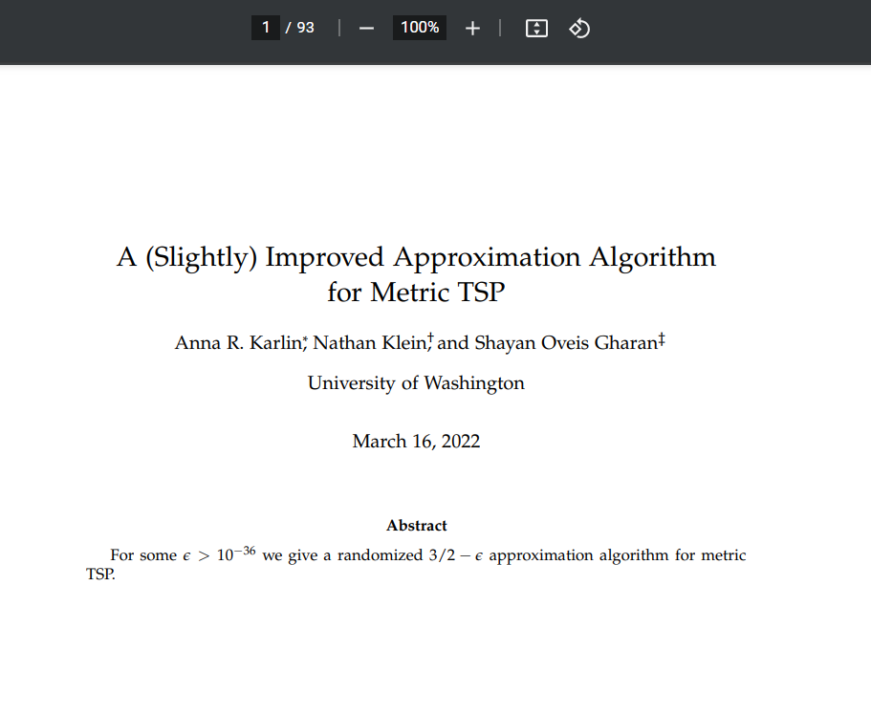
TSP: state of the art
3/2
[Christofides, 1976]
STOC 2021

