Slide 1
Advanced topics on Algorithms
Luciano Gualà
www.mat.uniroma2.it/~guala/

Slide 2
What: 3 topics, 4 lectures per topic
approximation algorithms:
well-established field
widely used approach for (NP-)hard problems
cool techniques: rounding, dual-fitting, primal-dual approach
parameterized algorithms:
multivariate analysis of algorithms
refined notions of efficiency and hardness
cool techniques: color coding, kernelization, treewidth
algorithms for massive data:
primitives for most data mining applications
sublinear time and space algorithms
cool techniques: sampling, sketches, locality sensitive hashing

Slide 3
How (to get credits)
attend lectures
final oral exam and/or class presentation (of uncovered material)
Why
expand your background: wider view of the huge world of algorithms
useful: be better theorists and practitioners
fun: amazing material and techniques
any question?

Slide 4
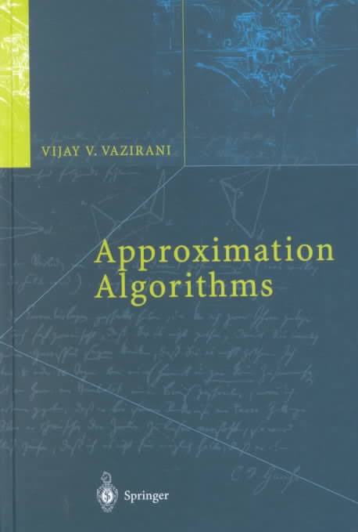
Approximation algorithms:
Episode I
(pilot)
main reference:

Slide 5
Def.
An α-approximation algorithm for an optimization problem is a polynomial-time algorithm that for all instances of the problem produces a solution whose value is within a factor of α the value of an optimal solution.
α: approximation ratio or approximation factor
minimization problem:
α≥1
for each returned solution x, cost(x)≤ α OPT
maximization problem:
α≤1
for each returned solution x, value(x) ≥ α OPT

Slide 6
minimum Vertex Cover problem

Slide 7
min cardinality Vertex Cover problem
Input:
an undirected graph G=(V,E)
Feasible solution:
U⊆V such that every edge (u,v)∈E is covered, i.e. u∈U or v∈U
measure (min):
cardinality of U

Slide 8
min cardinality Vertex Cover problem
Input:
an undirected graph G=(V,E)
Feasible solution:
U⊆V such that every edge (u,v)∈E is covered, i.e. u∈U or v∈U
measure (min):
cardinality of U
a vertex cover of size 7

Slide 9
min cardinality Vertex Cover problem
Input:
an undirected graph G=(V,E)
Feasible solution:
U⊆V such that every edge (u,v)∈E is covered, i.e. u∈U or v∈U
measure (min):
cardinality of U
a better vertex cover of size 4

Slide 10
Def.
Given a graph G=(V,E), a subset of edges M⊆E is a matching if no two edges in M share an endpoint.
Def.
A matching M⊆E is maximal if for every e∈E\M, M∪{e} is not a matching.

Slide 18
the computed vertex cover of size 6

Slide 19
Lemma
The algorithm returns a feasible VC.
proof
let M⊆E be the maximal matching computed by the algorithm.
x
y
edges in M are clearly covered
for maximality of M any other edge (x,y) shares and endpoint with some edge in M...
...and thus it is covered

Slide 20
Theorem
The algorithm is a 2-approximation algorithm for the VC problem.
proof
The returned solution is a feasible VC (previous lemma)
let M⊆E be the maximal matching computed by the algorithm, and U the corresponding VC.
any optimal solution must have size OPT at least |M|
Lower bounding scheme: the size of any maximal matching is a lower bound to the size of an optimal VC
thus:
|U|=2|M|≤2OPT

Slide 21
Three important questions:
1. Can the approximation ratio of Algorithm 1.2 be improved by a better
analysis?
2. Can an approximation algorithm with a better apx ratio be designed
using the lower bounding scheme of Algorithm 1.2, i.e. the size of a
maximal matching?
3. Is there some other lower bounding scheme that can lead to a better
approximation algorithm for VC?

Slide 22
1. Can the approximation ratio of Algorithm 1.2 be improved by a better
analysis?
NO
complete bipartite graph K_{n,n}
Algorithm 1.2 will pick all the 2n vertices
OPT=n (one side is an optimal VC)
tight example

Slide 23
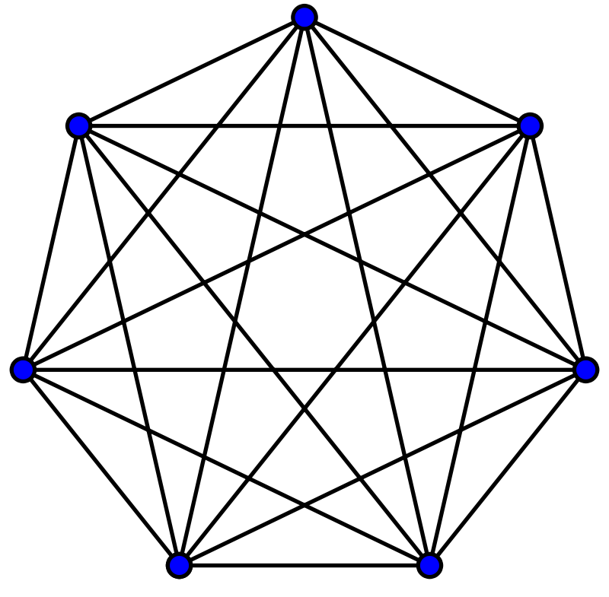
2. Can an approximation algorithm with a better apx ratio be designed
using the lower bounding scheme of Algorithm 1.2, i.e. the size of a
maximal matching?
NO
complete graph K_{n} where n is odd
size of any maximal matching is (n-1)/2
OPT=n-1

Slide 24
3. Is there some other lower bounding scheme that can lead to a better
approximation algorithm for VC?
OPEN
Partial answer:
Theorem
Assuming the unique games conjecture holds, if there exists an α-approximation algorithm for the VC problem with α<2, then P=NP.
roughly: a particular problem (called unique games) is NP-hard

Slide 25
Minimum Set Cover problem

Slide 26
minimum Set Cover problem
Input:
universe U of n elements
a collection of subsets of U, S={S₁,...,S_{k}}
each S∈S has a positive cost c(S)
Feasible solution:
a subcollection C⊆S that covers U (whose union is U)
measure (min):
Σ
c(S)
cost of C :
S∈C

Slide 27
4
4
9
2
6
3

Slide 28
4
4
9
2
6
3
a set cover of cost 16

Slide 29
4
4
9
2
6
3
a better set cover of cost 15

Slide 30
4
4
9
2
6
3
a better set cover of cost 12

Slide 31
greedy strategy: pick the most cost-effective set and remove the covered elements, until all elements are covered.
Let C be the set of elements already covered.
cost-effectiveness of S: c(S)/|S-C|
average cost at which
S covers new elements
average cost at which
e is covered

Slide 32
4
4
9
2
6
3

Slide 33
4
4
9
2
6
3
3/4
3/4
3/4
3/4

Slide 34
4
4
9
2
2
2
6
3
3/4
3/4
3/4
3/4

Slide 35
4
4
9
2
2
2
4
6
3
3/4
3/4
3/4
3/4

Slide 36
4
4
9
2
2
2
4
6
6
3
3/4
3/4
3/4
3/4
the computed set cover of cost 17

Slide 37
Number the elements of U in order in which they were covered, resoving ties arbitrarily. Let e₁,..., e_{n} this numbering.
Lemma
For each k∈{1,...,n}, price(e_{k}) ≤ OPT/(n-k+1)
proof
at any iteration, the leftovers sets of the optimal solution can cover all the remaining elements C’=U-C at cost at most OPT.
one of these leftovers sets has cost-effectiveness at most OPT/|C’|
at iteration in which e_{k} is covered, C’ contains at least n-k+1 elements.
by the greedy choice:
price(e_{k}) ≤
OPT/|C’|
≤ OPT/(n-k+1)

Slide 38
Theorem
The greedy algorithm is H_{n} factor approximation algorithm for the minimum Set Cover problem, where H_{n} =1+1/2+...+1/n.
proof
Since the cost of each picked set is distributed among the new covered elements:
n
n
Σ
Σ
cost of the cover=
≤
price(e_{k})
OPT/(n-k+1)
≤ H_{n}OPT
k=1
k=1
n
Σ
H_{n} =
1/k
n-th harmonic number
≤ ln n + 1
k=1

Slide 39
tight example
the greedy alg computes a cover having cost H_{n}
OPT=1+ε
Theorem
There exists some constant c>0 such that if there exists a (c ln n)-apx algorithm for the unweighted SC problem, then P=NP.
Theorem
If there exists a (c ln n)-apx algorithm for the unweighted SC problem, for some constant c<1, then there is an O(n^{O(log log n)})-time alg for each NP-complete problem.

Slide 40
the approximation game: get better and better approximation factor
Polynomial-Time Approximation Scheme:
(1+ε)-apx for any ε>0.
running time depends on ε
1
FPTAS
EPTAS
PTAS
O(1)
log^{k}n
n^{ε}
apx factor
exact algorithms
(1+ε)-apx in time f(1/ε)n^{O(1/ε)}
(1+ε)-apx in time f(1/ε) n^{O(1)}
(1+ε)-apx in time poly(1/ε) n^{O(1)}

Slide 41
Application to shortest superstring

Slide 42
the shortest superstring problem
Input:
a set of n strings over a finite alphabet S={s₁,...,s_{n}}
Feasible solution:
a string s that contains each s_{i} as a substring
measure (min):
length of s
notice: w.l.o.g. we can assume no string s_{i} is a substring of another s_{j}
S={abbc, cccaab, bccc}
a solution of length 12: abbcccaabccc
a better solution of length 9: bcccaabbc

Slide 43
reducing the problem to set cover
for s_{i}, s_{j} ∈S, and k>0
if the last k symbols of s_{i} are the same as the first k symbols of s_{j},
let σ_{ijk} be the string obtained by overlapping those k positions
let M be the set of the strings σ_{ijk} for all valid choices of i, j, k.
for a given string π,
let set(π)={s∈S : s is a substring of π}
the Set Cover instance:
the set of objects is S
collection of subsets: we have set(π) for each π ∈S∪M of cost |π|

Slide 44
Theorem
The above algorithm is a 2H_{n}-approximation algorithm for the shortest superstring problem.
proof
since we have computed a set cover, every s∈S is a substring of some π_{j}
the computed string is a feasible superstring
OPT: the value of the optimal solution for the shortest superstring
OPT_{SC}: the value of the optimal solution for the SC instance
claim: OPT_{SC} ≤ 2 OPT.
the computed string has length ≤ H_{n} OPT_{SC} ≤ 2H_{n} OPT

Slide 45
Let s be the optimal superstring of length OPT
we show there is a feasible SC of cost at most 2 OPT
leftmost occurrences (in s) of the n strings of S
since there is no string that is substring of another: they start and then end at distinct places in s
Σ
all the sets set(π_{i}) is a feasible SC of cost
|π_{i}|
i
notice: π_{i} and π_{i+2} do not overlap
Σ
|π_{i}|
≤ 2 |s| ≤ 2 OPT
i

