Slide 1
Analisi di Reti (mod 2)
Luciano Gualà
www.mat.uniroma2.it/~guala/

Slide 2
Mechanism Design Without Money
reference:
Twenty Lectures in Algorithmic Game Theory
Tim Roughgarden
Chapters 9 & 10.

Slide 3
Motivations and applications
motivations:
sometimes the use of money is infeasible or illegal;
applications:
voting;
organ donation;
school choice;
...
what can be done:
strong impossibility results in general
still some of mechanism design’s greatest hits

Slide 4
House allocation problem
&
Top Trading Cycle algorithm

Slide 5



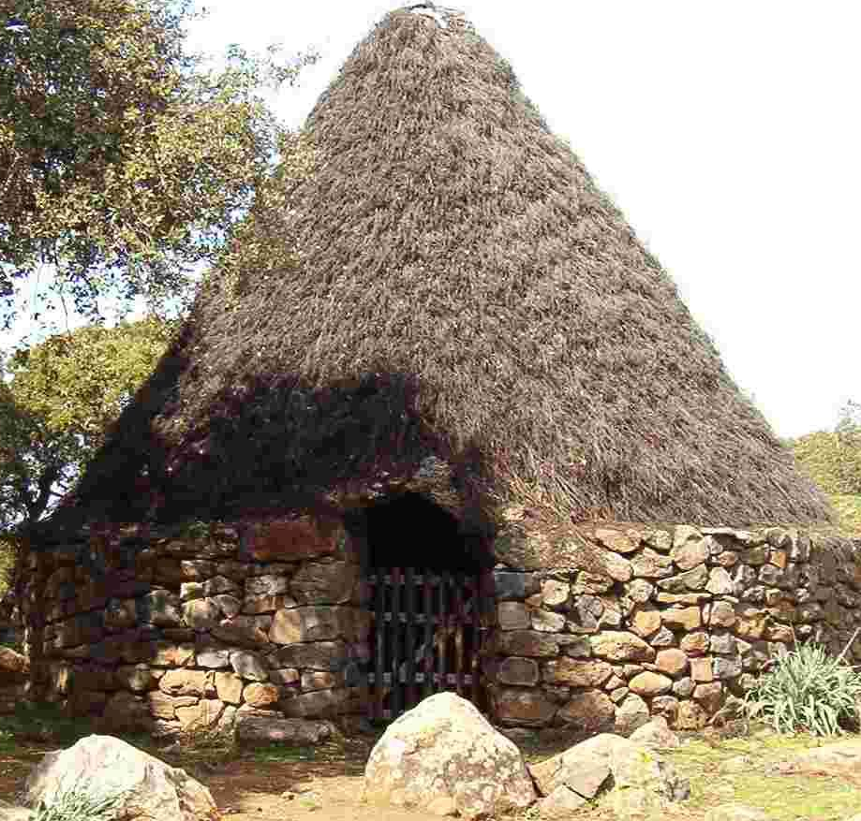
House allocation problem
n agents
each agent initially owns a house
preferences (type) of the agent i: a total ordering over the n houses
  an agent need not prefer her own house over the others
1
2
3
4
1’s preferences:
1,3,2,4
2’s preferences:
1,3,2,4
3’s preferences:
1,4,3,2
4’s preferences:
1,2,3,4
goal 1: reallocate the houses to make the agents better off
goal 2: do it in a way agents cannot manipulate the allocation
Top Trading Cycle (TTC) algorithm

Slide 6


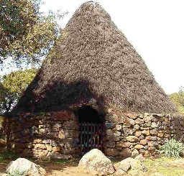

TTC algorithm (idea)
allocation proceeds in iterations
at each iteration:
  each remaining agent participates with her own house
  each remaining agent points to her favorite still available house
  look at (disjoint) cycles formed and perform the reallocation suggested by the cycles
  remove the agents of the cycles
2
2’s preferences:
1,3,2,4
1
4
1’s preferences:
1,3,2,4
4’s preferences:
1,2,3,4
3
3’s preferences:
1,4,3,2

Slide 7
TTC algorithm (idea)
allocation proceeds in iterations
at each iteration:
  each remaining agent participates with her own house
  each remaining agent points to her favorite still available house
  look at (disjoint) cycles formed and perform the reallocation suggested by the cycles
  remove the agents of the cycles
2
2’s preferences:
1,3,2,4
1
4
1’s preferences:
1,3,2,4
4’s preferences:
1,2,3,4
3
3’s preferences:
1,4,3,2

Slide 8

TTC algorithm (idea)
allocation proceeds in iterations
at each iteration:
  each remaining agent participates with her own house
  each remaining agent points to her favorite still available house
  look at (disjoint) cycles formed and perform the reallocation suggested by the cycles
  remove the agents of the cycles
2
2’s preferences:
1,3,2,4
1
4
1’s preferences:
1,3,2,4
4’s preferences:
1,2,3,4
3
3’s preferences:
1,4,3,2

Slide 9
TTC algorithm (idea)
allocation proceeds in iterations
at each iteration:
  each remaining agent participates with her own house
  each remaining agent points to her favorite still available house
  look at (disjoint) cycles formed and perform the reallocation suggested by the cycles
  remove the agents of the cycles
2
2’s preferences:
1,3,2,4
1
4
1’s preferences:
1,3,2,4
4’s preferences:
1,2,3,4
3
3’s preferences:
1,4,3,2

Slide 10
TTC algorithm (idea)
allocation proceeds in iterations
at each iteration:
  each remaining agent participates with her own house
  each remaining agent points to her favorite still available house
  look at (disjoint) cycles formed and perform the reallocation suggested by the cycles
  remove the agents of the cycles
2
2’s preferences:
1,3,2,4
1
4
1’s preferences:
1,3,2,4
4’s preferences:
1,2,3,4
3
3’s preferences:
1,4,3,2

Slide 11
TTC algorithm (idea)
allocation proceeds in iterations
at each iteration:
  each remaining agent participates with her own house
  each remaining agent points to her favorite still available house
  look at (disjoint) cycles formed and perform the reallocation suggested by the cycles
  remove the agents of the cycles
2
2’s preferences:
1,3,2,4
1
4
1’s preferences:
1,3,2,4
4’s preferences:
1,2,3,4
3
3’s preferences:
1,4,3,2

Slide 12
TTC algorithm (idea)
allocation proceeds in iterations
at each iteration:
  each remaining agent participates with her own house
  each remaining agent points to her favorite still available house
  look at (disjoint) cycles formed and perform the reallocation suggested by the cycles
  remove the agents of the cycles
2
2’s preferences:
1,3,2,4
1
4
1’s preferences:
1,3,2,4
4’s preferences:
1,2,3,4
3
3’s preferences:
1,4,3,2

Slide 13
TTC algorithm (idea)
allocation proceeds in iterations
at each iteration:
  each remaining agent participates with her own house
  each remaining agent points to her favorite still available house
  look at (disjoint) cycles formed and perform the reallocation suggested by the cycles
  remove the agents of the cycles
2
2’s preferences:
1,3,2,4
1
4
1’s preferences:
1,3,2,4
4’s preferences:
1,2,3,4
3
3’s preferences:
1,4,3,2

Slide 14
G has at least one directed cycle, since traversing a sequence of outgoing edges must eventually repeat a vertex
Because all out-degrees are 1, these cycles are disjoint

Slide 15
Some properties of the TTC algorithm
Lemma
Let N_{k} denote the set of agents removed in the k-th iteration of the TTC algorithm. Every agent of N_{k} receives her favorite house outside of those owned by N₁ ∪... ∪N_{k-1}, and the original owner of this house is in N_{k}.
Theorem
When the TTC algorithm is used for the reallocation, for every agent, it is a dominant strategy to report truthfully.

Slide 16
proof
Fix an agent i and reports by the others.
Assume i reports truthfully.
Let N_{k} be the set of agents removed in the k-th iteration.
N₁
N₂
N_{k}
...
N_{j}
N_{h}
∈
i
By the previous lemma it suffices to prove:
Claim: no misreport can net i a house of an agent in N₁∪... ∪N_{j-1}.
For each k<j:
- no agent in N_{k} point to i at iteration k
otherwise i would belong to N_{k}
- no agent in N_{k} point to i at iteration <k
otherwise that agent would point to i at iteration k

Slide 17
Why the previous theorem is nice?
Notice: the mechanism that never reallocates anything is also truthful
Consider a reallocation of the houses. A subset of agents forms a blocking coalition for this reallocation if they can internally reallocate their houses to make some member better off while making no member worse off.
A core allocation is a reallocation with no blocking coalitions.
Theorem
For every house allocation problem, the allocation computed by the TTC algorithm is the unique core allocation.

Slide 18
proof
Claim 1: every allocation that differs from the TTC allocation is not a core
allocation.
Claim 2: the TTC allocation is a core allocation.
proof of Claim 1
every agent in N₁ receives her first choice
N₁ is a blocking coalition for any allocation ≠ from the TTC one
every core allocation must agree with the TTC one on agents in N₁
every agent in N₂ receives her first choice outside N₁
N₂ is a blocking coalition for any allocation ≠ from the TTC one that agrees with TTC on N₁
every core allocation must agree with the TTC one on agents in N₁ and N₂
...

Slide 19
proof
Claim 1: every allocation that differs from the TTC allocation is not a core
allocation.
Claim 2: the TTC allocation is a core allocation.
proof of Claim 2
consider an arbitrary subset S of agents and an internal reallocation of their houses
the reallocation partitions S into directed cycles
consider any such cycle C
- if C contains two agents i∈N_{j} and t∈N_{k} with j<k
i is worse off than in the TTC allocation
- if C contains agents all in N_{k} but there is an agent i that does not
receives her favorite choice in N_{k}
i is worse off than in the TTC allocation
the TTC allocation has no blocking coalitions.

Slide 20
Kidney Exchange

Slide 21
Background
many people suffer from kidney failure and need a kidney transplant
In US more than 100.000 people are on the waiting list for such a transplant
old idea (used also for other organs): deceased donors
special feature for kidneys: living donors
(a healthy person can survive just fine with a single kidney)
compatibility issues:
having a living kidney donors is not always enough
a patient-donor pair can be incompatible
(primary culprits for incompatibility: blood and tissue types need to match)
idea: swap donors!
P₁
P₂
blood type B
blood type A
D₁
D₂
blood type B
blood type A
kidney exchange

Slide 22
initially, few kidney exchanges were done on an ad-hoc basis
This made clear the need of a system to organize kidney exchanges
a system where patient-donor pairs can register and be matched with others
goal: how such an exchange system can be designed in order to enable
as many matches as possible?
currently, monetary compensation is illegal in most of the countries
problem naturally modeled as a mechanism design problem without money

Slide 23
first idea: model the problem as a house allocation problem
each patient-donor pair treated as a agent-house
  patient=agent
  donor=house
a patient’s total ordering over the donors can be defined according to the estimated probability of a successful kidney transplant
use the TCC algorithm to find kidney exchanges
the reallocation of donors suggested by the TCC algorithm can only improve every patient’s probability of a successful transplant
Good case for the TTC algorithm.
- each circle represents an incompatible patient-donor pair
- each arrow represents a kidney transplant from the donor in the first
pair to the patient of the second pair.

Slide 24
first idea: model the problem as a house allocation problem
some technical issues:
need to manage patients without a donor
(agent without a house)
need to manage deceased donors
(house without an agent/owner)
the TTC algorithm & its incentive guarantee can be extended to this more general setting (with some non-trivial extra work)
some more important issues:
the TTC algorithm can find very long cycles
(the corresponding surgeries must happen simultaneously)
how many surgeries?
4
what if P₁-D₂ surgeries today and P₂-D₁ surgeries tomorrow?
D₁ could renege on her offer
- P₁ unfairly got a kidney for free
- P₂ is still sick and can no longer participate in a kidney exchange

Slide 25
first idea: model the problem as a house allocation problem
some technical issues:
need to manage patients without a donor
(agent without a house)
need to manage deceased donors
(house without an agent/owner)
the TTC algorithm & its incentive guarantee can be extended to this more general setting (with some non-trivial extra work)
some more important issues:
the TTC algorithm can find very long cycles
(the corresponding surgeries must happen simultaneously)
really bad case

Slide 26
first idea: model the problem as a house allocation problem
some technical issues:
need to manage patients without a donor
(agent without a house)
need to manage deceased donors
(house without an agent/owner)
the TTC algorithm & its incentive guarantee can be extended to this more general setting (with some non-trivial extra work)
some more important issues:
the TTC algorithm can find very long cycles
(the corresponding surgeries must happen simultaneously)
modeling patient’s preferences as a total order over donors is overkill
(binary preferences over donors are more appropriate)
change the model: use graph matching!

Slide 27
A matching of an undirected graph is a subset of the edges that share no endpoints.
The relevant graph for kidney exchanges:
- we have a vertex for each incompatible patient-donor pair
- there is an edge between (P_{i},D_{i}) and (P_{j},D_{j}) if and only if
P_{i} and D_{j} are compatible & P_{j} and D_{i} are compatible
P₁D₁
P₂D₂
P₅D₅
P₃D₃
P₄D₄

Slide 28
A matching of an undirected graph is a subset of the edges that share no endpoints.
The relevant graph for kidney exchanges:
- we have a vertex for each incompatible patient-donor pair
- there is an edge between (P_{i},D_{i}) and (P_{j},D_{j}) if and only if
P_{i} and D_{j} are compatible & P_{j} and D_{i} are compatible
P₁D₁
P₂D₂
P₅D₅
P₃D₃
P₄D₄

Slide 29
A matching of an undirected graph is a subset of the edges that share no endpoints.
The relevant graph for kidney exchanges:
- we have a vertex for each incompatible patient-donor pair
- there is an edge between (P_{i},D_{i}) and (P_{j},D_{j}) if and only if
P_{i} and D_{j} are compatible & P_{j} and D_{i} are compatible
goal:
find a matching of maximum size
P₁D₁
P₂D₂
P₅D₅
P₃D₃
P₄D₄
notice: we are restricting ourselves to 2-length cycles

Slide 30
How do incentives come into play?
we assume that each patient i
- has a set E_{i} of compatible donors belonging to other patient-donor pairs
- can report any subset F_{i} ⊆ E_{i}
it makes sense since:
proposed kidney exchange can be refused by a patient for any reason
a patient cannot credibly misreport extra donors with whom she is incompatible
is this mechanism truthful?
It depends on how ties are broken between different maximum matchings

Slide 31
two types of ties
P₁D₁
P₂D₂
P₁D₁
P₂D₂
VS
P₃D₃
P₄D₄
P₃D₃
P₄D₄
P₂D₂
P₂D₂
P₁D₁
P₃D₃
VS
P₁D₁
P₃D₃
P₄D₄
P₄D₄
we will manage ties by prioritizing the patient-donor pairs
notice: most hospitals already rely on priority schemes to manage their
patients

Slide 32
re-index the vertices of G such that
V={1,2,...,n} are ordered from highest to lowest priority

Slide 33
Theorem
In the priority mechanism for pairwise kidney exchange, for every agent i, it is a dominant strategy to truthfully report E_{i}.
Exercise 1: Prove it.
Exercise 2:
Exhibit a tie-breaking rule between maximum-cardinality matchings such that the corresponding mechanism is not truthful.

Slide 34
Some other remarks and further directions
length of the cycles:
by using matching we are restricting ourselves to 2-length cycles
actual algorithms allow 3-way exchanges
(it can significantly increase the number of matched patients)
4-way exchanges does not seem to lead to significant further improvements
Incentives for hospitals:
many patient-donor pairs are reported to national kidney exchanges by hospitals
the objective of a hospital, to match as many of its patients as possible, is not perfectly aligned with the societal objective of matching as many patients as possible

Slide 35
Example 1
H₁ could match 1&2 internally without bothering to report them to national kidney exchange
H₁
1
2
3
H₂
4
5
6
H₂ could match 5&6 internally without bothering to report them to national kidney exchange

Slide 36
Example 1
H₁ could match 1&2 internally without bothering to report them to national kidney exchange
H₁
1
2
3
H₂
4
5
6
H₂ could match 5&6 internally without bothering to report them to national kidney exchange

Slide 37
Example 1
H₁ could match 1&2 internally without bothering to report them to national kidney exchange
H₁
1
2
3
H₂
4
5
6
Full reporting by hospitals leads to more matches
H₂ could match 5&6 internally without bothering to report them to national kidney exchange

Slide 38
Example 2 (impossibility result)
H₁
2
3
7
H₂
1
4
5
6
Assume truthful reporting.
A pair x will not be matched.
If x∈H₁, H₁ has convenience to not report 2&3 (and get all its pairs matched)

Slide 39
Example 2 (impossibility result)
H₁
2
3
7
H₂
1
4
5
6
Assume truthful reporting.
A pair x will not be matched.
If x∈H₁, H₁ has convenience to not report 2&3 (and get all its pairs matched)

Slide 40
Example 2 (impossibility result)
H₁
2
3
7
H₂
1
4
5
6
Assume truthful reporting.
A pair x will not be matched.
If x∈H₁, H₁ has convenience to not report 2&3 (and get all its pairs matched)

Slide 41
Example 2 (impossibility result)
H₁
2
3
7
H₂
1
4
5
6
Assume truthful reporting.
A pair x will not be matched.
If x∈H₁, H₁ has convenience to not report 2&3 (and get all its pairs matched)
If x∈H₂, H₂ has convenience to not report 5&6 (and get all its pairs matched)

Slide 42
Example 2 (impossibility result)
H₁
2
3
7
H₂
1
4
5
6
Assume truthful reporting.
A pair x will not be matched.
If x∈H₁, H₁ has convenience to not report 2&3 (and get all its pairs matched)
If x∈H₂, H₂ has convenience to not report 5&6 (and get all its pairs matched)

Slide 43
Example 2 (impossibility result)
H₁
2
3
7
H₂
1
4
5
6
Assume truthful reporting.
A pair x will not be matched.
If x∈H₁, H₁ has convenience to not report 2&3 (and get all its pairs matched)
If x∈H₂, H₂ has convenience to not report 5&6 (and get all its pairs matched)

Slide 44
Example 2 (impossibility result)
H₁
2
3
7
H₂
1
4
5
6
Assume truthful reporting.
A pair x will not be matched.
If x∈H₁, H₁ has convenience to not report 2&3 (and get all its pairs matched)
If x∈H₂, H₂ has convenience to not report 5&6 (and get all its pairs matched)
no truthful maximum matching is possible!

