Slide 1

Consensus & fault tolerance: distributed and strategic aspects of the Blockchain technology
Luciano Gualà
University of Rome
“Tor Vergata”

Slide 2

Understanding
Blockchain technology
cryptography
distributed
computing
game theory

Slide 3
Understanding
Blockchain technology
cryptography
distributed
computing
game theory
fault
tolerance

Slide 4
the distributed ledger problem
Roger Wattenhofer,
Distributed Ledger Technology – The science of the Blockchain

Slide 5
problem:
maintain a ledger containing a sequence of commands such that:
- all agents agree on the content of the ledger
- every agent can fairly write its commands

Slide 6
problem:
maintain a ledger containing a sequence of commands such that:
- all agents agree on the content of the ledger
- every agent can fairly write its commands

Slide 7
problem:
maintain a ledger containing a sequence of commands such that:
- all agents agree on the content of the ledger
- every agent can fairly write its commands

Slide 8
problem:
maintain a ledger containing a sequence of commands such that:
- all agents agree on the content of the ledger
- every agent can fairly write its commands

Slide 9
problem:
maintain a ledger containing a sequence of commands such that:
- all agents agree on the content of the ledger
- every agent can fairly write its commands
.
.
.

Slide 10
problem:
maintain a ledger containing a sequence of commands such that:
- all agents agree on the content of the ledger
- every agent can fairly write its commands
In Bitcoin System:
=
node of the network (miners)
blockchain
=
.
.
.
=
block (of transactions)

Slide 11
problem:
maintain a distributed ledger containing a seq. of commands such that:
- all agents agree on the content of the ledger
- every agent can fairly write its commands
network can be
used to exchange messages
?

Slide 12

a simple solution
serializer
(trusted party)

Slide 13
a simple solution
serializer
(trusted party)

Slide 14
a simple solution
serializer
(trusted party)

Slide 15

a simple solution
is it really
distributed?
.
.
.
serializer
(trusted party)
- what if the serializer fails?
fault
tolerance
- what if the serializer is not honest?

Slide 16
a better solution
Consistency:
all nodes always agree on the current state of the ledger
Eventual consistency:
all nodes eventually agree on the current state of the ledger (if no new updates are issued)

Slide 17
a better solution
Consistency:
all nodes always agree on the current state of the ledger
Eventual consistency:
all nodes eventually agree on the current state of the ledger (if no new updates are issued)

Slide 18
how to solve the distributed ledger problem

Slide 19
distributed ledger via repeated consensus
repeat:
- each node supports its command
exchange messages to get an
agreement on the winning
command
every node updates its (local)
ledger with the winning
command

Slide 20
distributed ledger via repeated consensus
repeat:
- each node supports its command
exchange messages to get an
agreement on the winning
command
every node updates its (local)
ledger with the winning
command

Slide 21

distributed ledger via repeated consensus
repeat:
- each node supports its command
exchange messages to get an
agreement on the winning
command
every node updates its (local)
ledger with the winning
command

Slide 22
distributed ledger via repeated consensus
repeat:
- each node supports its command
exchange messages to get an
agreement on the winning
command
every node updates its (local)
ledger with the winning
command

Slide 23
distributed ledger via repeated consensus
repeat:
- each node supports its command
exchange messages to get an
agreement on the winning
command
every node updates its (local)
ledger with the winning
command

Slide 24
distributed ledger via repeated consensus
repeat:
- each node supports its command
exchange messages to get an
agreement on the winning
command
every node updates its (local)
ledger with the winning
command

Slide 25
distributed ledger via repeated consensus
repeat:
- each node supports its command
exchange messages to get an
agreement on the winning
command
every node updates its (local)
ledger with the winning
command

Slide 26
distributed ledger via repeated consensus
repeat:
- each node supports its command
exchange messages to get an
agreement on the winning
command
every node updates its (local)
ledger with the winning
command

Slide 27
distributed ledger via repeated consensus
repeat:
- each node supports its command
exchange messages to get an
agreement on the winning
command
every node updates its (local)
ledger with the winning
command

Slide 28
the consensus problem

Slide 29
Consensus Problem
a set of n nodes

Slide 30
Consensus Problem
a set of n nodes
8
7
each node has:
unique ID
2
4
10
15
1
21

Slide 31
Consensus Problem
a set of n nodes
8
7
each node has:
unique ID
2
4
a color in { … }
10
15
1
21

Slide 32
Consensus Problem
a set of n nodes
8
7
each node has:
unique ID
2
4
a color in { … }
10
15
an underlying communication graph G
1
21

Slide 33
Consensus Problem
a set of n nodes
8
7
each node has:
unique ID
2
4
a color in { … }
10
15
an underlying communication graph G
1
21
Goal: a distributed protocol guaranteeing
8
7
Termination (protocol eventually ends)
Agreement (monochromatic final configuration)
2
4
Validity
10
15
the winning color is initially supported by some node
1
21

Slide 34

Models of computation
synchronous
asynchronous
shared clock
computation proceeds in rounds
messages sent in a round arrive in the next round
in a round, a node receives mgs & computes & sends msgs
no shared clock
no rounds
messages arrive in the finite but unbounded time

Slide 35
Models of computation
Quality measures:
# of messages
size of the messages
# of rounds (sync. model)
shared clock
computation proceeds in rounds
messages sent in a round arrive in the next round
in a round, a node receives mgs & computes & sends msgs
no shared clock
no rounds
messages arrive in the finite but unbounded time
Fault tolerance
must work when some nodes fail

Slide 36
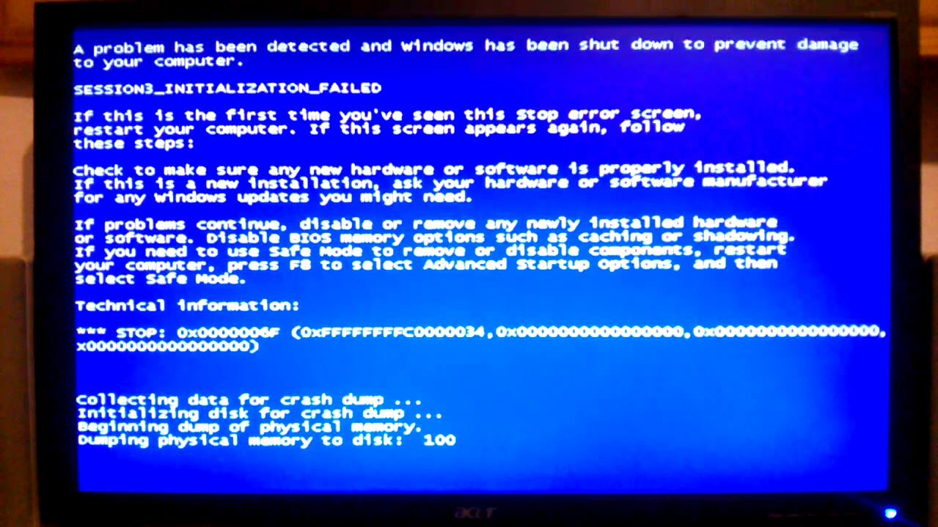


Type of failures
Crash failures
Byzantine failures
rational selfish failures

Slide 37
Type of failures
huge amount of work in the literature
(not really useful in the context for solving the distributed ledge problem)
Crash failures
Byzantine failures
rational selfish failures

Slide 38
Bitcoin system (in a nutshell)
Tim Roughgarden, Incentives in Computer Science
Lecture #9: Incentives in Bitcoin Mining, http://timroughgarden.org/f16/l/l9.pdf

Slide 39
Transactions
A Bitcoin transaction:
1. One or more senders.
2. One or more receivers.
3. The amount of BTC (Bitcoins) transferred from each
sender to each receiver.
4. A proof of ownership of the coins being transferred,
in the form of a pointer back to most recent transactions
involving the transferred coins.
5. A transaction fee, paid by the sender to the authorizer of
the transaction.

Slide 40
Transactions
A transaction is valid if:
It has been cryptographically signed by all of the senders.
The senders really do own the coins being transferred.
This can be verified using the senders’ public keys.
This can be verified as follows:
transactions are broadcast to all other users (through a peer-to-peer network);
all users keep track of all transactions that have ever been authorized;
thus, everyone knows everyone’s current balance
the ledger: the record of all the authorized transactions.

Slide 41
Transactions
Two important questions:
How do transactions get authorized and added to the ledger? (Traditionally, this would done by a centralized entity like a bank.)
How do Bitcoins get created in the first place? (Traditionally, money is printed by the government.)

Slide 42
Blocks
Transactions are added to the ledger in groups, known as blocks.
A block contains:
One or more transactions.
A hash of the previous block.
A nonce. (I.e., a bunch of bits that can be set arbitrarily.)
This imposes a natural linked list-type structure on the ledger:
the predecessor of a block b₂ being the block b₁ whose hash matches the hash stored in b₂.
Blockchain
…
b₁
b₂
b₃
b₄

Slide 43
Blockchain
Some issues:
How do new blocks get added to the blockchain?
Who can do it?
Why should they bother?
How can we make sure that everybody agrees on the contents of the blockchain?
Two key ingredients:
Any user can authorize a block. Bitcoin incentivizes users to do authorizations through explicit monetary rewards (in BTC, naturally).
Authorizing a new block of transactions involves a proof of work, meaning that the authorizer has to solve a computationally difficult puzzle.

Slide 44
Computational difficult puzzle
A block b is valid if h(b) is sufficiently close to 0.
h: pre-agreed upon hash function (currently, SHA-256)
the leading l bits of h(b) should all be 0, where l is a parameter
a block contains: transactions, the hash of the previous block, the nonce
has to be set properly set in order to make the block valid
parameter l chosen to keep the rate of valid block creation roughly every ten minutes

Slide 45

Block Rewards and Bitcoin Mining
Bitcoin mining: the process of finding new valid blocks.
A miner:
chooses a subset of the transactions;
inserts the hash of the current last block;
arbitrarily set the bits in the nonce (and hope that the resulting block is valid).
h is a cryptographic hash function
the accepted belief is that there is no algorithm for finding a valid block that is smarter or faster than random guessing or exhaustive search

Slide 46
cryptographic hash function
h:{0,1}* {0,1}^{k}
robust to (at least) the following attacks:
Preimage attack:
give x∈{0,1}^{k}, find a such that h(a)=x.
Second preimage attack:
given a, find b≠a such that h(a)=h(b).
Birthday attack:
find a and b≠a such that h(a)=h(b).

Slide 47
Block Rewards and Bitcoin Mining
The reward that a miner gets for adding a new (valid) block to the blockchain has two ingredients:
A flat reward that does not depend on the contents of the block (When Bitcoin debuted this reward was 50 BTC, but the protocol dictates that this amount gets cut in half every four years. Currently, it is 6.25.)
The sum of the transaction fees of the transactions in the block (Currently, transaction fees are non-zero but typically constitute only a few percent of the overall reward.)
remark: create a new block is the only way that new money gets printed
the miner gets the new mined BTCs as special transaction inserted into the mined block

Slide 48
Forks
When a new valid block has been found:
the miner is supposed to immediately broadcast it across the entire network, so that it gets appended to the blockchain;
If someone else announces a new valid block first, then the miner restarts this procedure, now using only transactions not already authorized by the new block, and using the hash of the new block.
when two miners solve a block at roughly the same time:
b₄
b₁
b₂
b₃
fork
’
b₄

Slide 49
Forks
Intended behavior when there is a fork:
a user should regard the longest branch as the valid one;
break ties according to the block that it heard about first.
fork
b₄
b₅
b₁
b₂
b₃
’
b₄
“orphaned” block

Slide 50
robustness

Slide 51
Bitcoin Mining Protocol:
work on the next block to be added to the longest chain
announce the solved block as soon as you get it
Does a miner have convenience to follow the protocol?

Slide 52





The Double-Spend Attack
Idea: miners deliberately create forks.
Assumption: Bob only ships the purchased goods to Alice once another block b₂ has been appended to b₁.
α: fraction of the computational
power controlled by Alice
b₃
b₄
b₅
b₀
b₁
b₂
probability of mining 3 blocks in a row: α³

Slide 53
The Double-Spend Attack
Idea: miners deliberately create forks.
Assumption: Bob only ships the purchased goods to Alice once k other blocks have been appended to b₁.
α: fraction of the computational
power controlled by Alice
b₃
b₄
b₅
b₀
b₁
b₂
probability of mining k+2 blocks in a row : α^{k+2}

Slide 54
The Double-Spend Attack
Idea: miners deliberately create forks.
Assumption: Bob only ships the purchased goods to Alice once k other blocks have been appended to b₁.
α: fraction of the computational
power controlled by Alice
b₃
b₄
b₅
if Alice keeps mining until her branch (hopefully) becomes longer:
b₀
b₁
b₂
probability of success:
[α/(1- α)]^{k+2}

Slide 55
The 51% Attack
if Alice controls > 50% of the computational power
b₄
b₅
b₇
b₈
b₁₀
b₁₁
b₀
b₁
b₂
b₃
b₆
b₉
remark:
Bitcoin is not intended to function when a single entity controls more than 50% of the computational power

Slide 56
selfish mining
I. Eyal and E. Gun Sirer, Majority is not enough: Bitcoin mining is vulnerable, Financial Cryptography 2014

Slide 57
idea: selfishly decide when to announce solved blocks

Slide 58
idea: selfishly decide when to announce solved blocks

Slide 59
idea: selfishly decide when to announce solved blocks

Slide 60
idea: selfishly decide when to announce solved blocks

Slide 61
idea: selfishly decide when to announce solved blocks

Slide 62
idea: selfishly decide when to announce solved blocks

Slide 63
wasted work!
idea: selfishly decide when to announce solved blocks

Slide 64
idea: selfishly decide when to announce solved blocks

Slide 65
idea: selfishly decide when to announce solved blocks

Slide 66
idea: selfishly decide when to announce solved blocks

Slide 67
idea: selfishly decide when to announce solved blocks

Slide 68
idea: selfishly decide when to announce solved blocks

Slide 69
idea: selfishly decide when to announce solved blocks

Slide 70
idea: selfishly decide when to announce solved blocks

Slide 71
idea: selfishly decide when to announce solved blocks

Slide 72
idea: selfishly decide when to announce solved blocks

Slide 73
idea: selfishly decide when to announce solved blocks

Slide 74
idea: selfishly decide when to announce solved blocks

Slide 75
idea: selfishly decide when to announce solved blocks

Slide 76
idea: selfishly decide when to announce solved blocks
wasted work!

Slide 77
idea: selfishly decide when to announce solved blocks

Slide 78
idea: selfishly decide when to announce solved blocks

Slide 79
A
B
idea: selfishly decide when to announce solved blocks
A
A
x
B
A
B
B
B
B
1-x

Slide 80
A
B
idea: selfishly decide when to announce solved blocks
A
A
x
B
A
B
B
B
B
1-x

Slide 81
A
B
idea: selfishly decide when to announce solved blocks
A
A
x
B
A
B
B
B
B
1-x

Slide 82
A
B
wasted work!
idea: selfishly decide when to announce solved blocks
A
A
x
B
A
B
B
B
B
1-x

Slide 83
Convenient if:
≥1/3 of the total computational power
x≥1/2 & 1/4 of the total computational power
A
B
wasted work!
idea: selfishly decide when to announce solved blocks
A
A
x
B
A
B
B
B
B
1-x

Slide 84
Thank you for your attention!

