Slide 1
Computing a Nash Equilibrium of a Congestion Game: PLS-completeness
based on Chapters 19 & 20 of
Twenty Lectures on Algorithmic Game Theory,
Tim Roughgarden

Slide 2
Global Connection Game
G=(V,E): directed graph
c_{e}: non-negative cost of the edge e ∈ E
player i has a source node s_{i} and a sink node t_{i}
Strategy for player i: a path P_{i} from s_{i} to t_{i}
Given a strategy vector S, the cost of player i
cost_{i}(S) = Σ c_{e}/k_{e}(S)
e∈P_{i}
k_{e}(S): number of players whose path contains e
G
8
t₁
2
s₁
=s₂
6
4
cost₁=7
cost₂=6
N(S)
1
t₂
8

Slide 3
Global Connection Game
potential game
a NE always exists
better-response dynamics always converge to a NE
Facts
no one knows how to define a dynamic converging to a NE in poly-time
no one knows how to compute a NE in poly-time
question:
can we derive an evidence that the probem is hard?
(tricky) answer:
theory of PLS-completeness

Slide 4
Congestion Game
E: set of resources
k players
player i picks a strategy S_{i} from an explicit set of strategies S_{i} ⊆ 2E
each resource e∈E has possible costs c_{e}(1), c_{e}(2),…, c_{e}(k)
Given a strategy vector S, the cost of player i is:
cost_{i}(S) = Σ c_{e}(k_{e}(S))
e∈S_{i}
k_{e}(S): number of players whose chosen strategy contains e

Slide 5
properties of CG
Congestion Game is a potential game
Rosenthal potential function:
k_{e}(S)
Φ(S) = Σ Σ c_{e}(i)
e∈E
i=0
a NE always exists (any local minimum of Φ is a NE)
better response dynamic converges to a NE

Slide 6
CG-NE problem
Given an instance of Congestion Game, find any NE
can we prove that CG-NE is NP-hard?
….if yes, this would yield to quite surprising consequences.

Slide 7
Addressing a typechecking error
an NP problem is a decision problem admitting short (polynomial size) witnesses for YES-instances and poly-time verifier
inputs accepted by the verifier are called witnesses
CG-NE is not a decision problem
class FNP (Functional NP): problem just like NP probems except that, for YES-instances, a witness must be provided
also called search problems
An algorithm for an FNP problem:
takes as input an instance
outputs a witness for a YES-instance or say “No”.

Slide 8
Reduction from one search problem L₁ to onother one L₂
Two polynomial-time algorithms:
- A₁ mapping instances x∈L₁ to instances A₁(x) of L₂
- A₂ mapping witnesses of A₁(x) to witnesses of x (and “no” to “no”)
Notice: if L₂ is solvable in poly-time then L₁ is solvable in poly-time as well.

Slide 9
Theorem
CG-NE is not FNP-complete unless NP=coNP
proof
Assume we have two poly-time algs
- A₁ that maps every SAT formula φ to instances of CG-NE A₁(φ)
A₂ that maps every NE S of A₁(φ) to a satisfying assignment A₂(S) of φ,
if one exists, or to the string “no” otherwise.
Then NP=CoNP.
Let φ be unsatisfiable SAT formula, S be a NE of A₁(φ).
S is a short, efficiently verifiable proof of the unsatisfiability of φ
A poly-time verifier:
compute A₁(φ)
verify that S is a NE of A₁(φ)
verify that A₂(S) returns “no”
Note: we’re using only the fact that every instance of CG has a NE

Slide 10
TFNP (total FNP): problems in FNP for which every instance has at least one witness.
Theorem
If a TFNP problem is FNP-complete then NP=coNP.

Slide 11
FNP
CG-NE
problem of finding a mixed-strategy NE for a finite game
factoring
…
TFNP
can we prove that CG-NE is TFNP-complete?
no: no complete problem is known for TFNP (and people think no one can exist)
Syntactic
classes
Semantic
classes
vs

Slide 12
FNP
CG-NE
problem of finding a mixed-strategy NE for a finite game
factoring
…
TFNP
PLS
can we prove that CG-NE is TFNP-complete?
no: no complete problem is known for TFNP (and people think no one can exist)
which is the right class for CG-NE?
PLS: abstract local search problems

Slide 13
Maximum Cut problem
Input:
an undirected graph G=(V,E,w) with non-negative edge weights
Solution:
a cut (X,Y), where X and Y are a partition of V
Measure (to miximize):
the weight of the cut, ∑ w(x,y)
X
Y
4
8
10
4
1
3
(x,y)∈E:
x∈X,y∈Y
It is NP-hard

Slide 14
A natural heuristic: Local search algorithm
- initialize with an arbitrary cut (X,Y)
while there is an improving local move do
take an arbitrary such move
improving local move:
move a single vertex v from one side of the cut to the other side, if this improves the weight of the current cut.
local optimum: cut with no improving local move available.

Slide 15
local optimum vs global optimum
X
Y
1
4
2
5
6
3
local opt of weight 15

Slide 16
local optimum vs global optimum
1
X
4
2
5
6
Y
3
global opt of weight 17

Slide 17
local optimum vs global optimum
is finding a local opt easier than finding a global opt?
sometimes strictly easier: unweighted graphs
- max cut is still NP-hard for unweighted graphs
- local search algorithm converges in poly-time
facts:
no known poly-time local search alg for finding local opt
for general weights
- no known poly-time alg for computing a local opt for
general weights

Slide 18
local Max-Cut problem
Given an instance of Max Cut, find any local opt.
….this problem is PLS-complete.

Slide 19
Ingredients of an Abstract Local Search Problem
1.
The first polynomial-time algorithm takes as input an instance and outputs an arbitrary feasible solution.
2.
The second polynomial-time algorithm takes as input an instance and a feasible solution, and returns the objective function value of the solution.
3.
The third polynomial-time algorithm takes as input an instance and a feasible solution, and either reports “locally optimal” or produces a solution with better objective function value.

Slide 20
A PLS reduction from L₁ to L₂
Two polynomial-time algorithms:
- A₁ mapping instances x∈L₁ to instances A₁(x) of L₂
A₂ mapping every local optimum of A₁(x) to local optimum of x
Notice: if L₂ is solvable in poly-time then L₁ is solvable in poly-time as well.

Slide 21
Definition.
A problem L is PLS-complete if L∈PLS and every problem in PLS reduces to it.
Theorem (Johnson, Papadimitriou, Yannakakis ’85, Schaffer, Yannakakis 91)
Computing a local maximum of a maximum cut instance with general non-negative edge weights is a PLS-complete problem.
Theorem (Johnson, Papadimitriou, Yannakakis, ’85, Schaffer, Yannakakis 91)
Computing a local maximum of a maximum cut instance with general non-negative edge weights using local search can require an exponential (in |V|) number of iterations, no matter how an improving local move is chosen in each iteration.

Slide 22
Theorem
(Fabrikant, Papadimitriou, Talwar 2004)
CG-NE is PLS-complete.
proof
CG-NE ∈ PLS
3 algorithms of the formal definition:
Alg 1: given the instance, returns any strategy profile S
Alg 2: given a strategy profile S, compute Φ(S)
Alg 3: given a strategy profile S, computes a better
response for any player, if any, or report “S is a NE”.
completeness: reduction from local MaxCut

Slide 23
proof
a player for each vertex v
two resources r_{e} and r_{e} for each edge e
two strategies for player v:
S_{v} = {r_{e} : e ∈δ(v)}
S_{v} = {r_{e} : e ∈δ(v)}
cost of a resource r ∈ {r_{e} , r_{e}}:
c_{r}(0)=c_{r}(1)=0 and c_{r}(2)=w(e)
bijection between 2^{|V|} strategy profiles and cuts of the graph
cut corresponding to strategy profile S:
(X_{S}:={v : v plays S_{v} in S}, Y_{S}:=V\X_{S})
k_{r}(S)
Φ(S) = Σ Σ c_{r}(i)
=W-W(X_{S},Y_{S})
r∈R
i=0
W = Σ w(e)
e∈E
(X_{S},Y_{S}) is a local maximum cut iff S local minimum for Φ(S)

Slide 24
what about the problem of computing mixed Nash Equilibria?

Slide 25
MNE problem
Given an instance of a 2-player game in normal form (bimatrix game), find any mixed NE
Nash’s theorem guarantees that a mixed NE always exists
MNE ∈TFNP
no polynomial time algorithm is known for MNE
what is the right class for MNE problem?

Slide 26
PLS: abstract local search problems
nodes: feasible solutions
edges: improving moves
generic reason of membership: solvable by local search, i.e. by following a directed path to a sink vertex.
witnesses

Slide 27
PPAD
canonical
source
in- & out-degree
at most 1
s
generic reason of membership: solvable by following a directed path from the source to the sink vertex.
witnesses

Slide 28
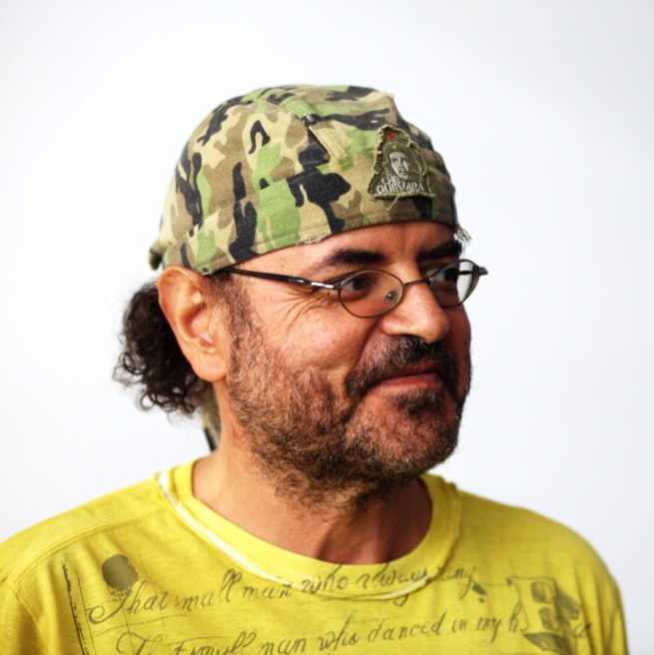
PPAD: polynomial parity argument in a directed graph
canonical
source
in- & out-degree
at most 1
s
generic reason of membership: solvable by following a directed path from the source to the sink vertex.
witnesses
class PPAD introduced in 94
by Christos H. Papadimitriou

Slide 29
FNP
TFNP
PLS
PPAD
Theorem
(Daskalakis, Godberg, Papadimitriou 06, Chen,Deng,Teng 06)
Computing any MNE of a bimatrix game is PPAD-complete

