Slide 1
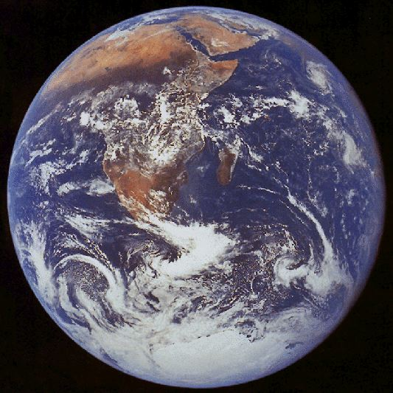


Climate models
for deep time and deep space
Antonello Provenzale
Institute of Geosciences and Earth Resources
National Research Council of Italy
Roma, March 2019

Slide 2

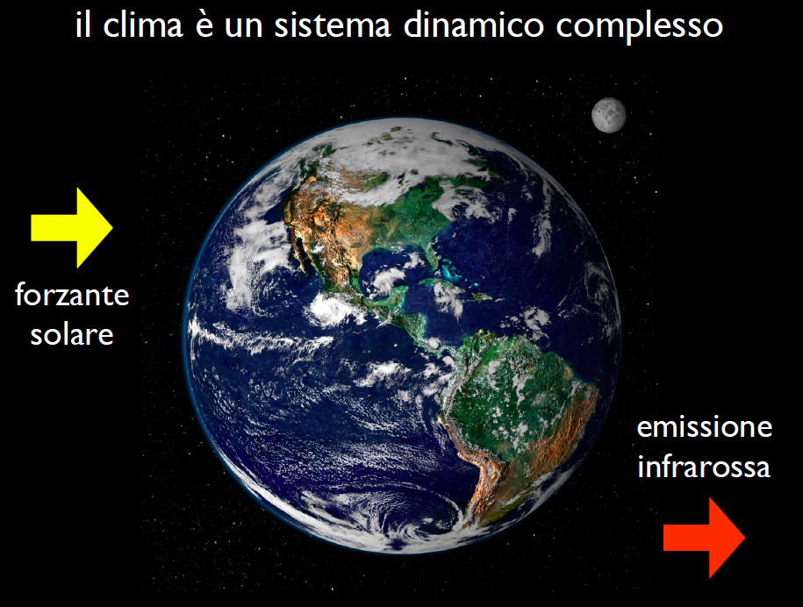
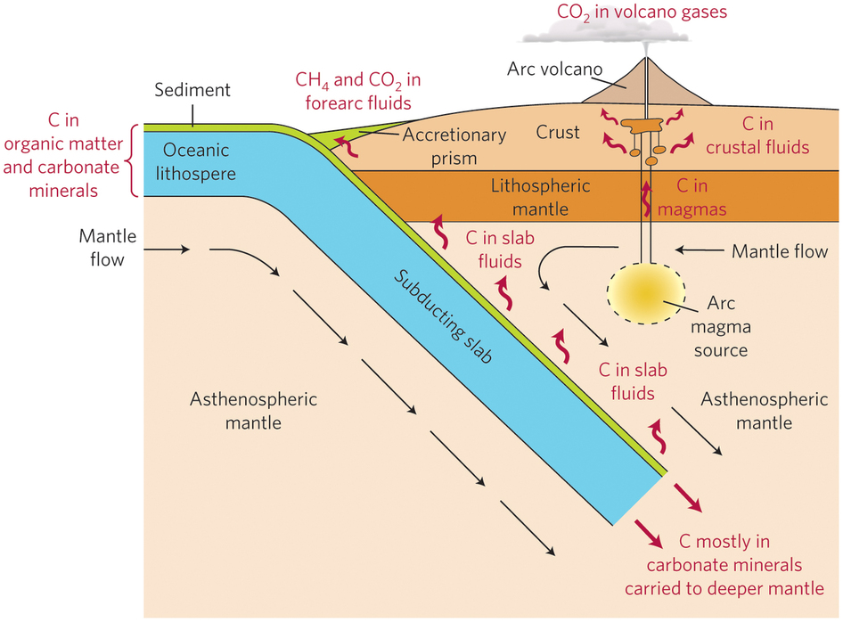
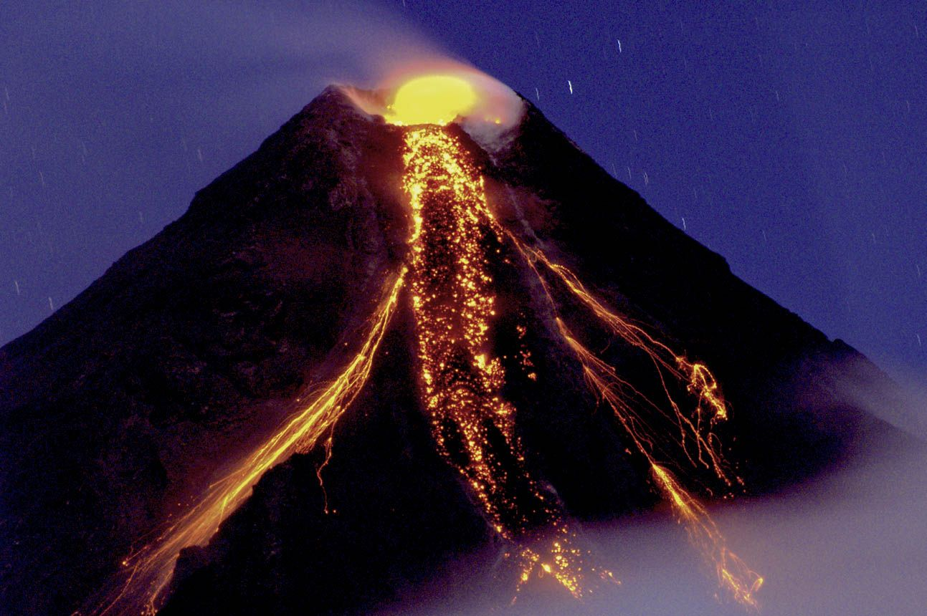
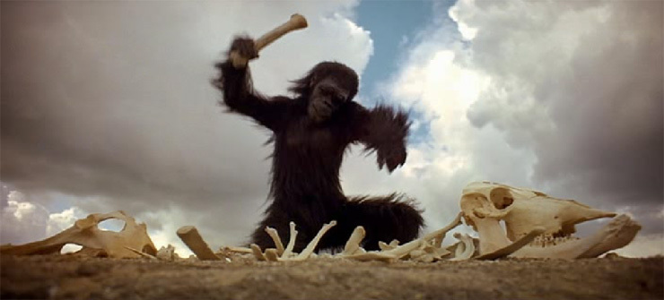
Earth’s climate: an open nonlinear system
Gravitational friction
Solar
forcing
Plate tectonics
Infrared
emission
Radioactive decay
+ condensation in the core

Slide 3
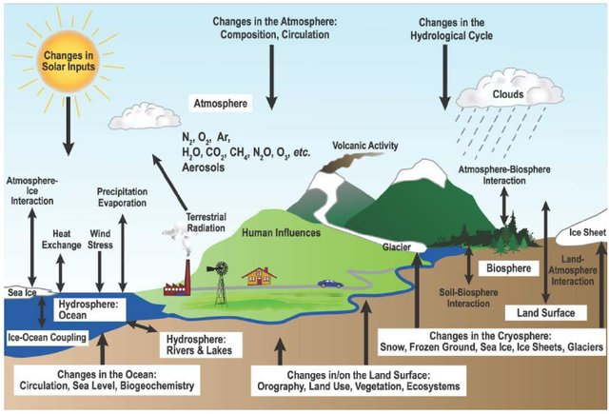
Climate: the inner workings

Slide 4
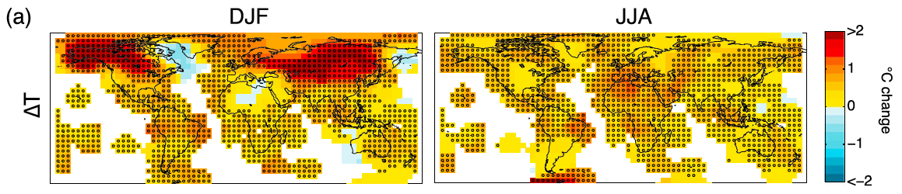
Temperature rise in the last century
In the last 150 years, a global uncontrolled climate experiment, with uncertain outcome
Keeling curve,
from Broecker 2017
Turco et al.
GRL 2015

Slide 5
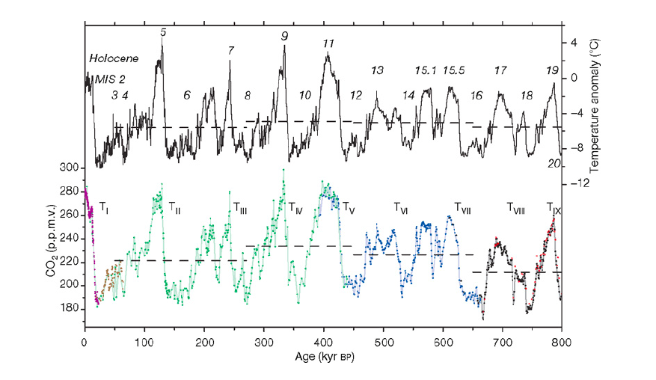
Earth’s climate varies on all time scales
Luthi et al., Nature 2008

Slide 6
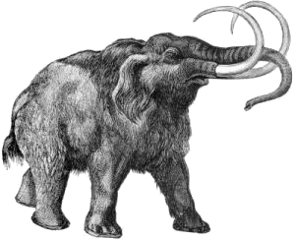
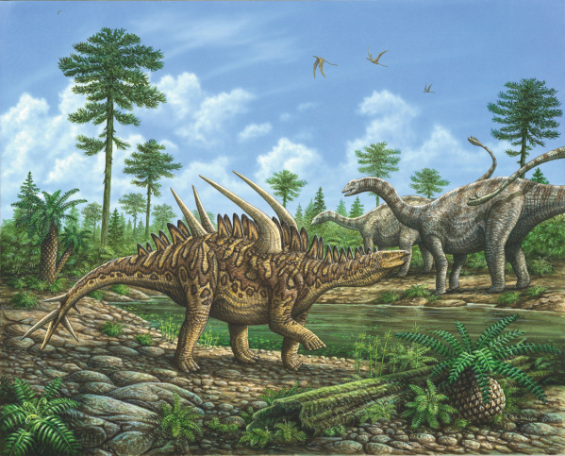
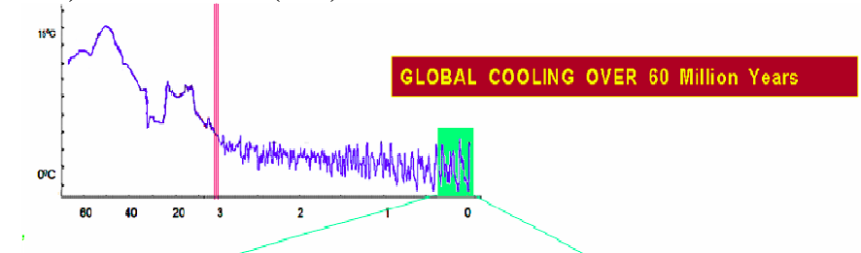
Earth’s climate varies on all time scales

Slide 7
Longer term and
abrupt events: the PETM

Slide 8
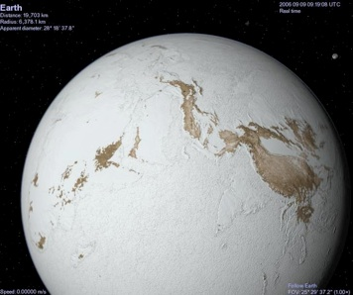
Extreme changes in the far past
Snowball Earth

Slide 9
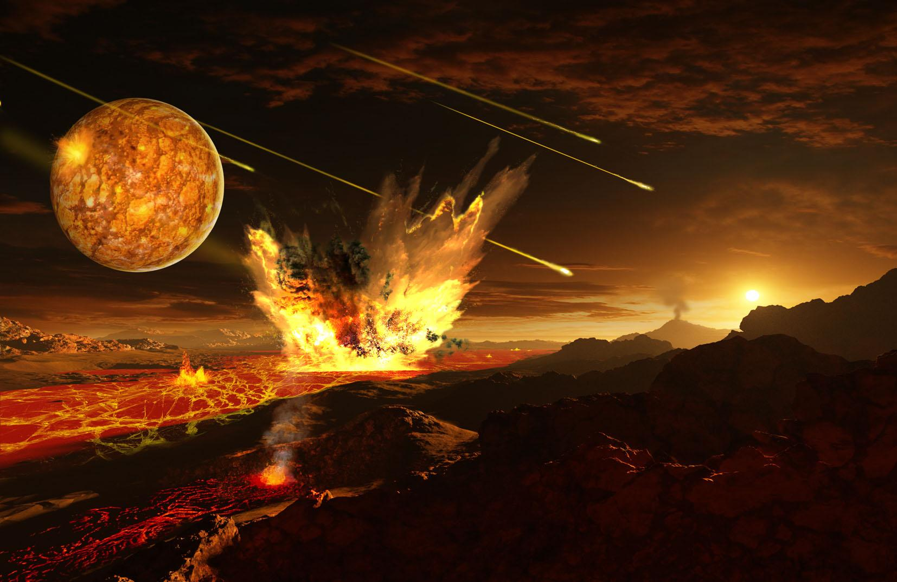
Back to Hadean…
a story longer than 4 billion years

Slide 10
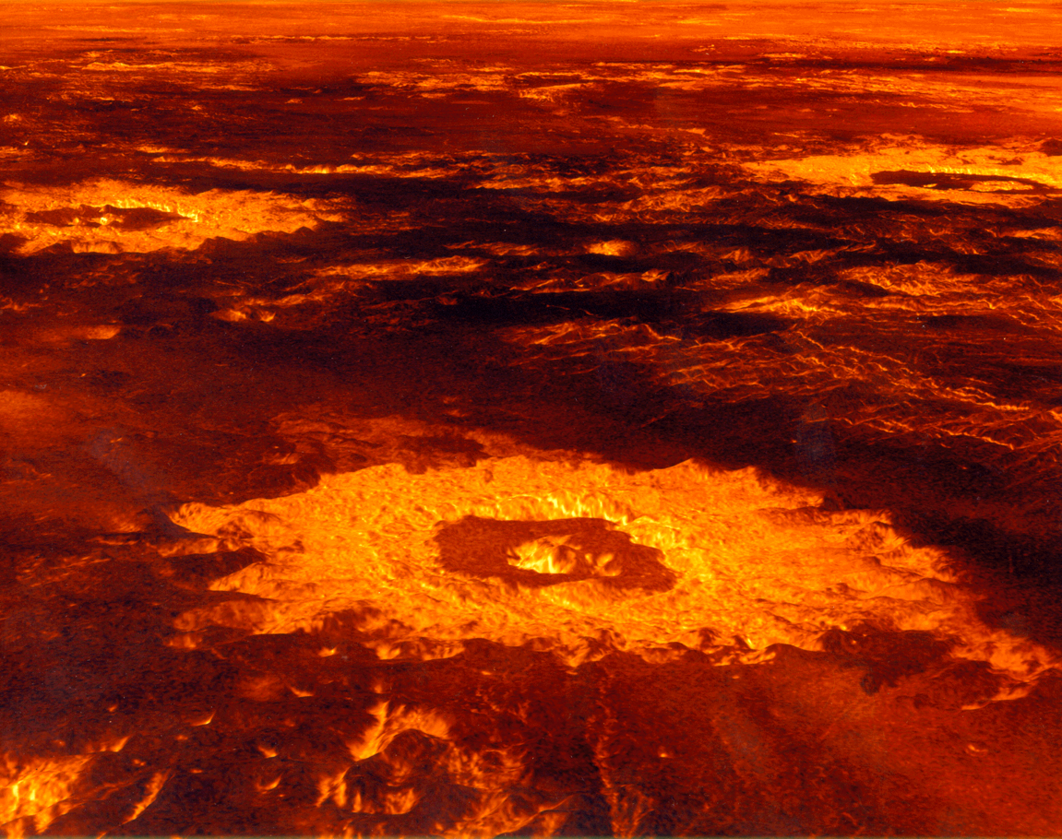
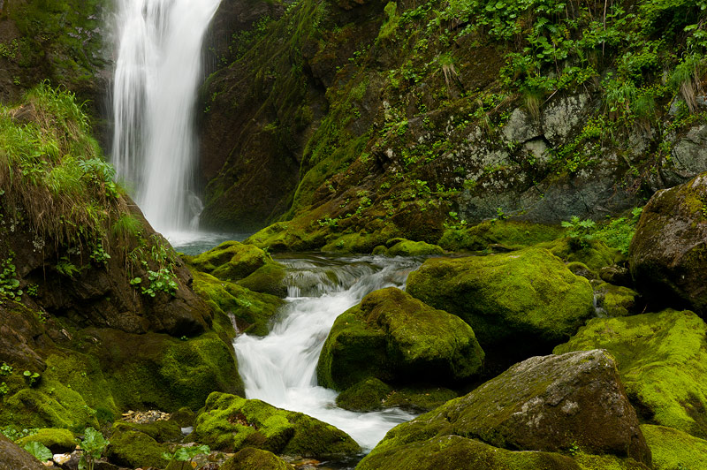
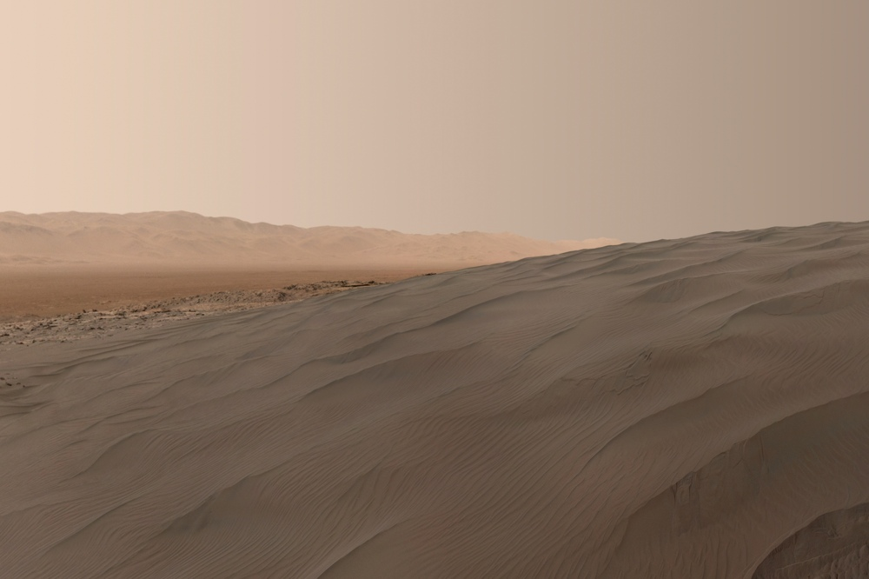
The climate of Sol 3 has been remarkably stable

Slide 11
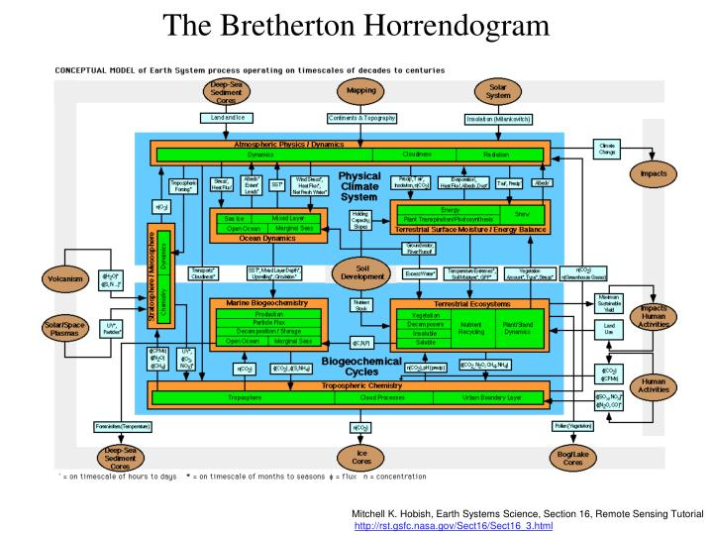
How do we represent
the overwhelming complexity of climate?

Slide 12
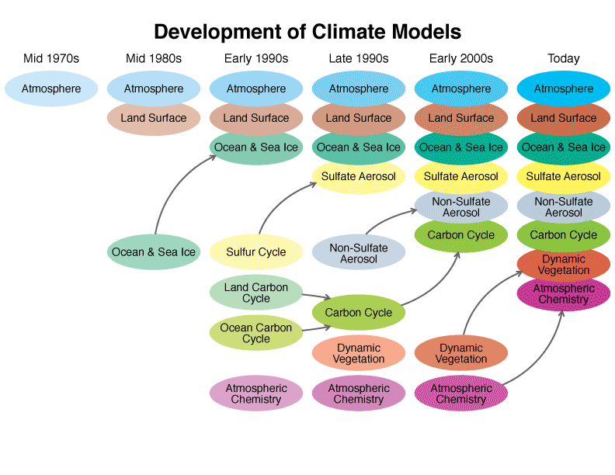

Slide 13

https://archaeogaming.com/2018/06/21/deep-thought-on-v-1-onsen-iv/2017-06-11-deep-thought/
Gimme a bigger computer
and I’ll solve the climate problem

Slide 14

The climate model hierarchy
Global Climate Models
Regional Climate Models
Complexity and «realism»
Intermediate Complexity Earth System Models
«Understanding»
Process models:
Energy Balance Models
Radiative-convective models

Slide 15
Reductionism I: the “spheres”
Atmosphere
Pedosphere
Lithosphere
Anthroposphere
Biosphere
Hydrosphere
Cryosphere

Slide 16
Reductionism II: biogeochemical cycles
Nitrogen
Sulfur
Carbon
Water cycle
Metals
Phosphorus

Slide 17
Reductionism III: process decomposition
Ice - Albedo
Temperature – Atmospheric water vapor
VOC - Aerosols - Clouds
CO₂ – Ocean Acidity
ENSO
Vegetation - precipitation
Temperature - clouds - Albedo

Slide 18
Solar input and infrared emission
Larger solar input
Higher temperature
Stabilized
temperature
Larger infrared emission

Slide 19
A stabilizing mechanism:
volcanic emissions and rock weathering
Larger volcanic CO₂ emissions
Higher temperature
Stabilized
temperature
Faster rock
weathering
Reduction of atmospheric CO₂

Slide 20
A well-known positive feedback:
ice-albedo
Higher surface
temperature
Less ice/snow
More
absorbed heat
Lower albedo

Slide 21
A complicated case:
Cloud – temperature feedback
Greenhouse
effect
Albedo

Slide 22
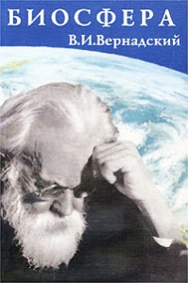
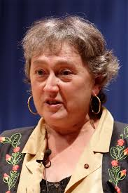

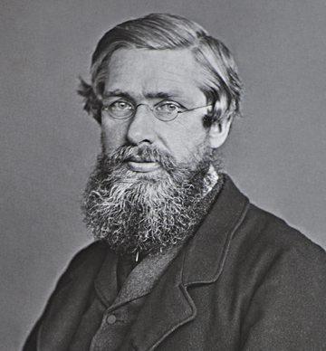
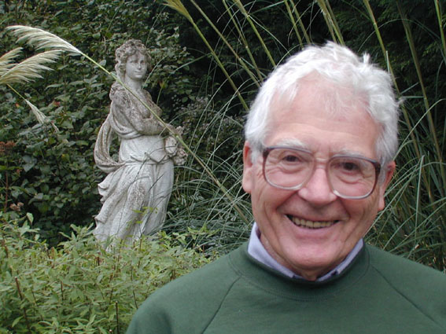
Climate
“One Grand Organic Whole”
(A.R. Wallace)
Biosphere

Slide 23
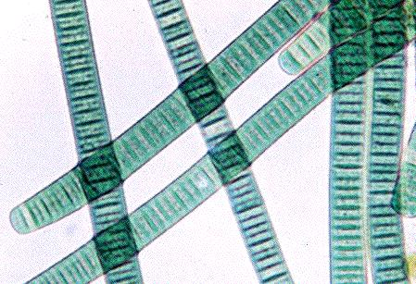
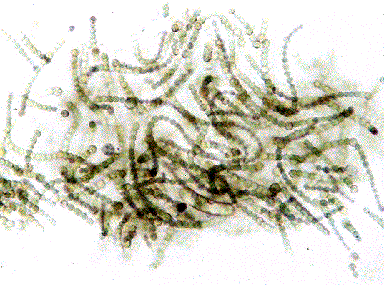

The Great Oxydation Event
Oxygen production from Cyanobacteria
http://www.ucmp.berkeley.edu/bacteria/nostoc.gif
“Great Oxygenation Event” about 2,4 Ga
Huronian Glaciation,
an example of Snowball Earth?
ga.water.usgs.gov

Slide 24

Oxygen leads to a large variety of minerals
which in turn provide habitats and support
to new forms of life:
coevolution of geosphere and biosphere
Oxygen-rich waters circulate in the upper crust and favor chemical reactions
that lead to new minerals
ga.water.usgs.gov

Slide 25
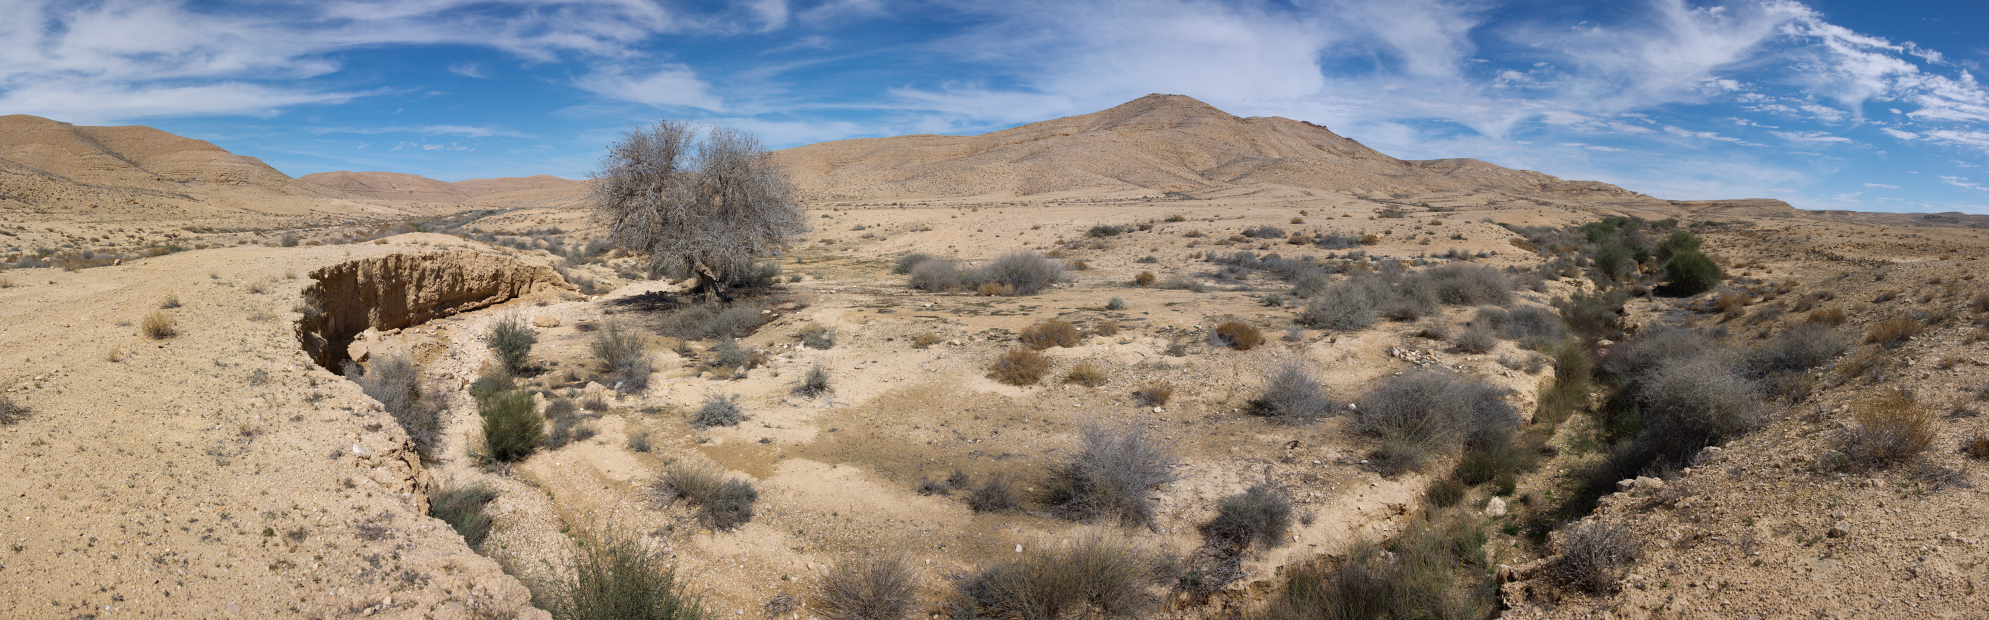
Feedbacks of vegetation on climate
Albedo: usually, vegetation is darker than bare soil
Vegetation reduces CO₂ from the atmosphere
Evapotranspiration from vegetation is stronger than pure evaporation from bare soil

Slide 26
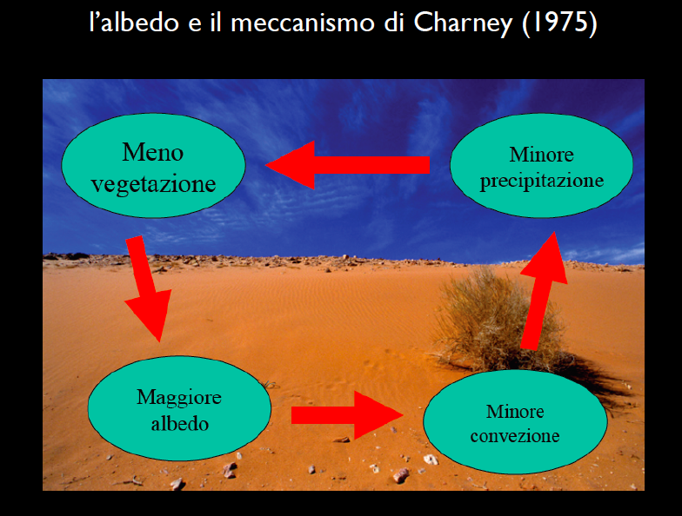
Vegetation - climate interaction
Albedo and the Charney mechanism (1975)
Lower convection and precipitation
Less vegetation
Higher albedo
Lower soil temperature

Slide 27
A classic example: the Charney mechanism (1975):
Vegetation dynamics:
a logistic equation
for the fraction of soil
covered by vegetation, V
First principle
of Thermodynamics

Slide 28
A classic example: the Charney mechanism (1975):
T
V
0
1

Slide 29
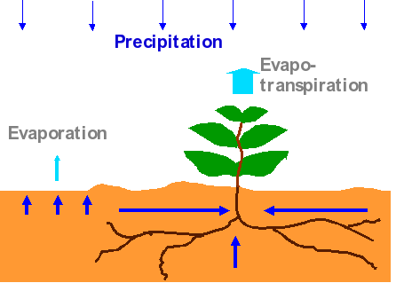
A conceptual model approach:
interaction between vegetation and climate
Plant transpiration and the hydrological cycle
Lower precipitation
Less vegetation
Lower transpiration
Lower convection

Slide 30
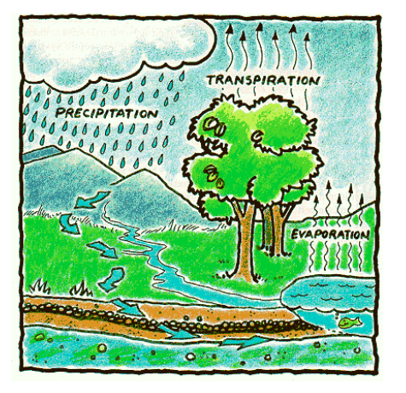
Continental water cycle: Long-range transport vs “local” recycling

Slide 31
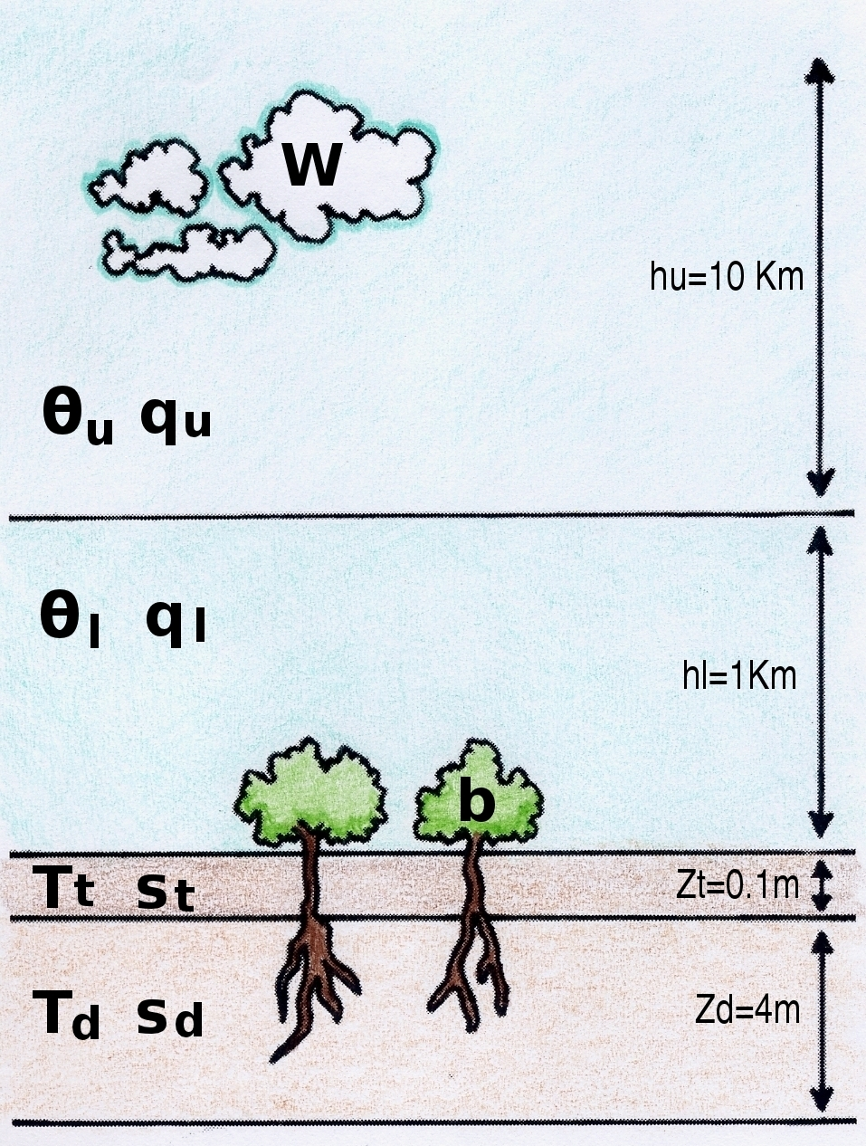
A box model with four layers
Elisa Lovecchio
F. Cresto Aleina, M. Baudena, F. D’Andrea, AP, Tellus B 2013
Elisa Lovecchio, Laurea Thesis, 2013, Sara Lenzi, Laurea Thesis, 2016

Slide 32
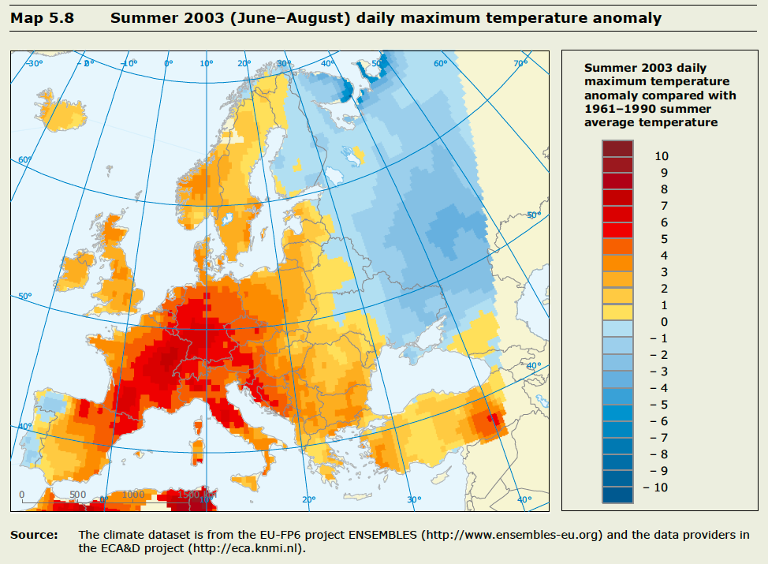
Summer heat waves
at continental midlatitudes
Causes include:
  prevailing anticyclonic conditions
  dry soil moisture anomaly

Slide 33
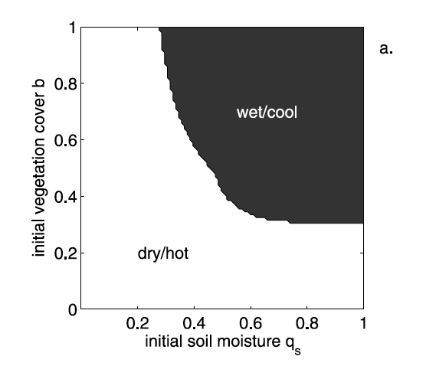
Multiple equilibria of the soil-atmosphere system
D’Andrea et al GRL 2006, Baudena et al WRR 2009

Slide 34
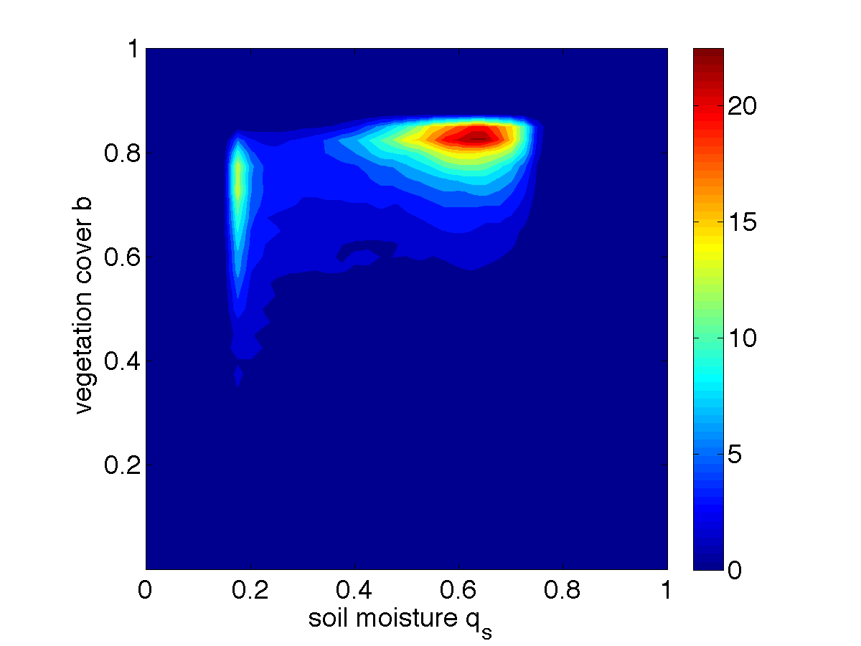
Effects of stochastic variability in moisture flux
D’Andrea et al GRL 2006, Baudena et al WRR 2009

Slide 35
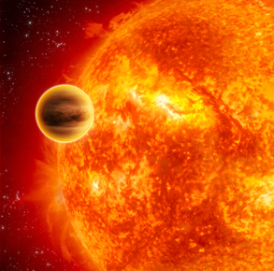
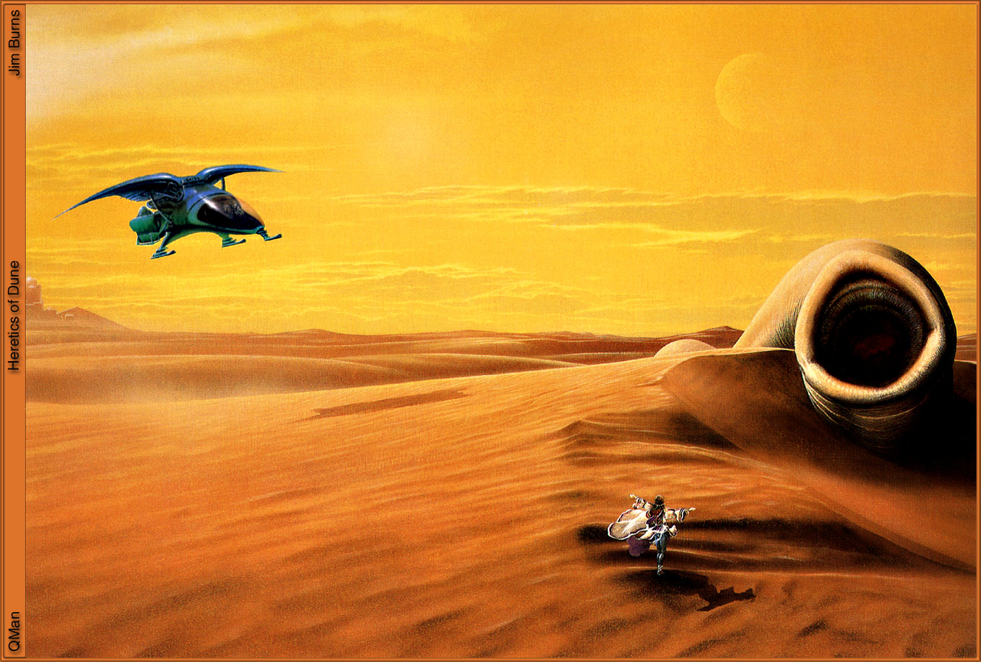
Climate of desert-like worlds:
role of albedo, evapotranspiration
and carbon feedbacks
Cresto Aleina et al, Tellus B 2013, Lenzi et al, in preparation 2019

Slide 36
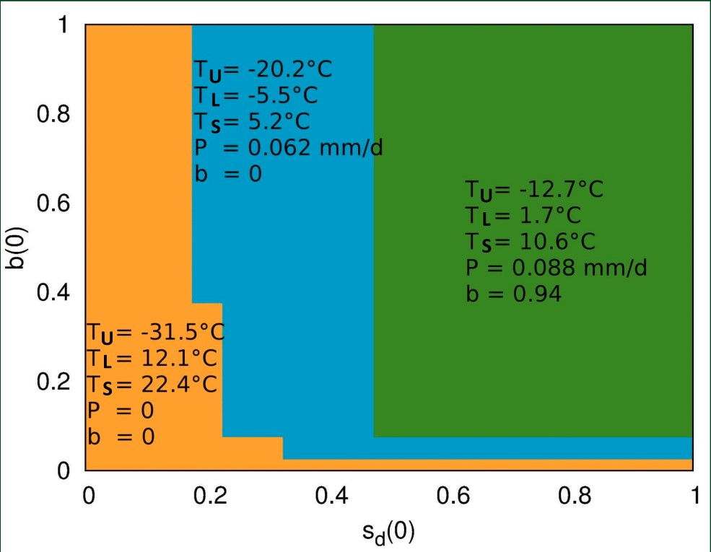
Multiple equilibria of the climate-vegetation system
(albedo and evapotranspiration feedback)
Vegetation albedo increases soil and PBL temperature with respect to bare soil
Vegetation transpiration cools soil and PBL temperature with respect to bare soil
The transpiration feedback is dominant
F. Cresto Aleina, M. Baudena, F. D’Andrea, AP, Tellus B 2013
Elisa Lovecchio, Laurea Thesis, 2013

Slide 37
Conceptual biogeochemistry:
The fast carbon cycle
Williamson, Lenton, Shepherd, Edwards (2OO6)

Slide 38
Plants and atmospheric CO₂:
a complex (potentially stabilizing) feedback
Less vegetation
Potentially weaker hydrological cycle
More vegetation
Lower atmospheric CO₂
Cooler soil
Cooler and drier atmosphere

Slide 39
Questions:
Do multiple equilibria disappear when
the carbon cycle is included?
How does vegetation affect
surface temperature?

Slide 40
Full model, fixed atmospheric relative humidity
350 W/m²
Lenzi and Provenzale, preliminary results, 2019

Slide 41
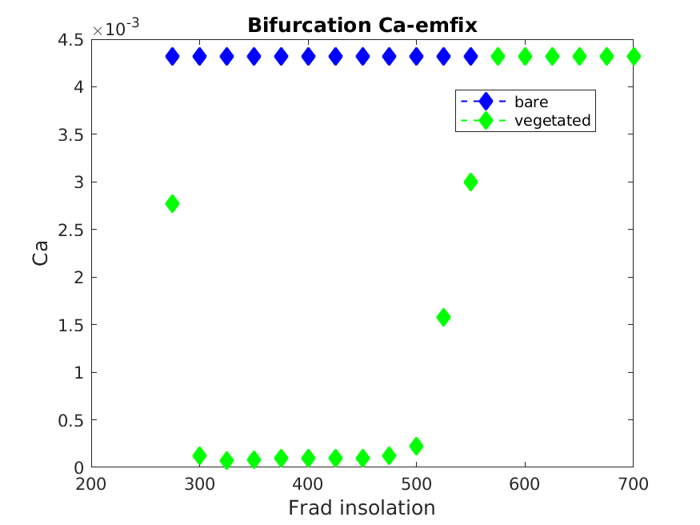
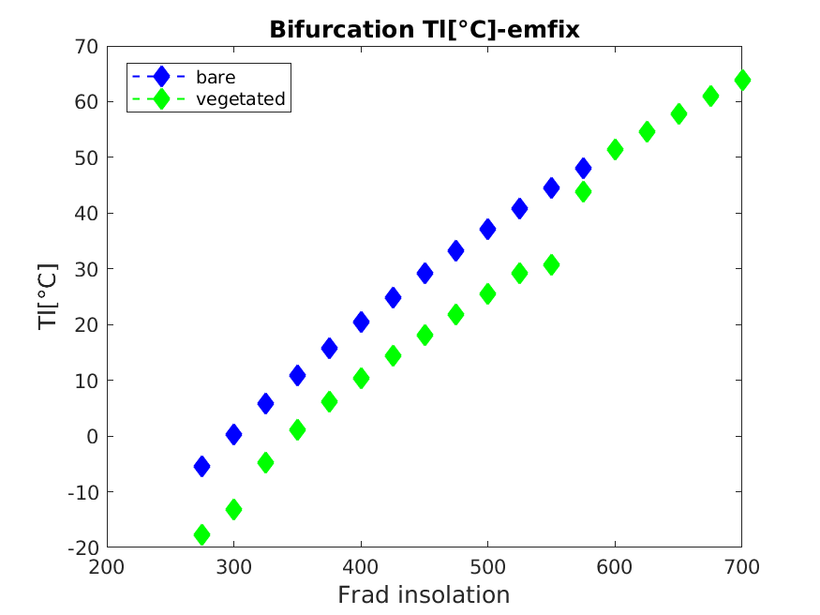
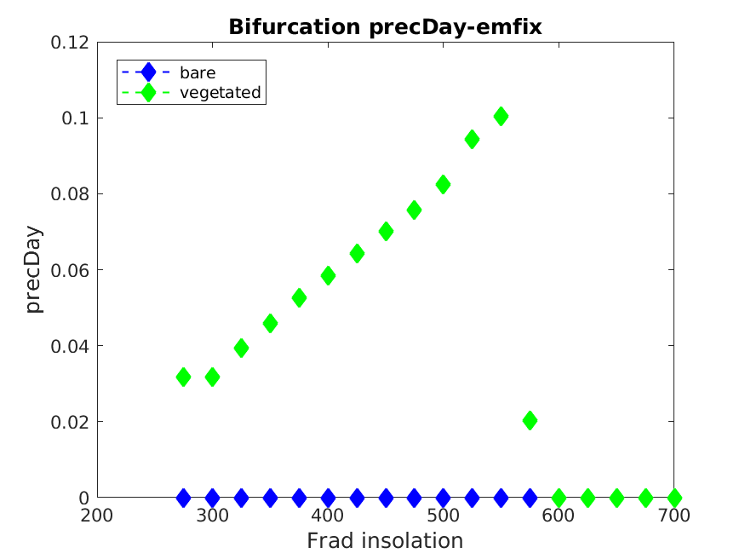
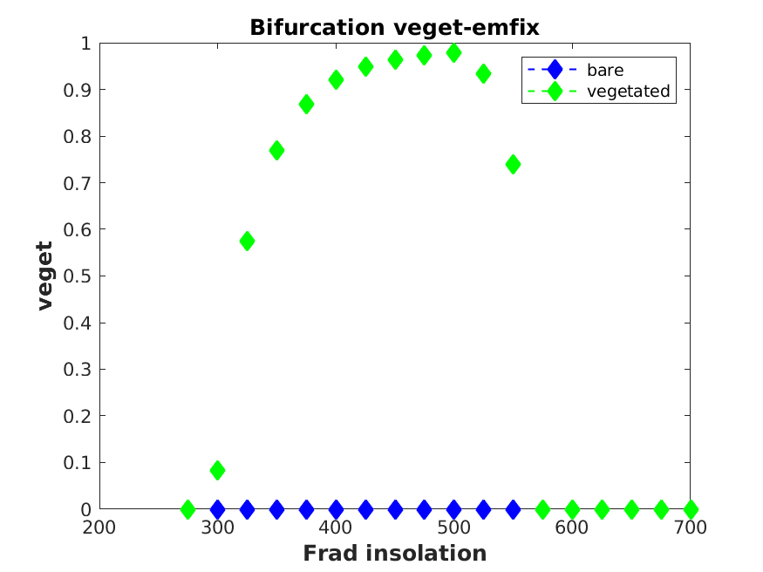
What happens at varying stellar flux

Slide 42


One-dimensional Energy Balance Models
Zonal averages
Diffusive meridional transport
Vladilo et al, ApJ 2013, ApJ 2015,
Silva et al, Int. J. Astrobiology 2016, MNRAS 2017

Slide 43
ESTM:
Earth-like planet Surface Temperature Model

Slide 44
ESTM for Sol 3

Slide 45
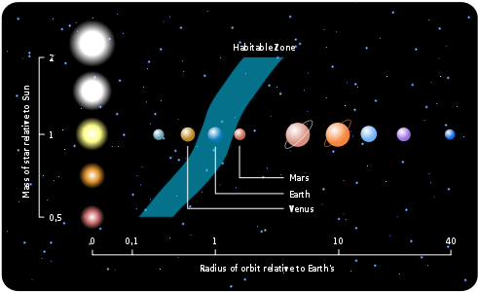
Planetary “habitability”
https://www.e-education.psu.edu/astro801/content/l12_p4.html

Slide 46
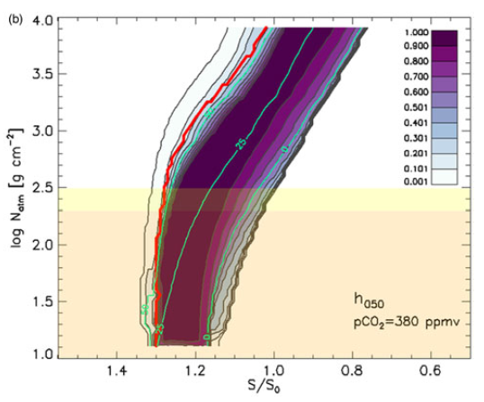
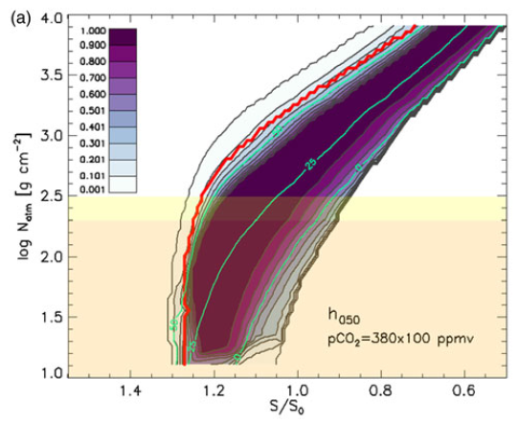
Planetary habitability and complex life
Vladilo et al., ApJ 2015, 2016; Silva et al., Int. J. Astrobiology 2016, MNRAS 2017

Slide 47
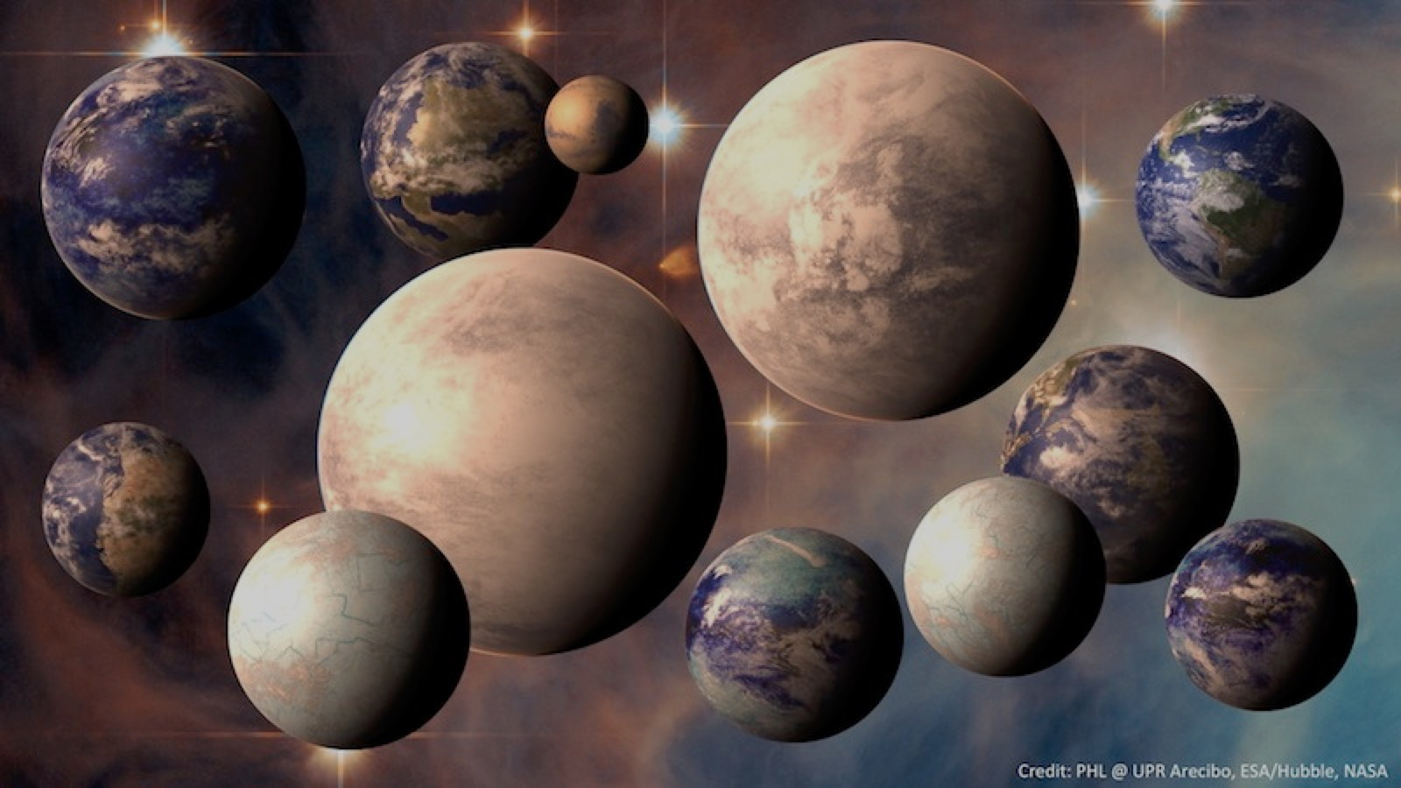
Explore 10⁵ cases
by varying eccentricity, obliquity,
semimajor axis, atmospheric pressure,
CO₂ partial pressure,
for several initial values of temperature
The Bistable Collective:
INAF OATS: Giuseppe Murante, Giovanni Vladilo, Giuliano Taffoni,
Laura Silva, Michele Maris, Elisa Londero, Cristina Knapic, Sonia Zorba
CNR: Elisa Palazzi (ISAC), Antonello Provenzale (IGG)

Slide 48
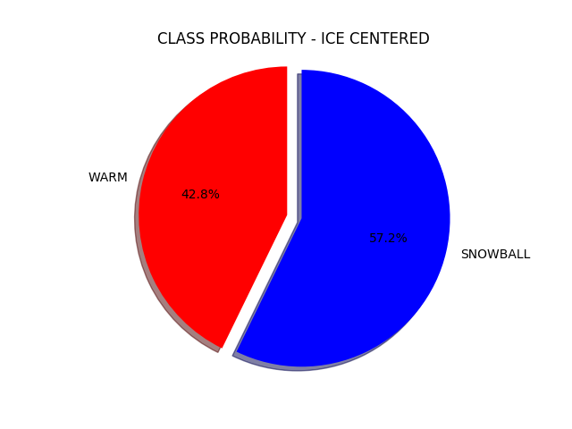
Warm vs Snowball cases
Overall distribution (4 params)

Slide 49
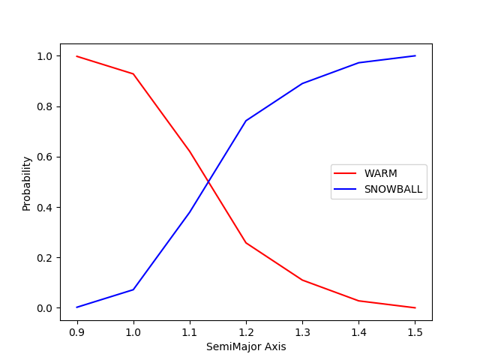
Warm vs Snowball cases
Overall distribution (semimajor axis)

Slide 50
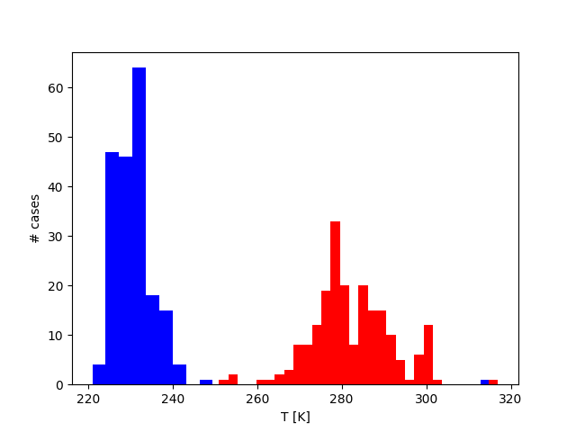
Warm vs Snowball cases
Only bistable cases (4 params)

Slide 51
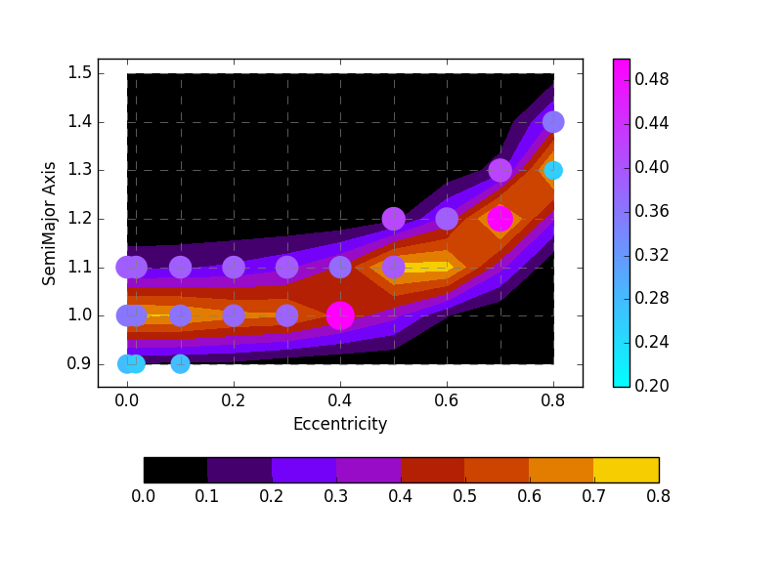
Only bistable cases
Probability of snowball
Habitability index

Slide 52
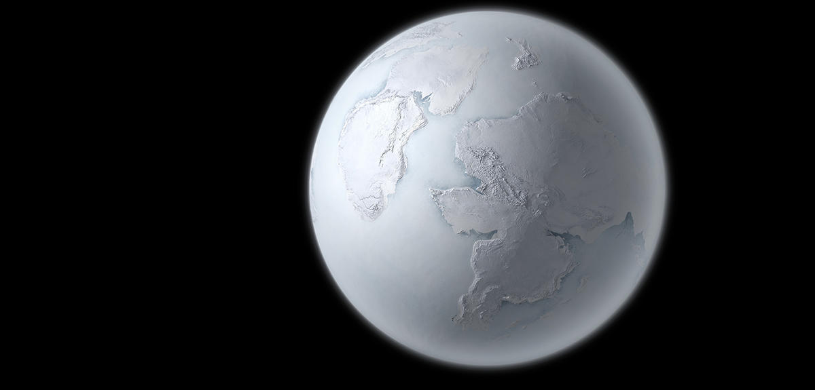
Perspectives
Bistability occurs in a limited
but “habitability relevant” parameter range
Most important control parameters are
SMA, pressure and eccentricity
Effects on habitability (metazoans)?
Effects on habitability search?

Slide 53
What one can do with simple climate models
(eg, 1D EBM + column)
Explore specific processes
Planetary habitability
Long (and ancient) paleo simulations
Explore exotic situations
Learn a lot

Slide 54
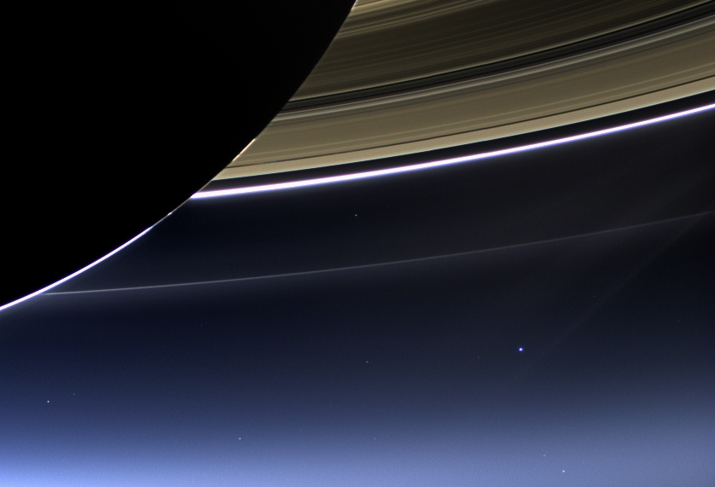
Cassini, NASA/JPL
Caltech/Space Science Institute
Thank you for your attention

