Slide 1


Observatory of Complex Systems
http://ocs.unipa.it
A percolation approach for the detection of bottlenecks in air traffic networks
S. Miccichè
salvatore.micciche@unipa.it
Università degli Studi di Palermo
Dipartimento di Fisica e Chimica
Mathematical Models and Methods in Earth and Space Sciences
Tor Vergata, 21 March 2019

Slide 2







Preface
work done in collaboration with:
Giuseppe Pappalardo and Rosario N. Mantegna
within the research project:
ADAPT - Advanced prediction models
for flexible trajectory-based operations
http://adapt-h2020.eu
PARTNERS:
SPONSORS:
Investigating a relevant socio-technical complex system with tools and methodologies of Statistical Physics, Network Science and Complex Systems.

Slide 3
How the system works
STRATEGIC PHASE: planning of the trajectories
Accommodate as many as possible aircraft in a certain airspace, given the sectors capacity constraints
TACTICAL PHASE: managing the trajectories
Maintain the planned number of trajectories in each sector and avoid that they crash into each other;
Take into account congestions due to ground delays;
Take into account changes due to extreme weather events or STRIKES;
Take into account airspace closures due to existing military areas.
Sector 1
Sector 2
Sector 5
Sector 4
Origin O
Destination D
Sector 3

Slide 4
The scientific question
Task 5.1.1:
Empirical investigation of aircraft trajectories
MAIN OBJECTIVE 1: metrics for hotspots
We will help other WPs by providing metrics and methodologies for a statistically sound assessment of the bottlenecks/congestion present in the airspace.
Data will be fundamental.

Slide 5

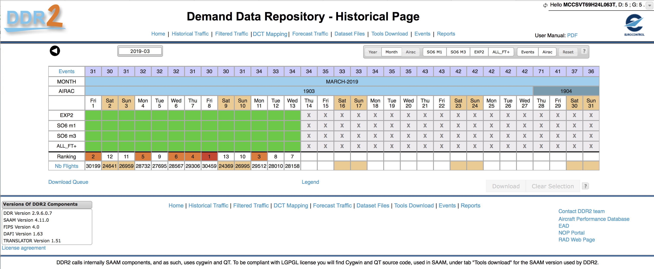
Where data come from?
Data are provided by Eurocontrol that is the European agency that coordinates the activities of all European national agencies involved in the Air Traffic Management
EUROCONTROL is an intergovernmental organisation with 41 Member and 2 Comprehensive Agreement States. EUROCONTROL is committed to building, together with itspartners, a Single European Sky that will deliver the air traffic management (ATM) performance required for the twenty-first century and beyond.

Slide 6
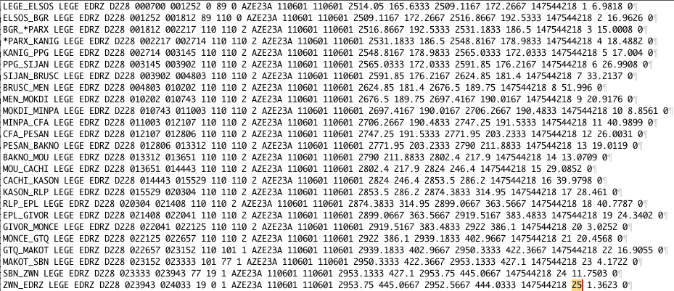
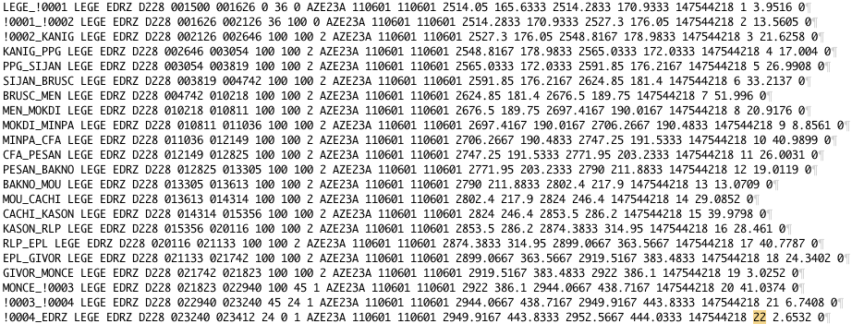
What data do we have?
M1 and M3 files: planned and actual trajectories data
M1
25 segments
M3
22 segments
M1 file
Number of lines: 715753
Size: 88M
01/06/2011 (unzipped)
M3 file
Number of lines: 678006
Size: 83M

Slide 7
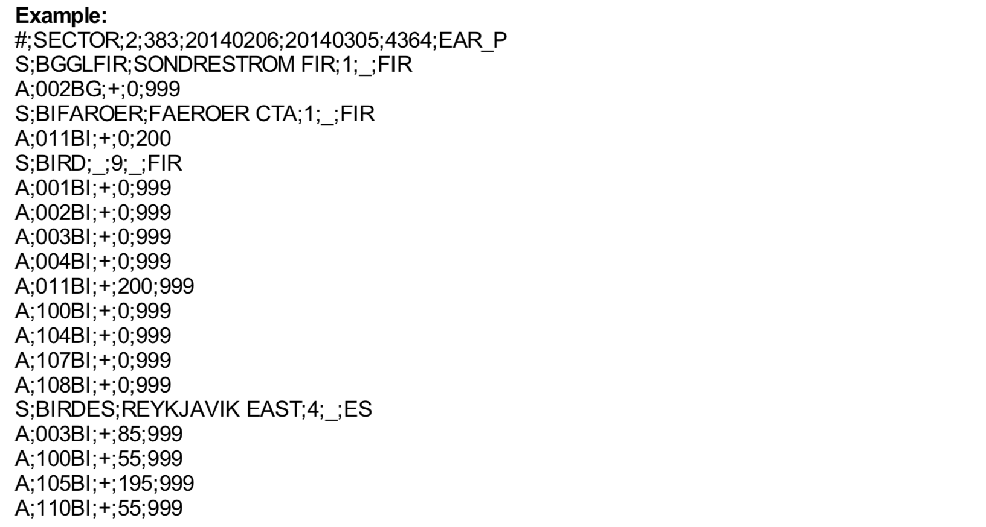
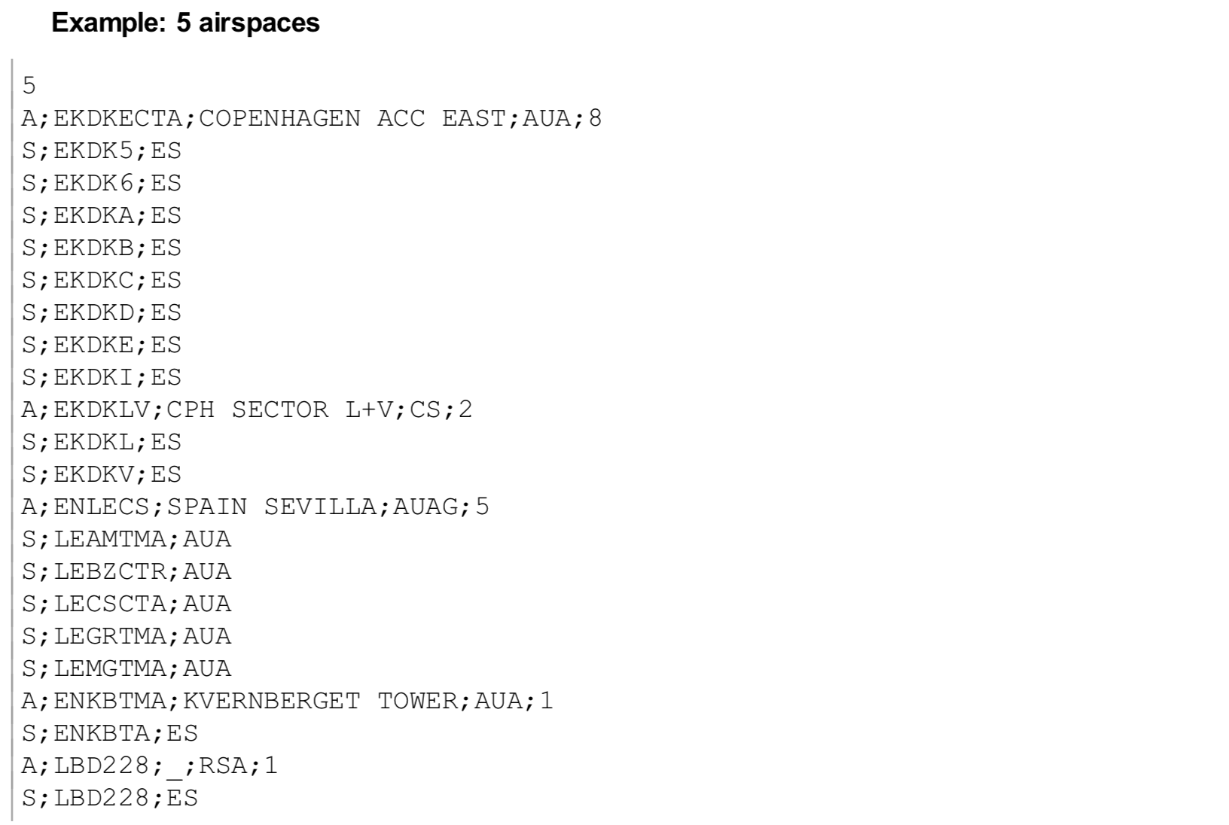
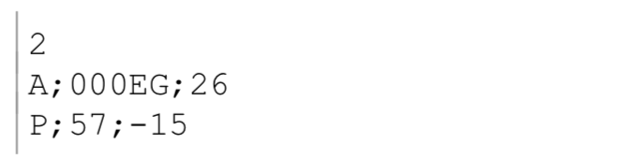
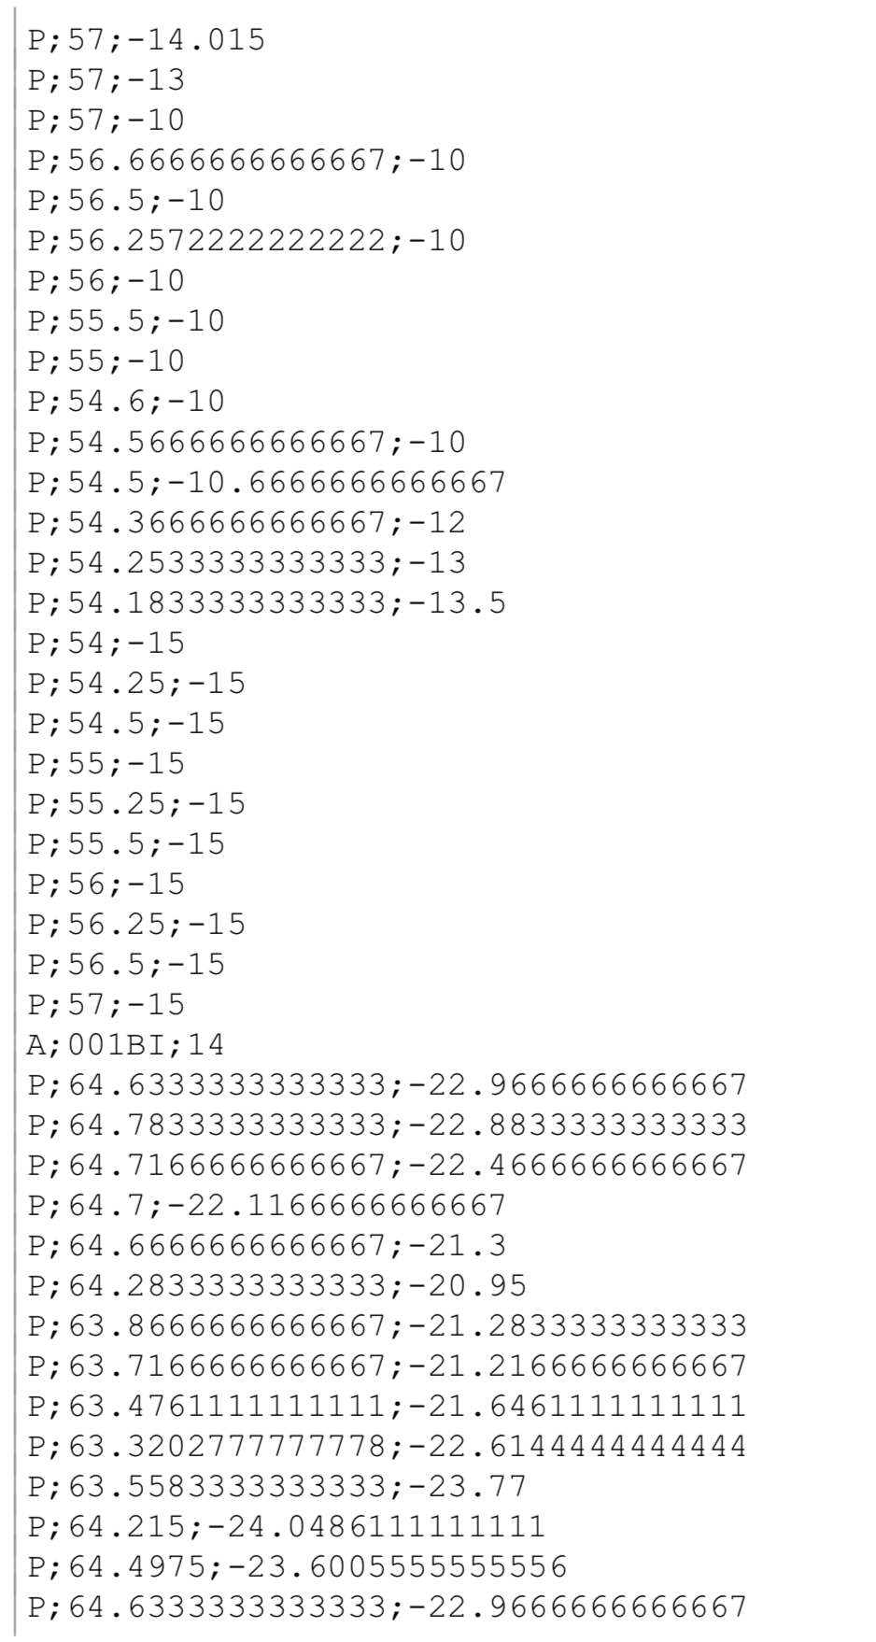
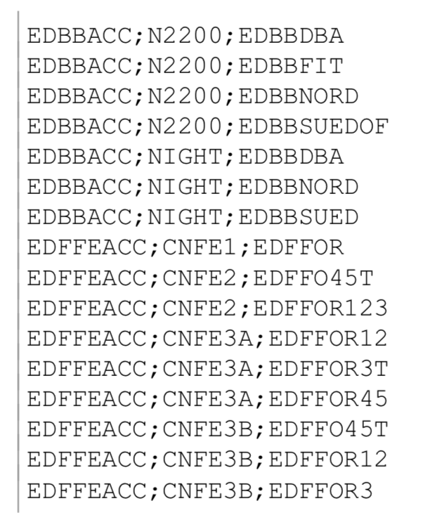
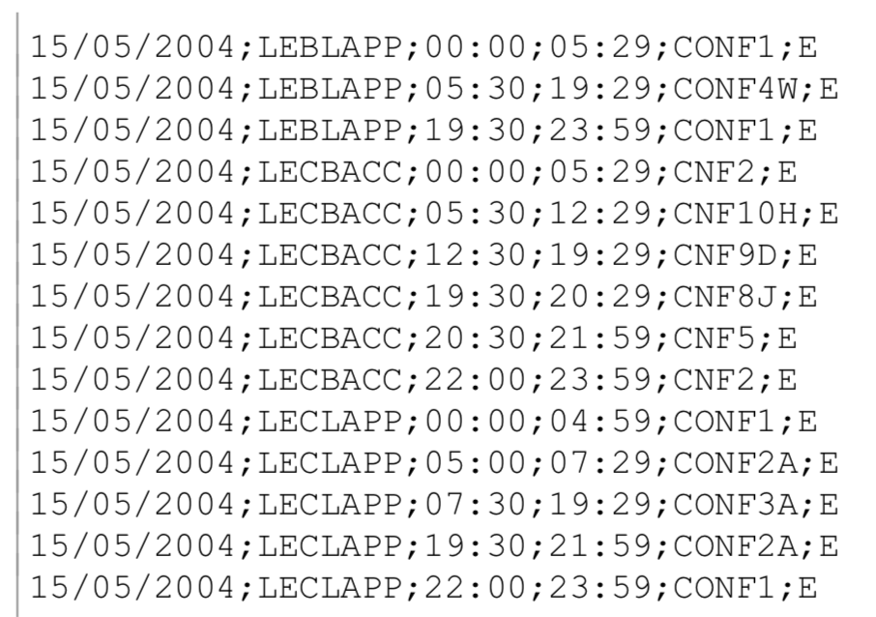
What data do we have?
GSL files: sectors and airblocks
SPC files: collapsed sectors and sectors
GAR files: boundaries
CFG files: configuration
COS files: opening scheme

Slide 8
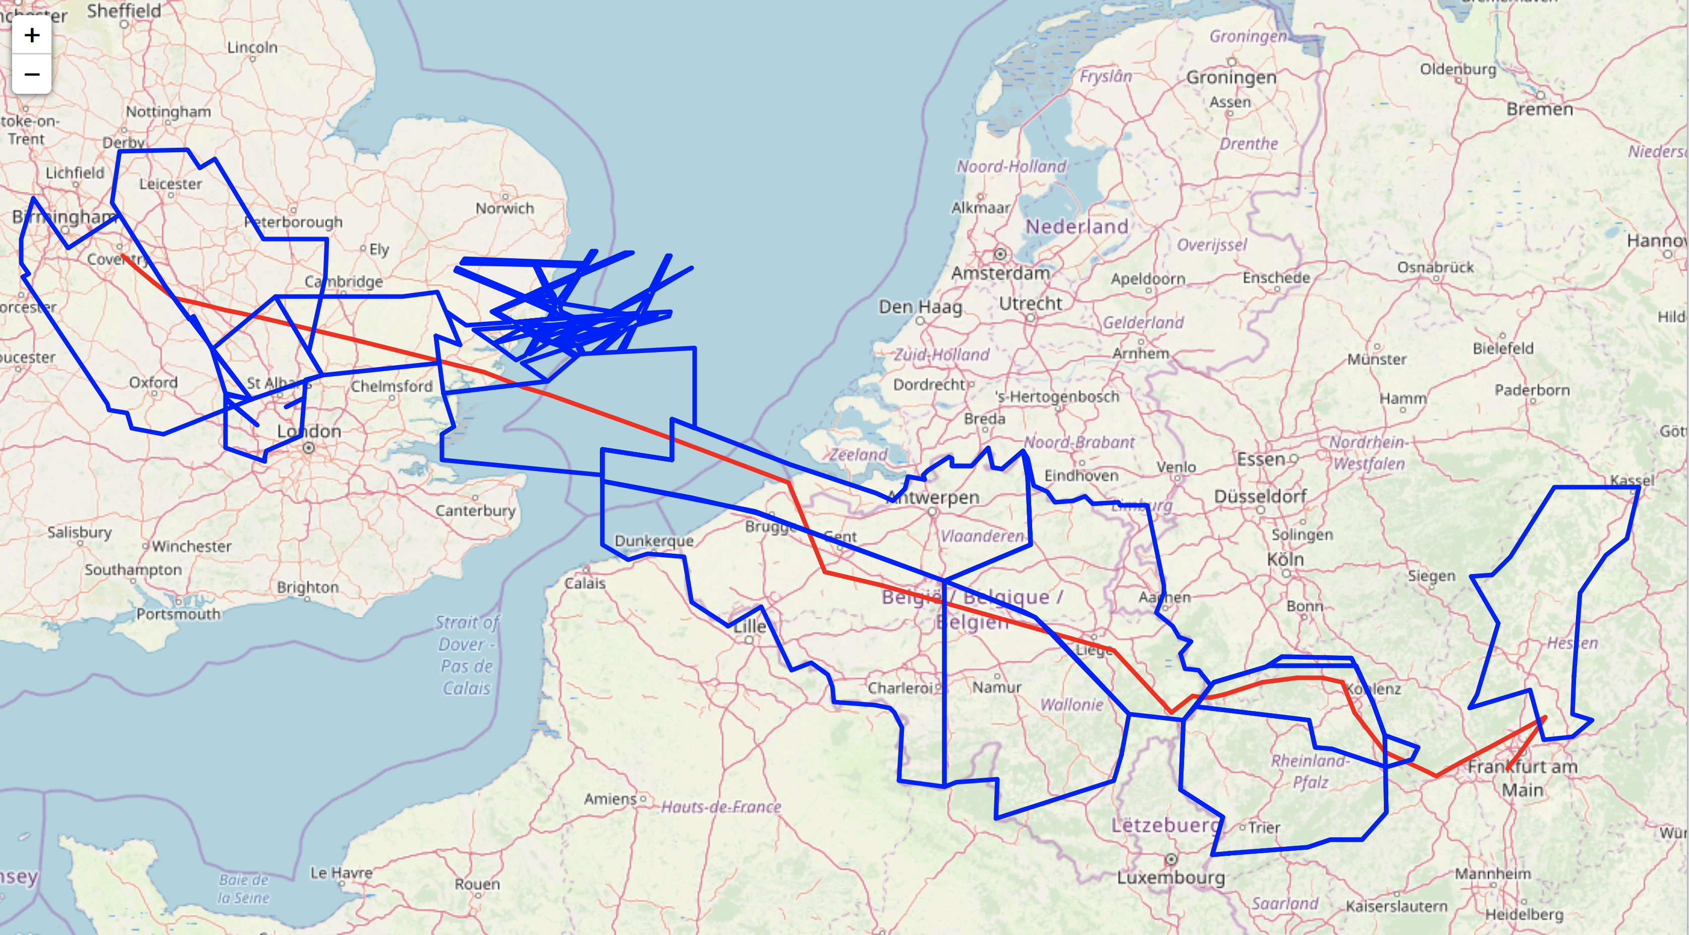
What data do we have?

Slide 9
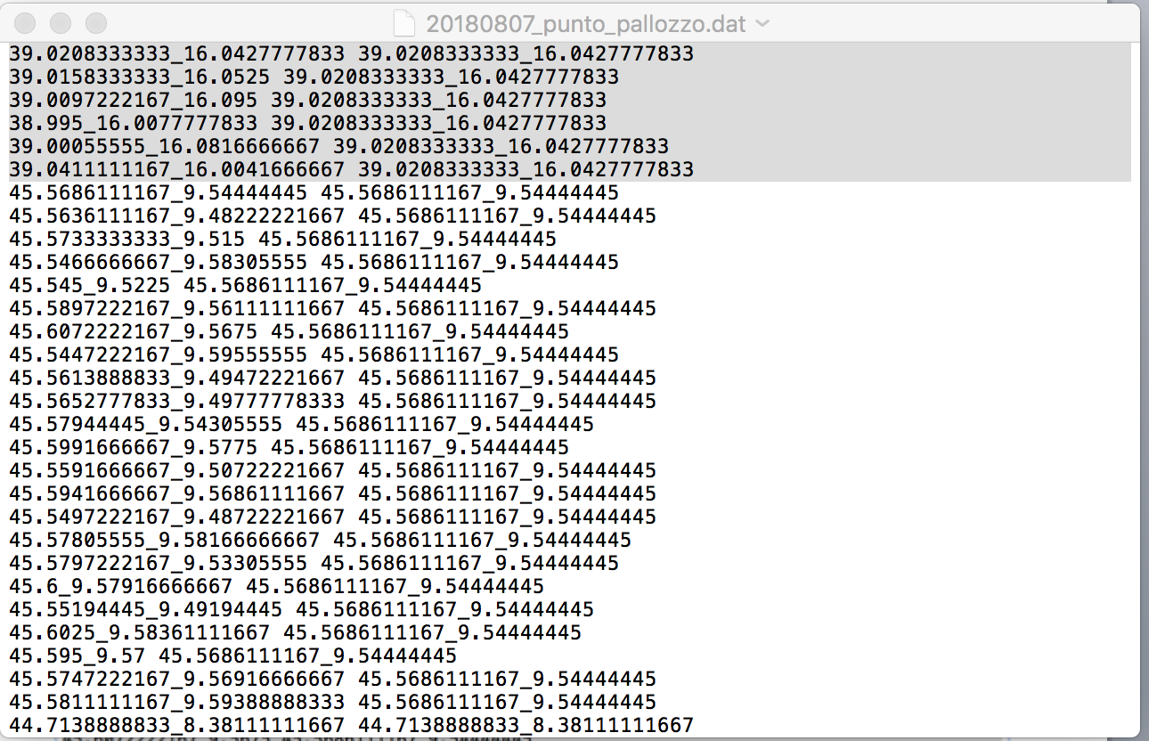
Aggregation
NVPs ➔ agg-NVPs
1709898➔ 210562
AIRAC 309 sett 2014
Aggregate together all NVPs within a 5 km radius.
Exhaustive search – brute force
Computationally demanding
APAPT WP-5

Slide 10
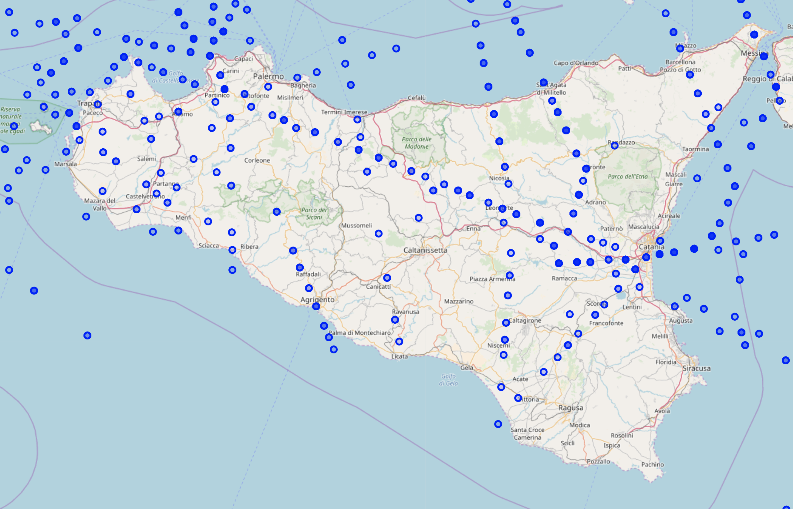
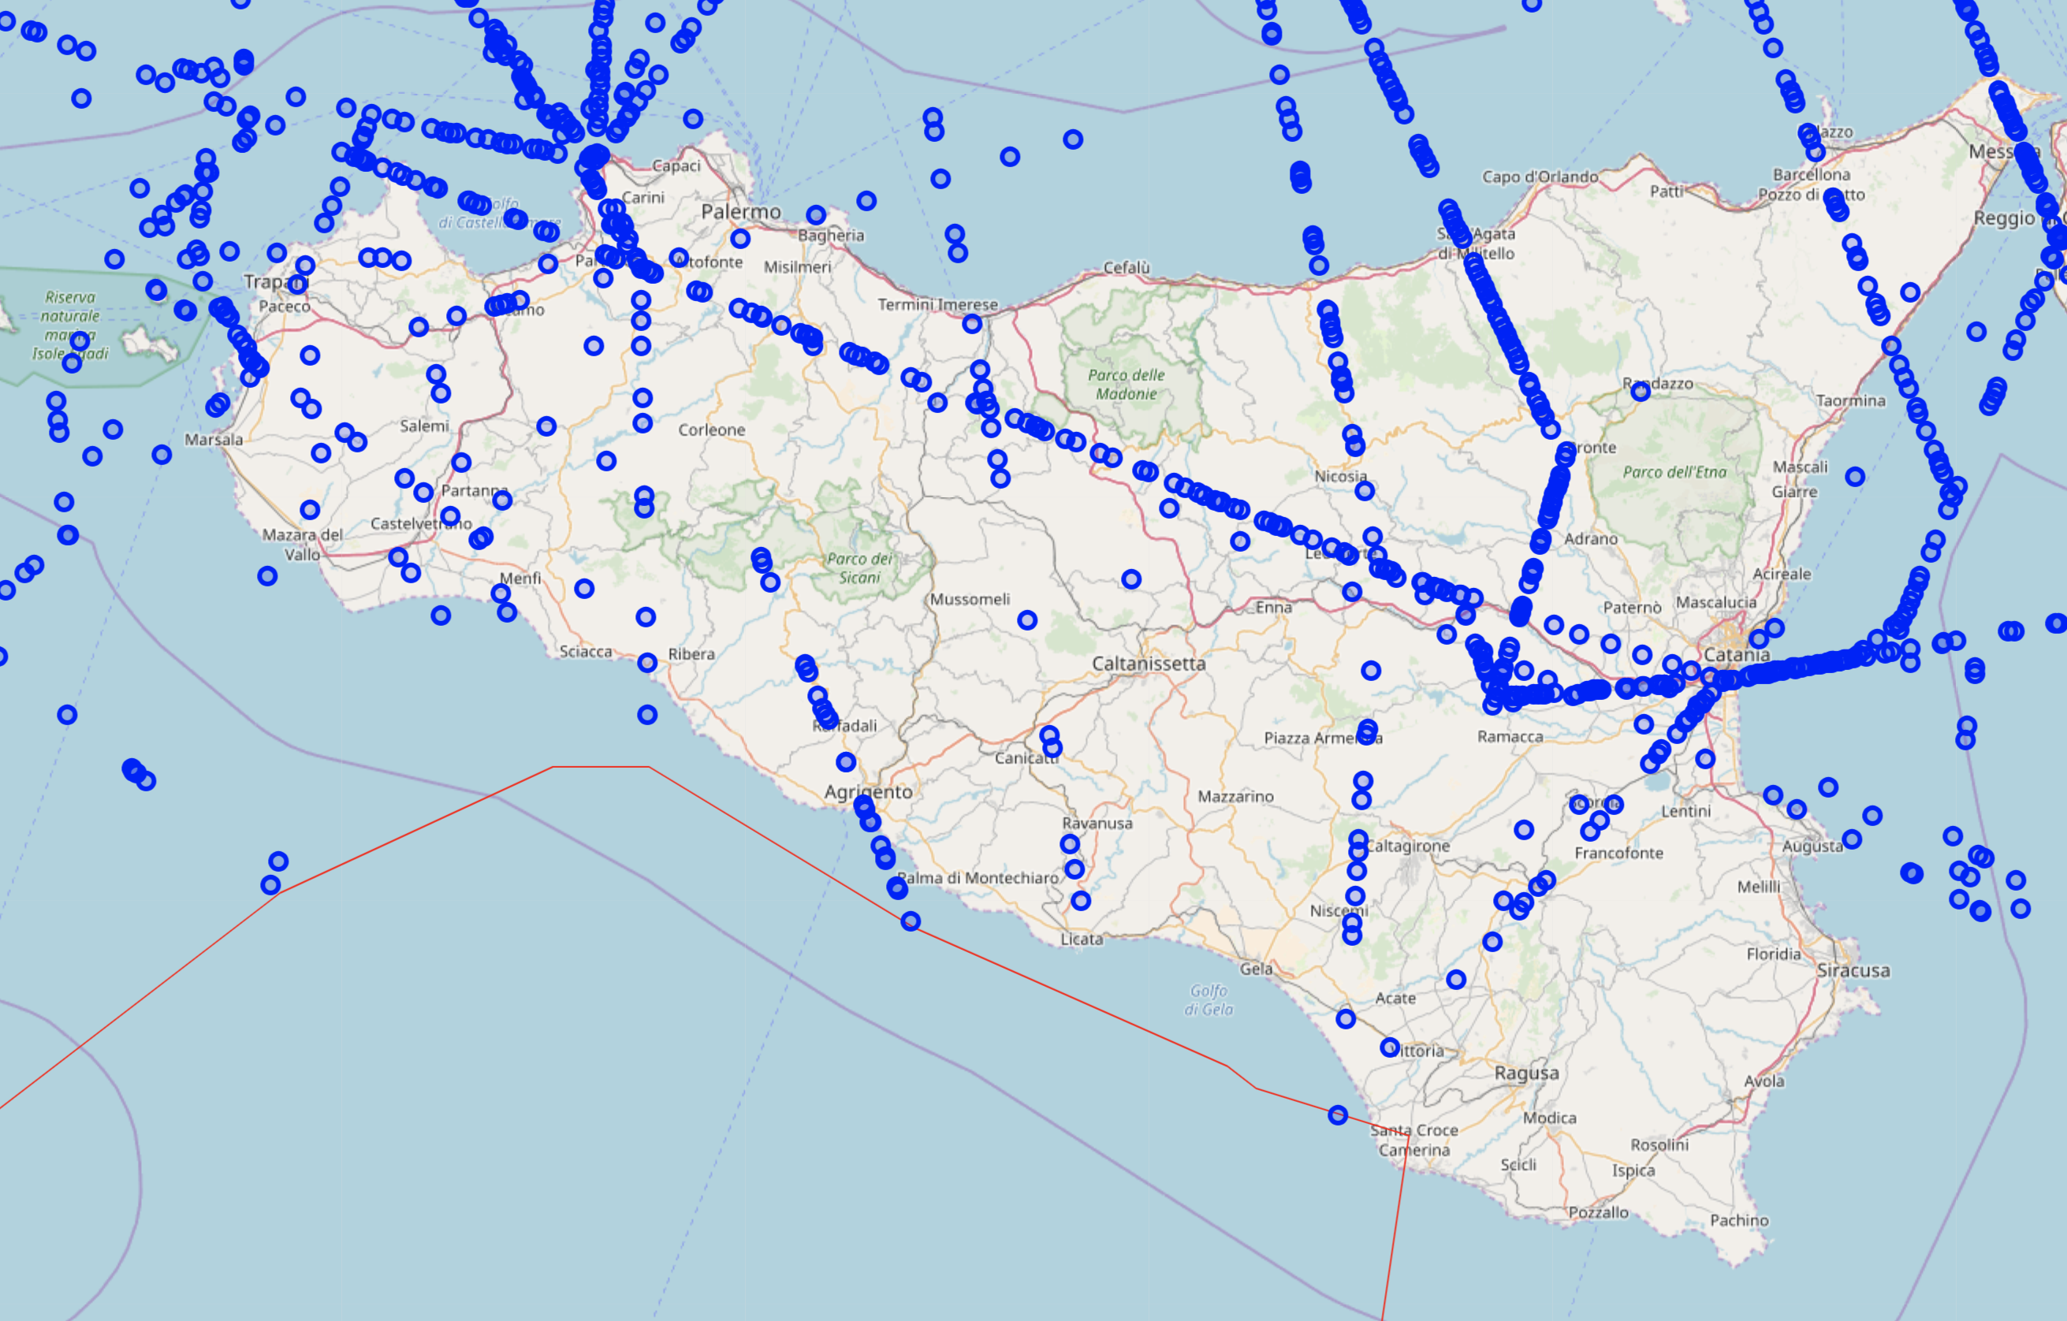
Aggregation
Agg-NVPs
NVPs
APAPT WP-5

Slide 11
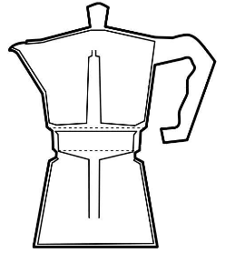
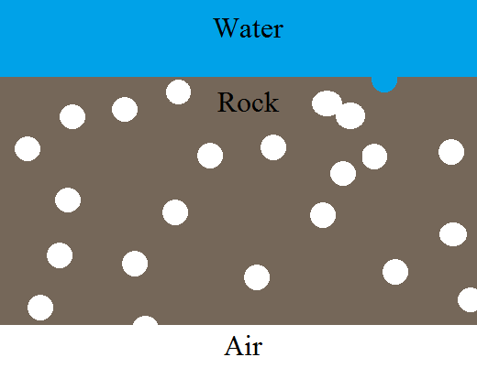
Percolation
Percolation is the phenomenon by which a flow (of water) goes through a porous medium.
Formally: let us consider a rock which has many small cavities. Let us randomly place spherical cavities of radius r in a medium, allowing them to overlap. At what volume fraction of cavities is water able to travel arbitrarily long distances through the medium?
such fraction is called
order parameter
r=V_{cavity}/V_{medium}

Slide 12
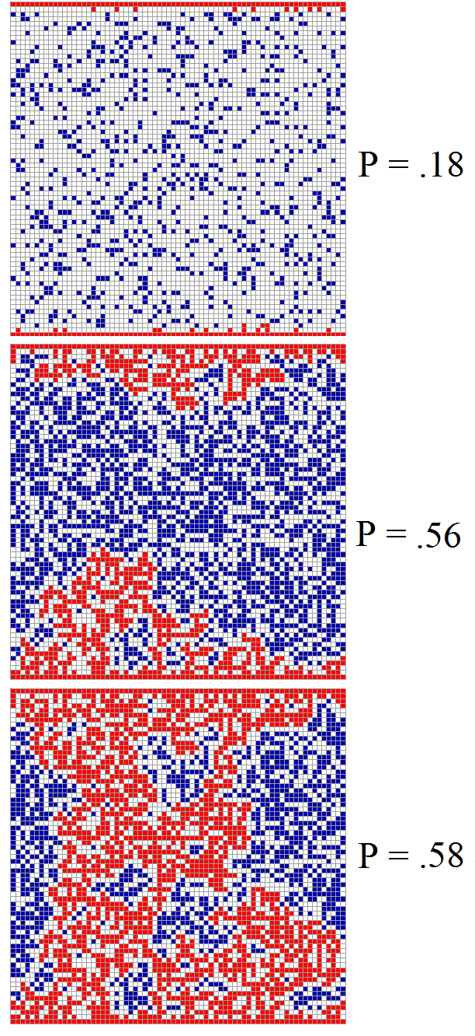
Percolation
In our previous example we considered cavities distributed arbitrarily through space. It was an example of what is called continuum percolation.
Most of the percolation theory written down so far deals with percolation on lattices. For instance, consider a square grid. The chance that a given square is a “cavity” is a fixed probability, q.
The question is: what is the value of q such that one can go from one side of the lattice to another?
There is a general consensus that the percolation threshold on the square lattice is:
q_{c} = 0.59274605

Slide 13
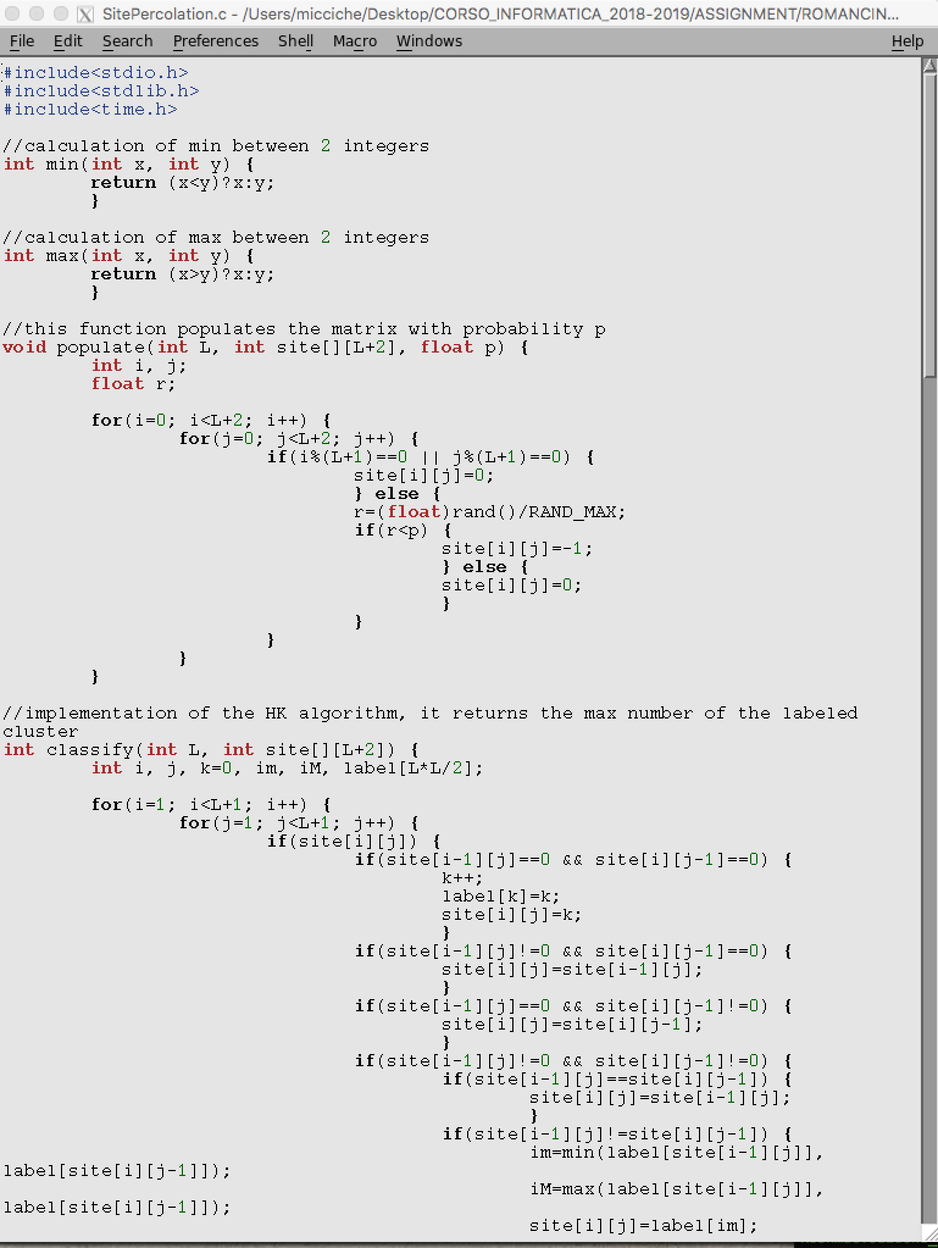
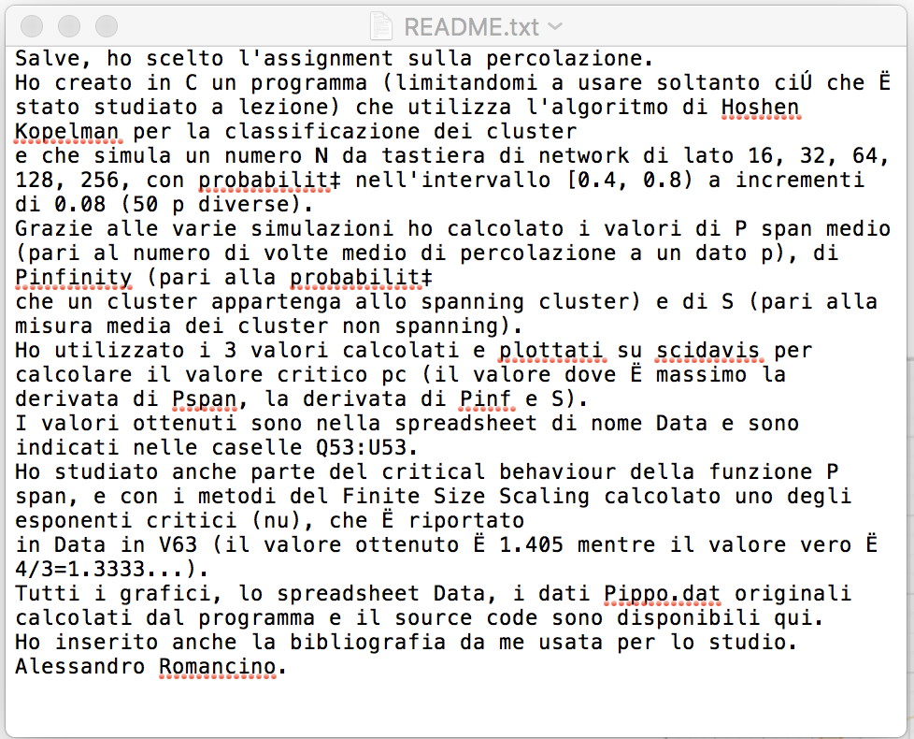
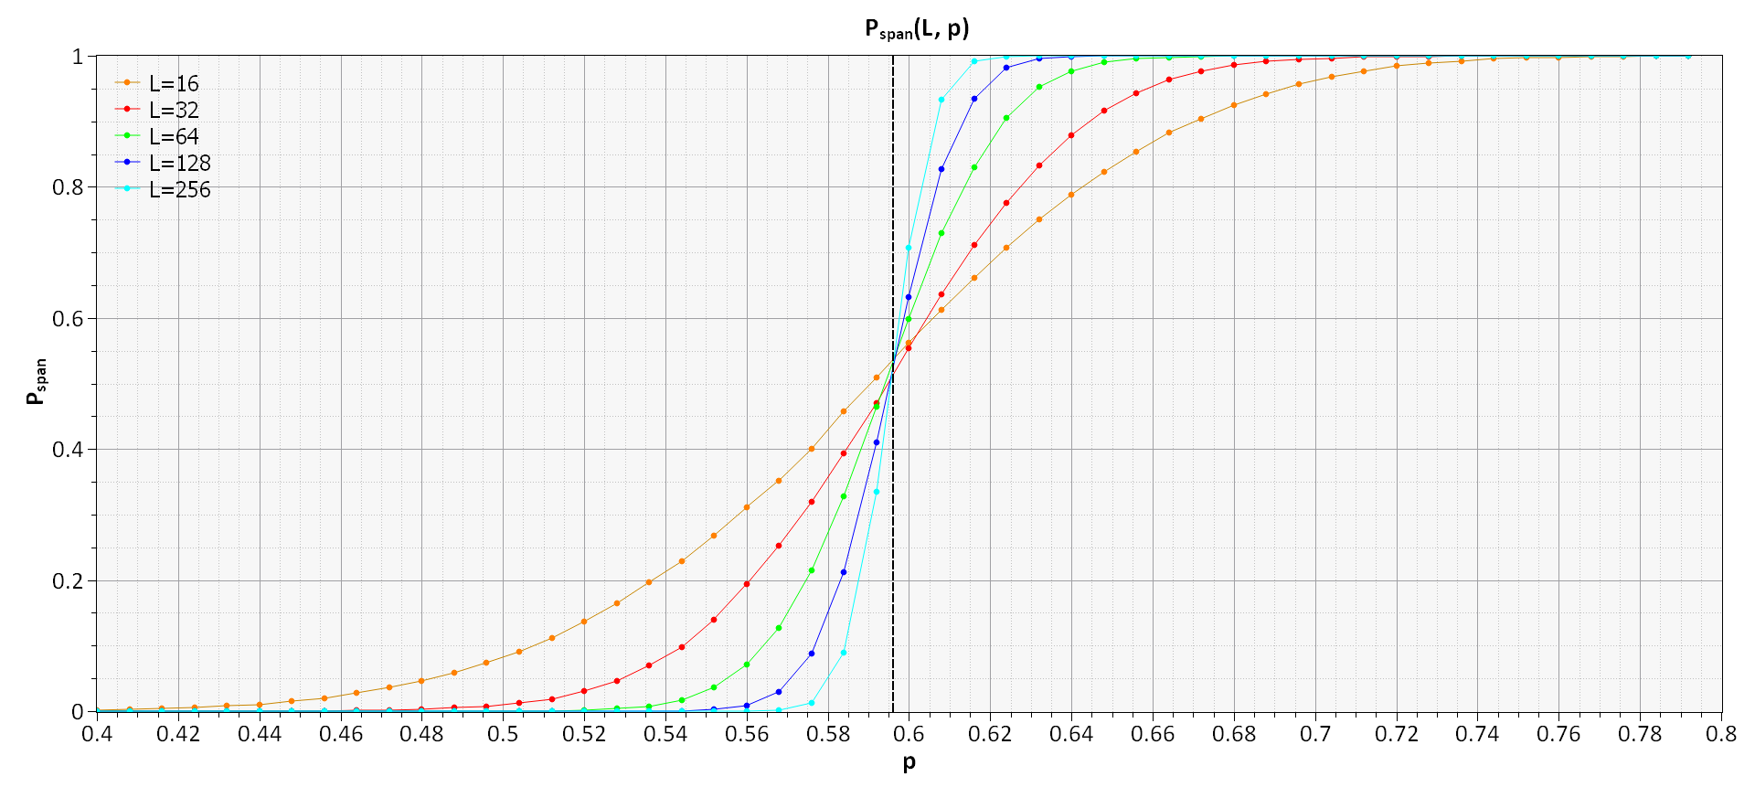
Percolation
A student of mine: Physical Sciences Degree – Course on Informatics and Programming

Slide 14
Percolation
In general, percolation is a random process exhibiting a phase transition. In the simplest setting percolation is investigated in simple geometrical systems such as regular lattices covering a 2D surface.
One speaks about of node percolation the links of the lattice are always present between two occupied sites, but each site is occupied with probability q and empty with probability (1-q).
One speaks about bond percolation when a link between two neighboring sites is present with probability q and its absence is observed with probability (1-q). In this variant all sites are present in the system and links between any pair of them may or may not be present.

Slide 15
Percolation
In our context, percolation refers to probabilistic, network-wide emergent behaviour, between sites.
Specifically, percolation refers to the phenomenon by which, according to the value of q, which play the role of an order parameter, the network shows a transition
from
a phase where all nodes are connected in a unique giant connected component
to
a phase where nodes belong to clusters of elements not connected between each others, i.e. the network gets fragmented.

Slide 16
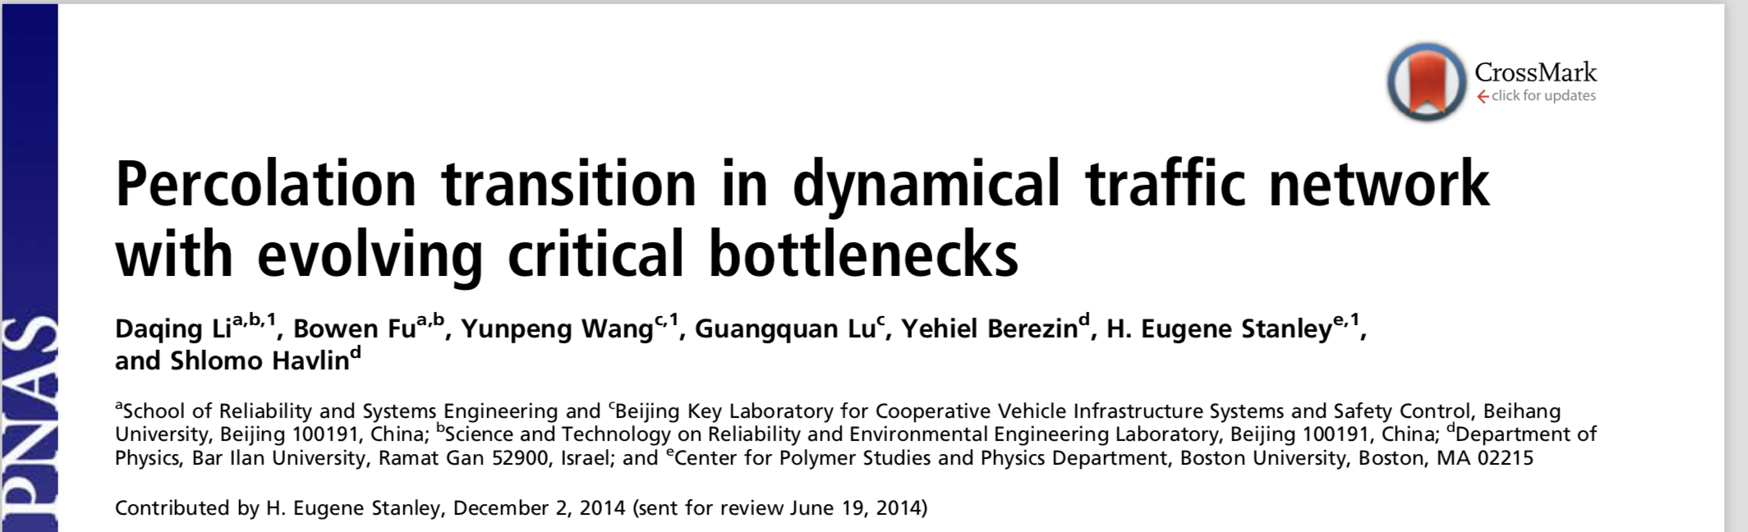
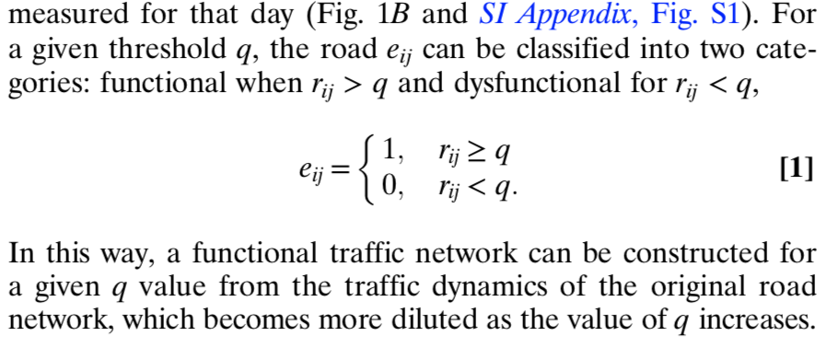
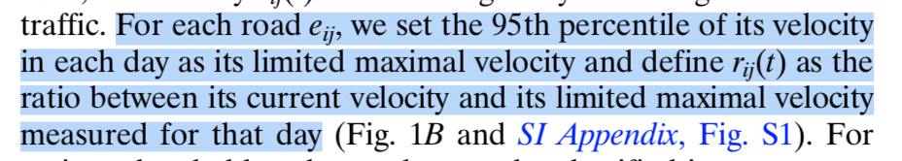
A Percolation approach in urban traffic
Network representation
of city roads
NO
A very peculiar
network !!
APAPT WP-5

Slide 17
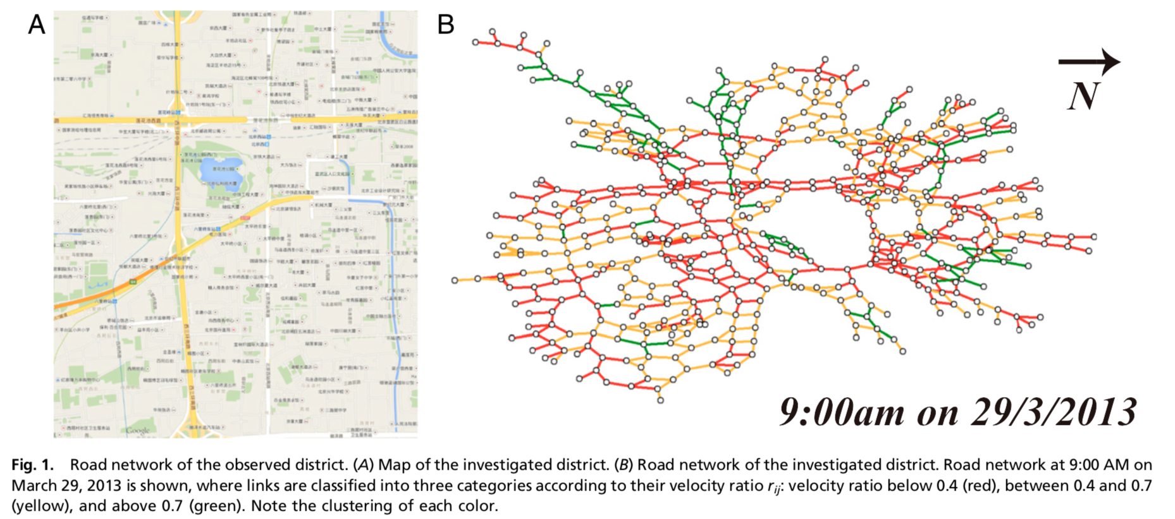
A Percolation approach in urban traffic
APAPT WP-5

Slide 18
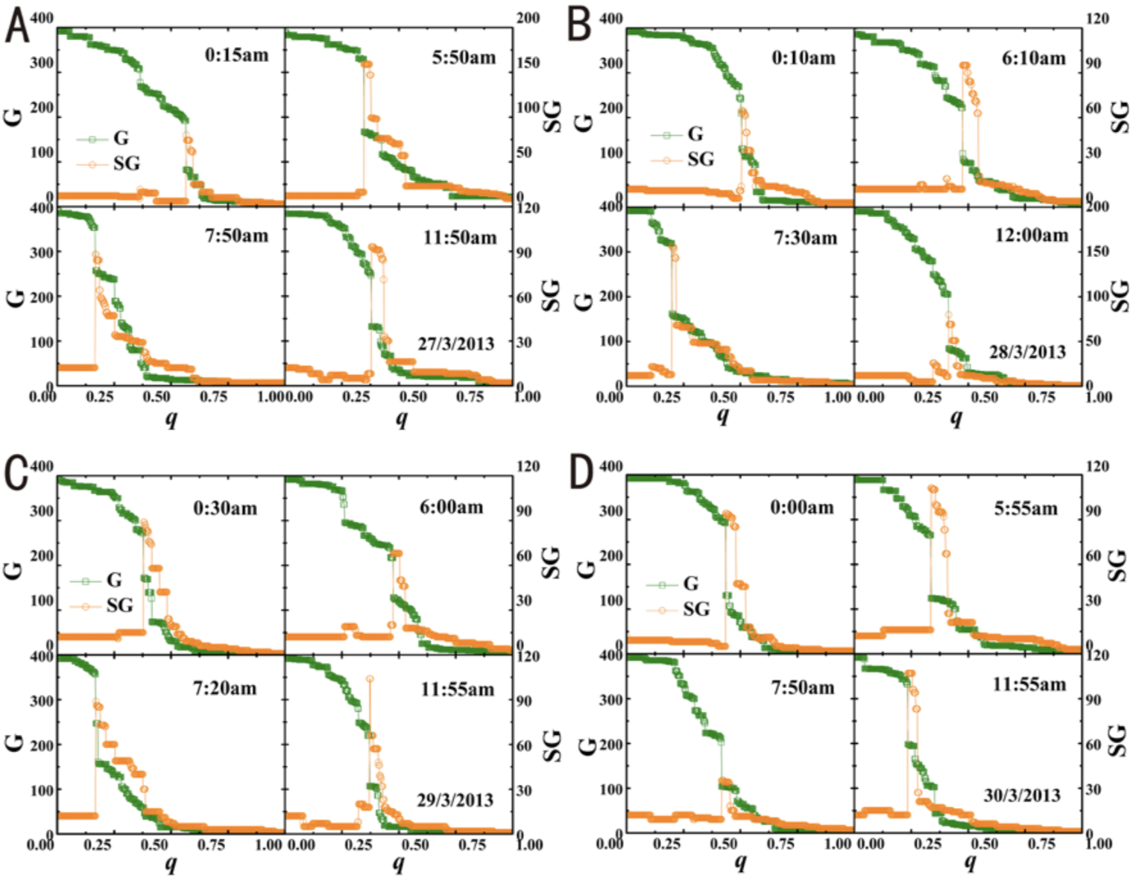
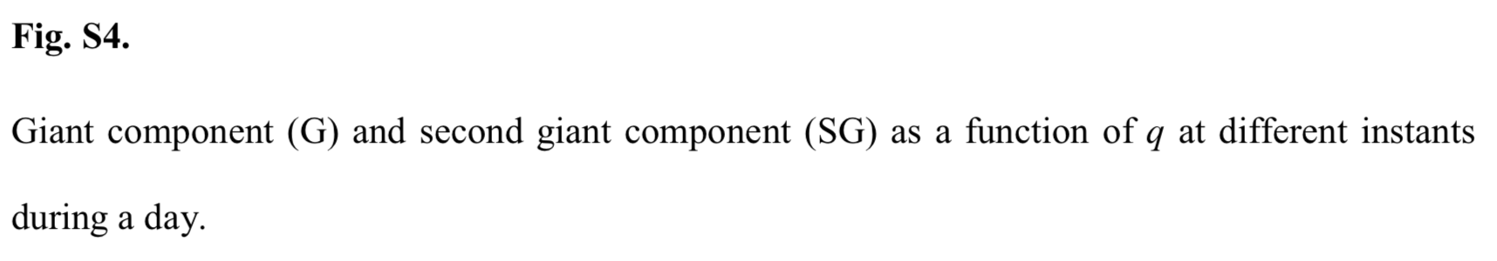
A Percolation approach in urban traffic
APAPT WP-5

Slide 19
A percolation approach in air traffic
Network representation
of city roads
What about our case?
For each ij pair:
Compute the inferred segment traffic load Q_{ij}(t) in a hourly
time window of a specific day
2) Compute the maximal segment traffic load Q_{max}(t) in a hourly
time window over an entire AIRAC cycle
3) Define r_{ij}=Q_{ij}(t)/Q_{max}(t)
4) Then make the thresholding
5) Then compute the size of the largest and second largest connected
component of the network
6) Then keep your fingers crossed !!!!
Network representation
of NVP connections
YES
A much richer
network !!
APAPT WP-5

Slide 20
A percolation approach in air traffic
It does not work !!!!
APAPT WP-5

Slide 21
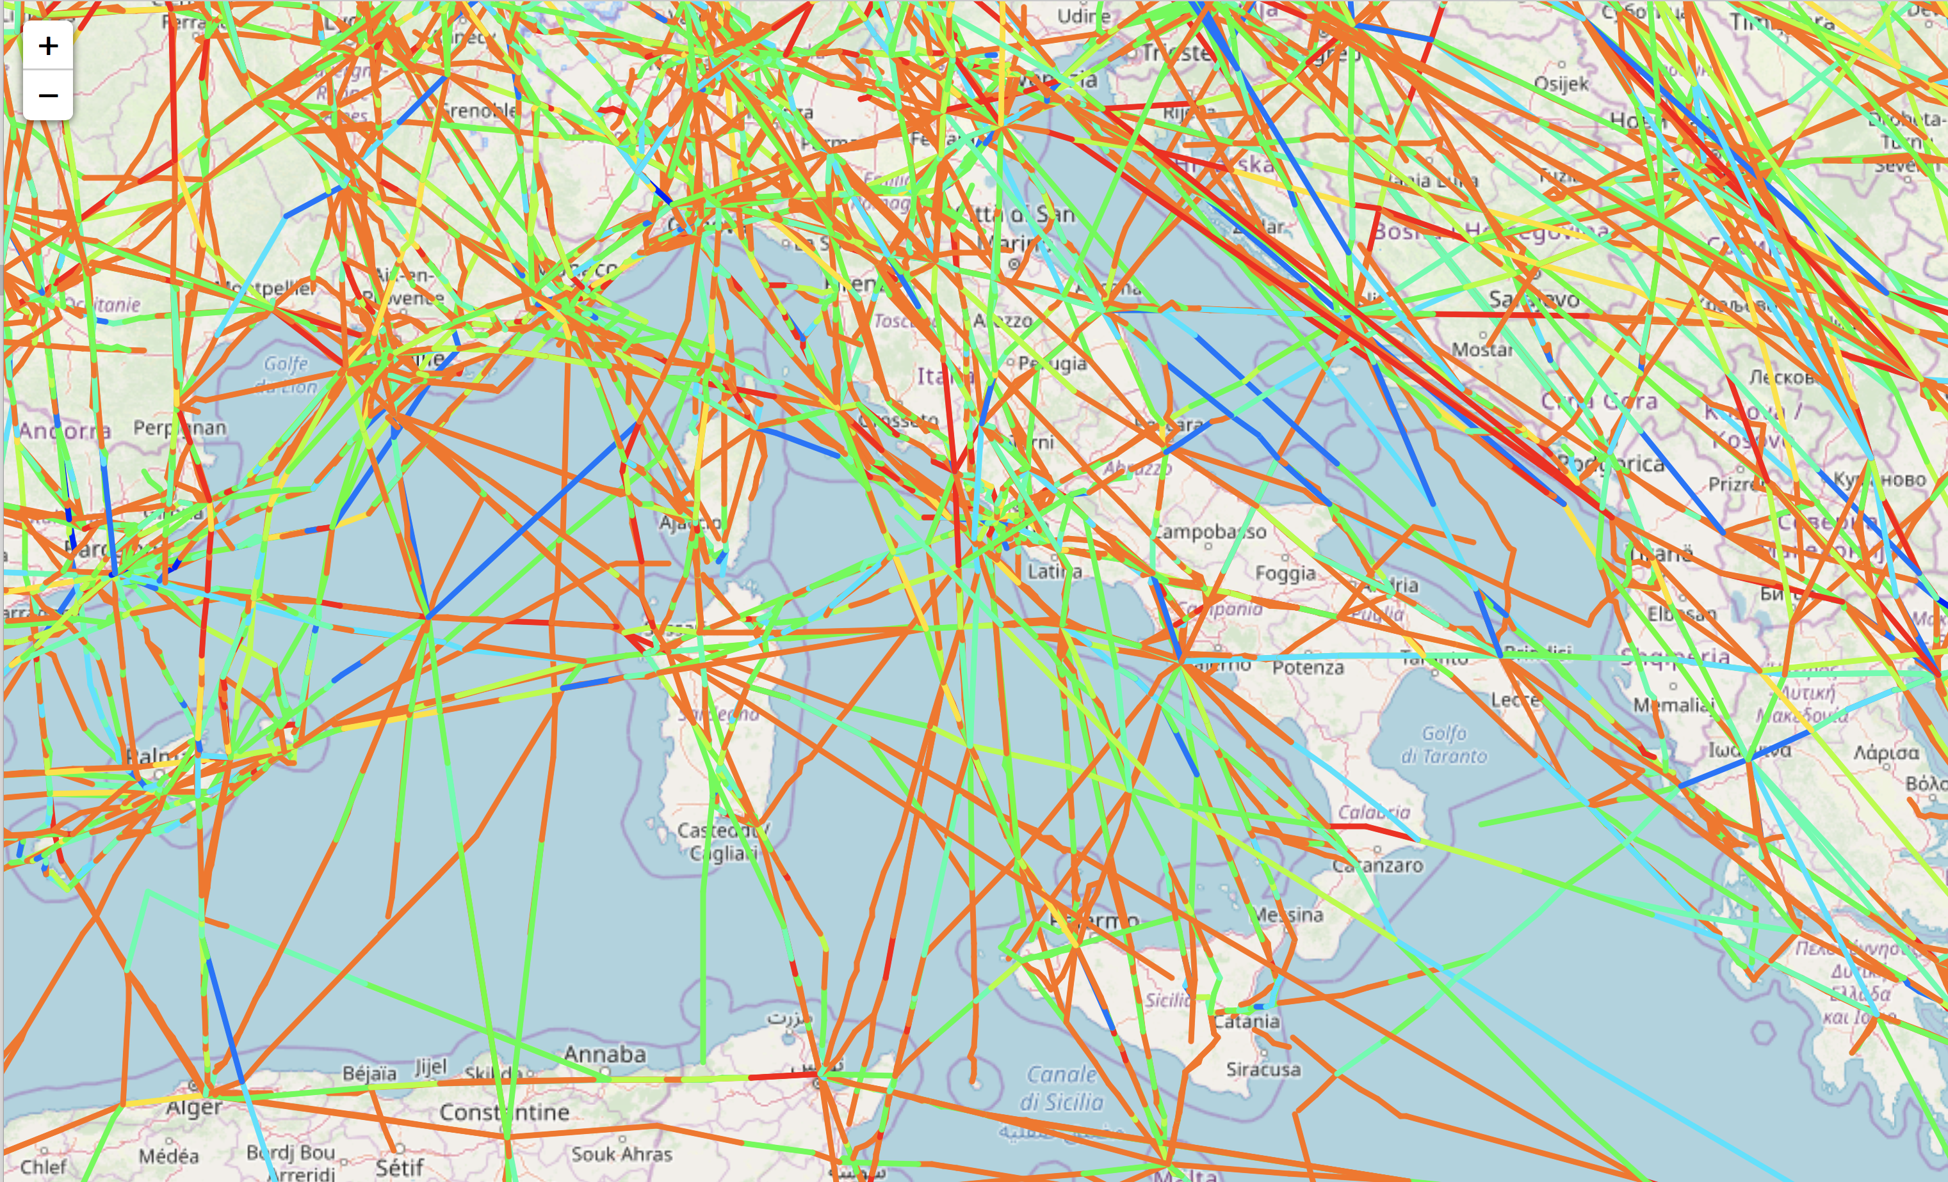
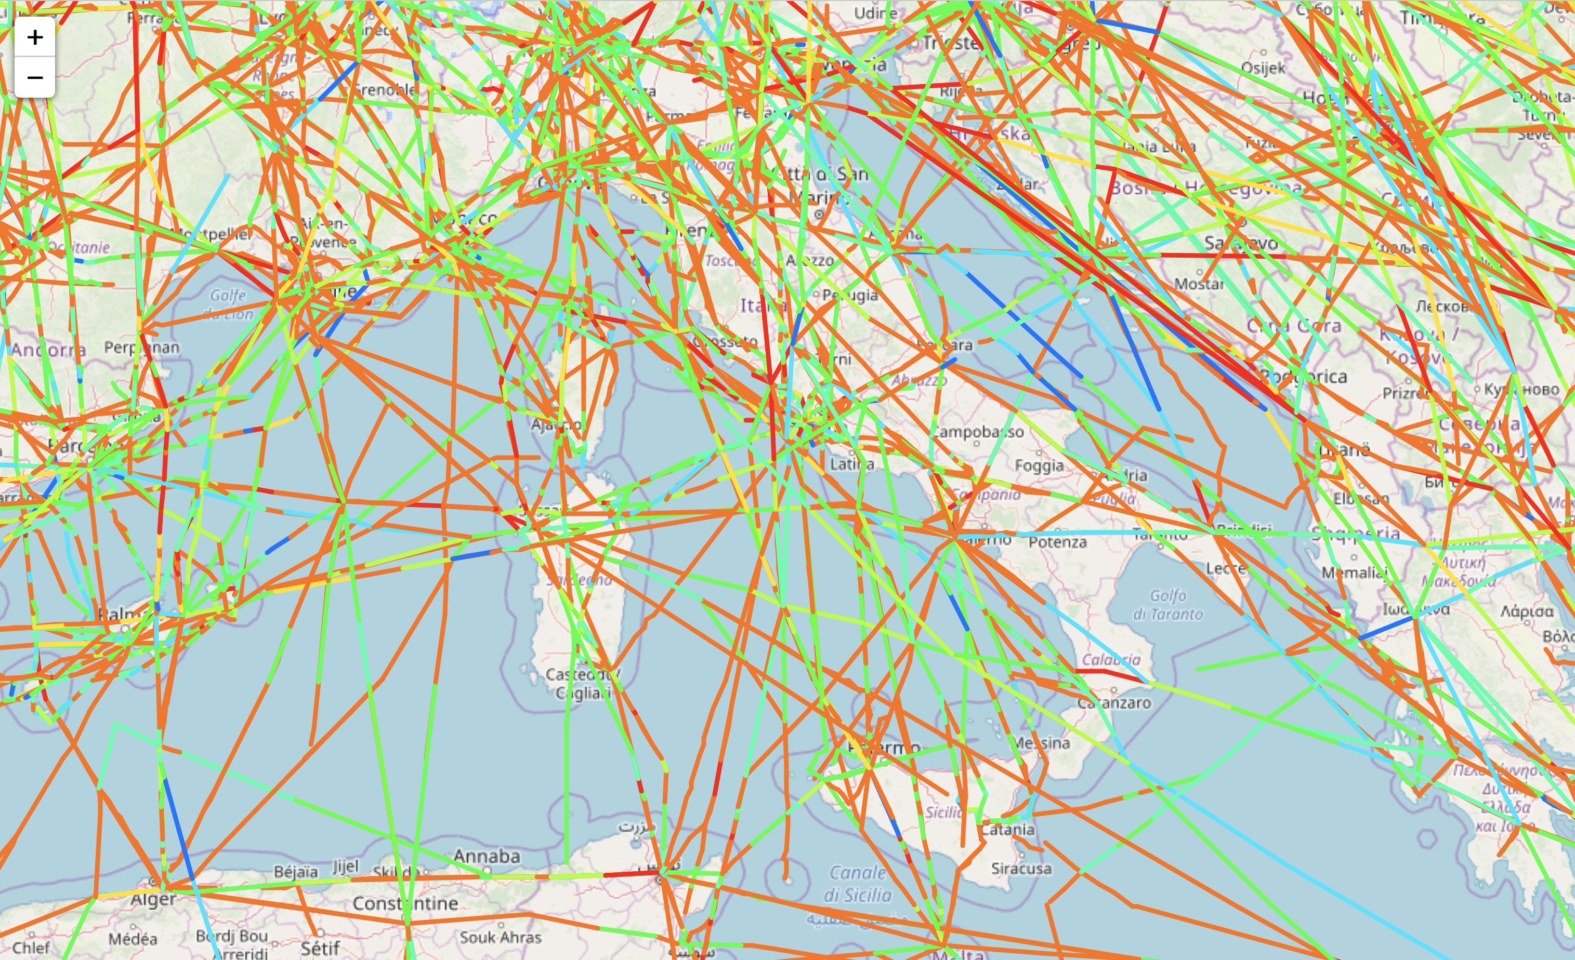
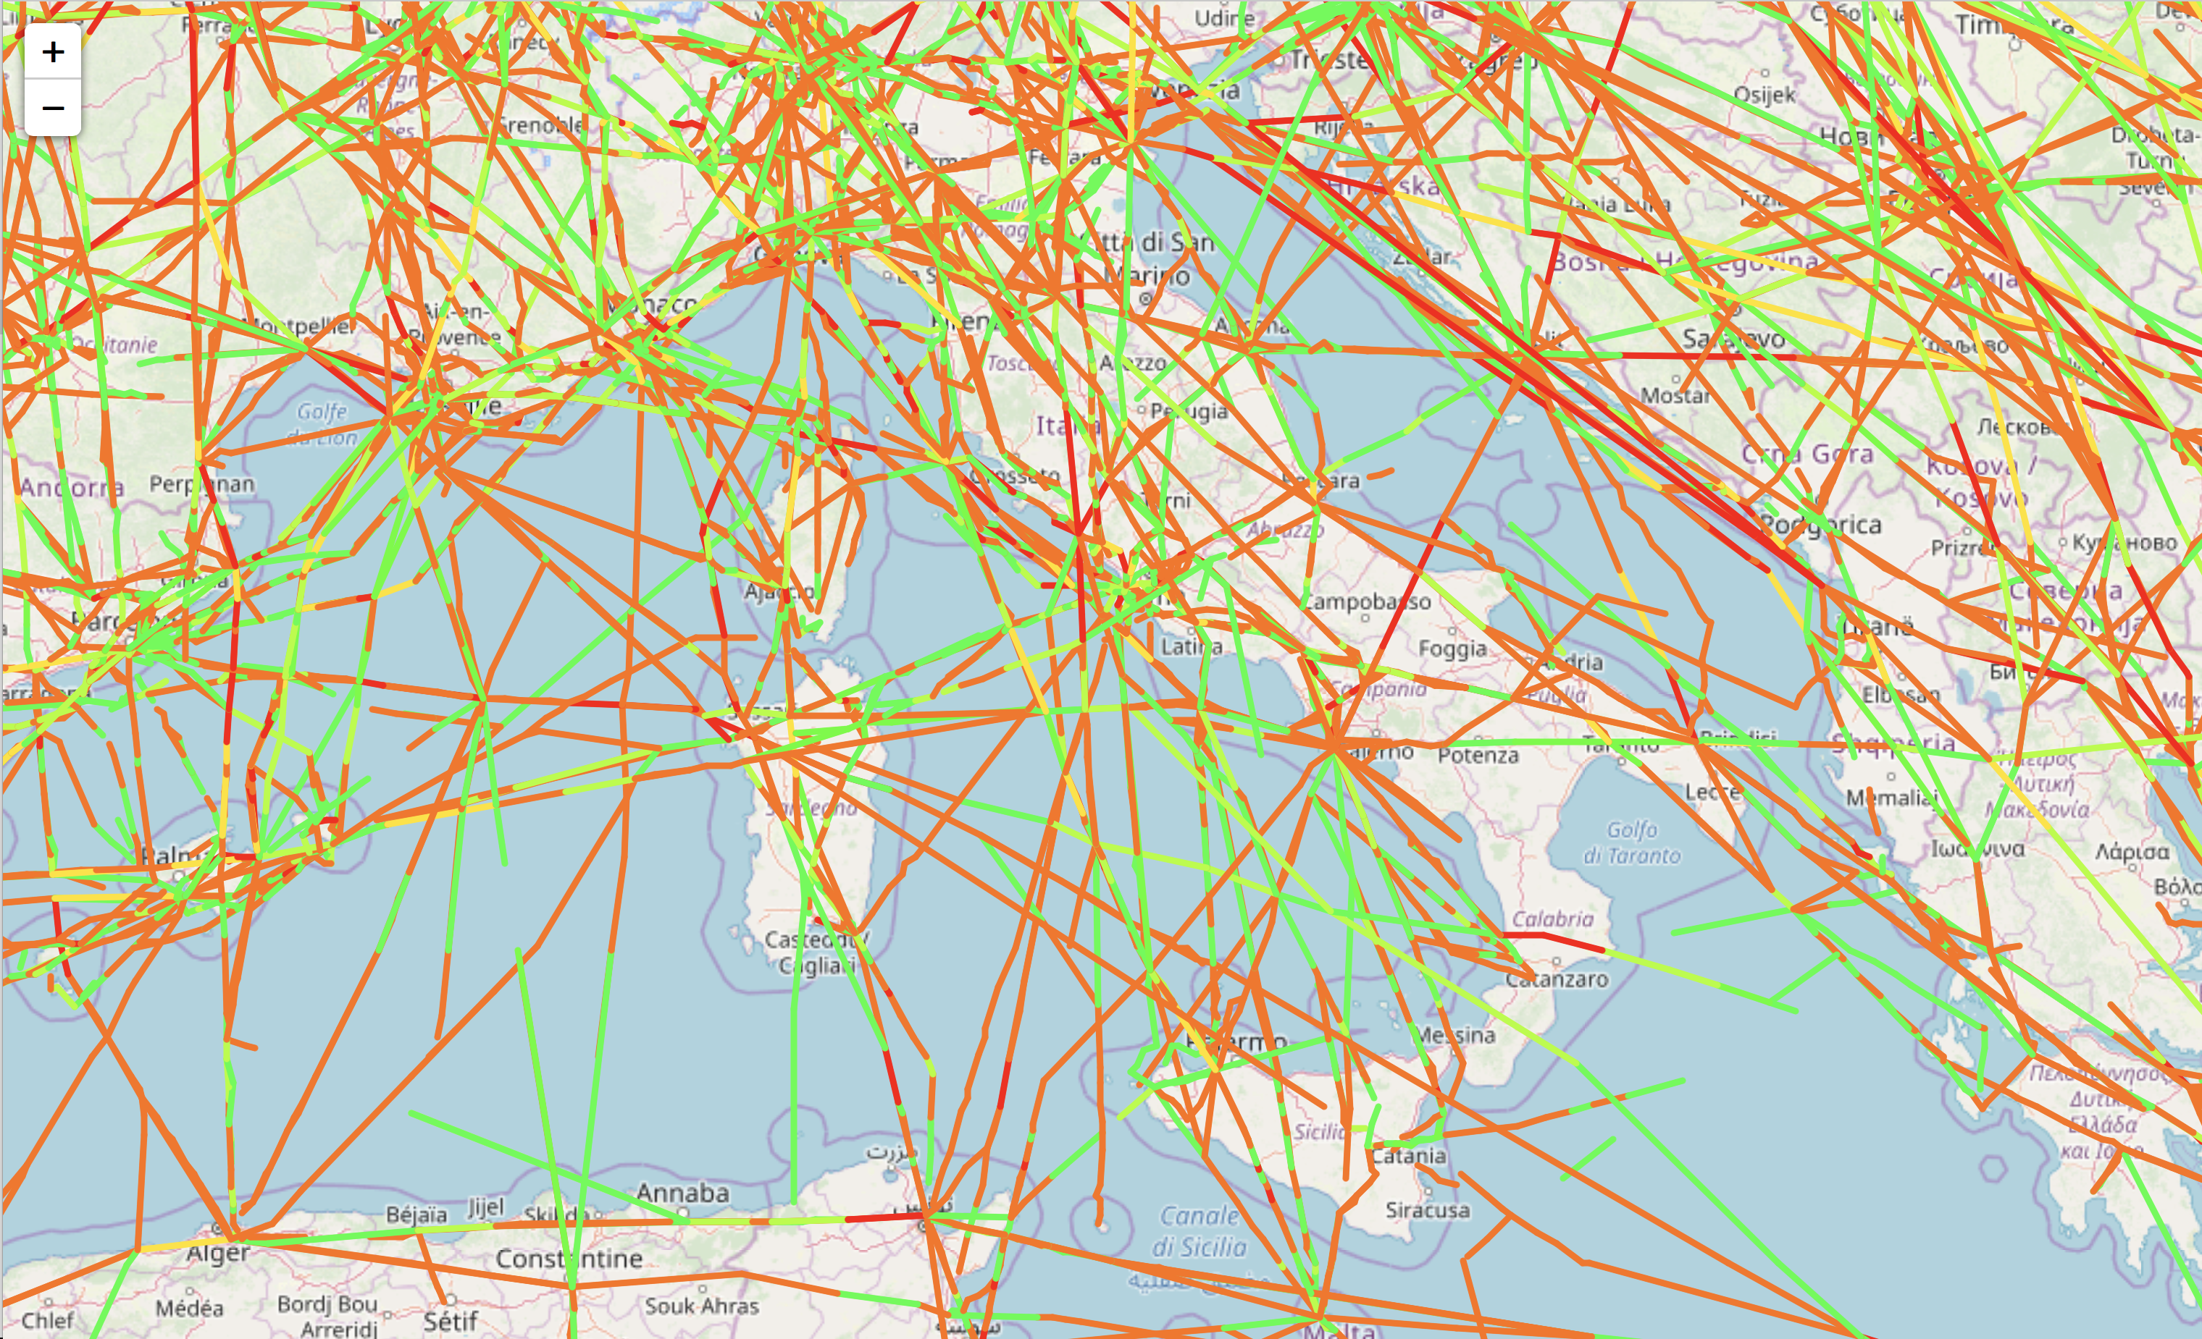
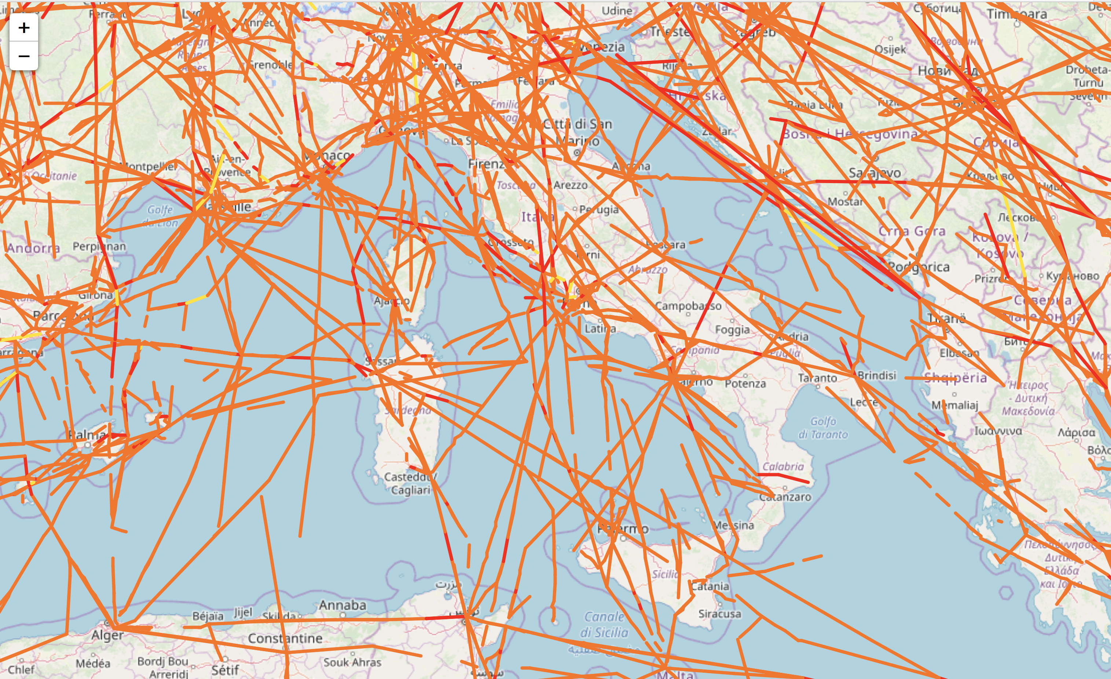
A percolation approach in air traffic
12/09/2014 all 13:00 q=0. (all links)
12/09/2014 all 13:00 q=0.2
12/09/2014 all 13:00 q=0.5
12/09/2014 all 13:00 q=0.9

Slide 22
A percolation approach in air traffic
Why?
NO
YES
Is it possible that long-range links keep the network connected even at large threshold values?
long-range links
short-range links
short-range links
APAPT WP-5

Slide 23
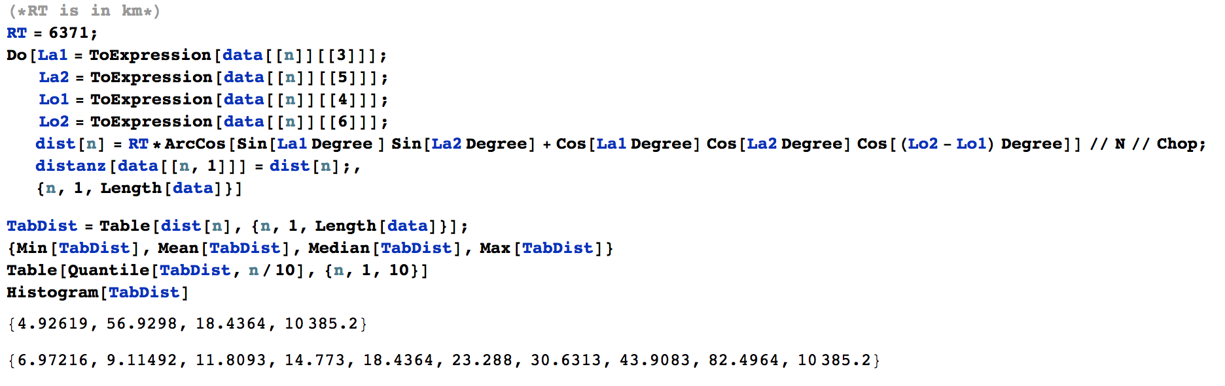
A percolation approach in air traffic
DECILES
MEDIAN
MEAN
Power-law with exponent close to 2

Slide 24
A percolation approach in air traffic
Keep links with distance < 18.43 (1.38 minutes)
We are close, ….

Slide 25
A percolation approach in air traffic
Keep links with distance < 23.29 (1.75 minutes)
We are close, ….

Slide 26
A percolation approach in air traffic
Keep links with distance < 23.29
We are close, ….

Slide 27
A percolation approach in air traffic
4_th decile - 14.77
5_th decile - 18.43
6_th decile - 23.29
There is a dependence also from the
distance threshold
7_th decile - 30.63
8_th decile - 43.90
9_th decile - 82.50

Slide 28
A percolation approach in air traffic
What is the interpretation of our results?
The investigations we have so far performed, although preliminary, yet clearly shows that percolation occurs in the navigation balls network generated starting from the aircraft trajectories flying over the ECAC airspace in a certain day.
This approach is therefore able to detect links, characterized by certain q values, which carry a potential risk of disruption in the network.
long-range links play a role: percolation seems to be a local effect !!
Percolation thresholds might be different in different time–intervals over a day
Also the distance threshold seems to be different in different time–intervals over a day
We are therefore able to detect links i j such that
IF the traffic load is at a certain percentage r_{ij} of their maximal traffic load Q_{ij}(t)
AND
IF such percentage is above a critical value q_{c}
THEN the network may undergo the risk of getting fragmented into small disconnected parts.
Long-range links contribute to keep connected the air traffic network.

Slide 29
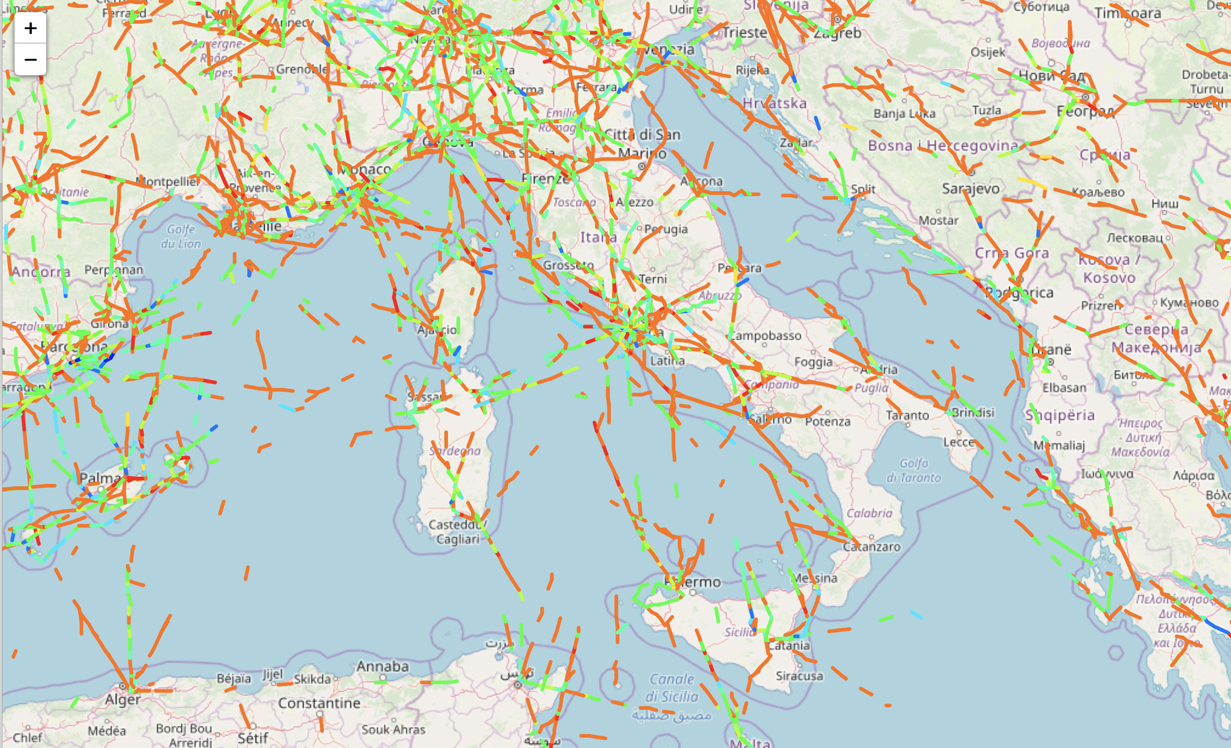

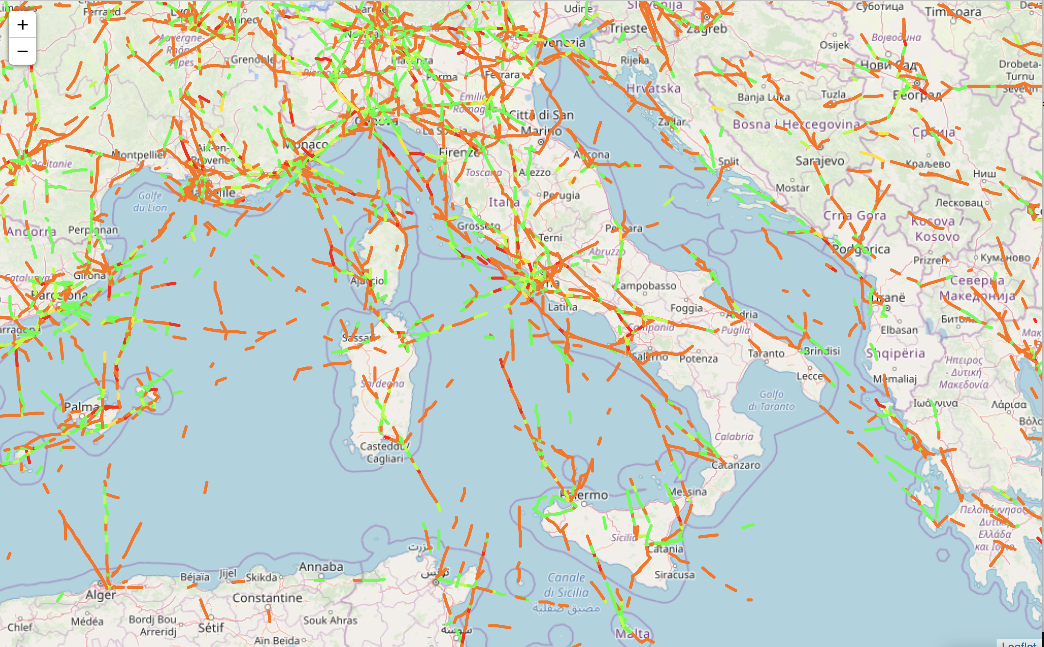
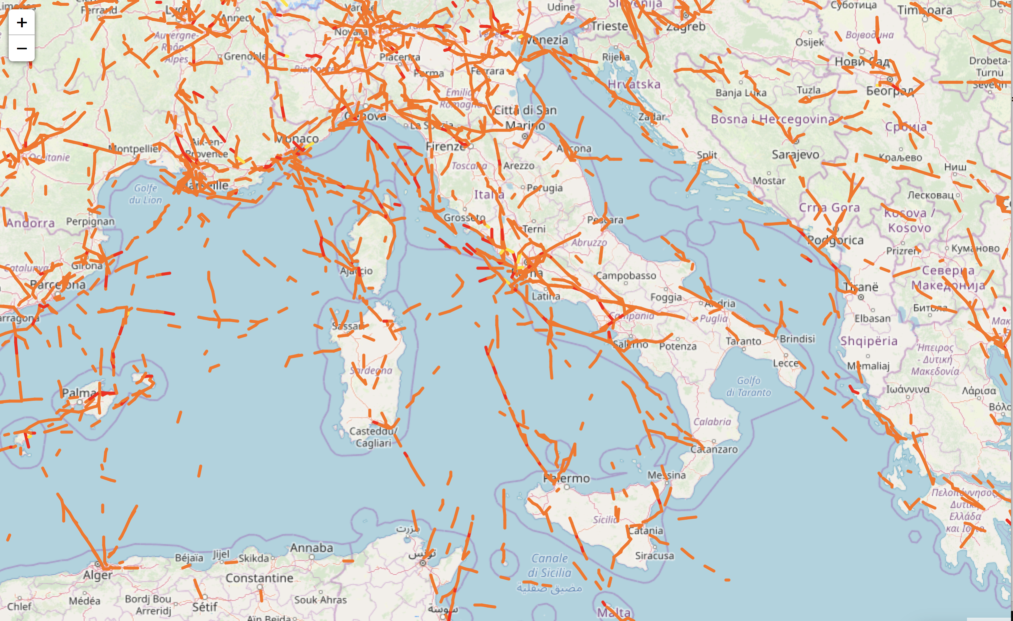
A percolation approach in air traffic
12/09/2014 <23.29 km 13:00 q=0. (all links)
12/09/2014 <23.29 km 13:00 q=0.2
12/09/2014 <23.29 km 13:00 q=0.5
12/09/2014 <23.29 km 13:00 q=0.9

Slide 30
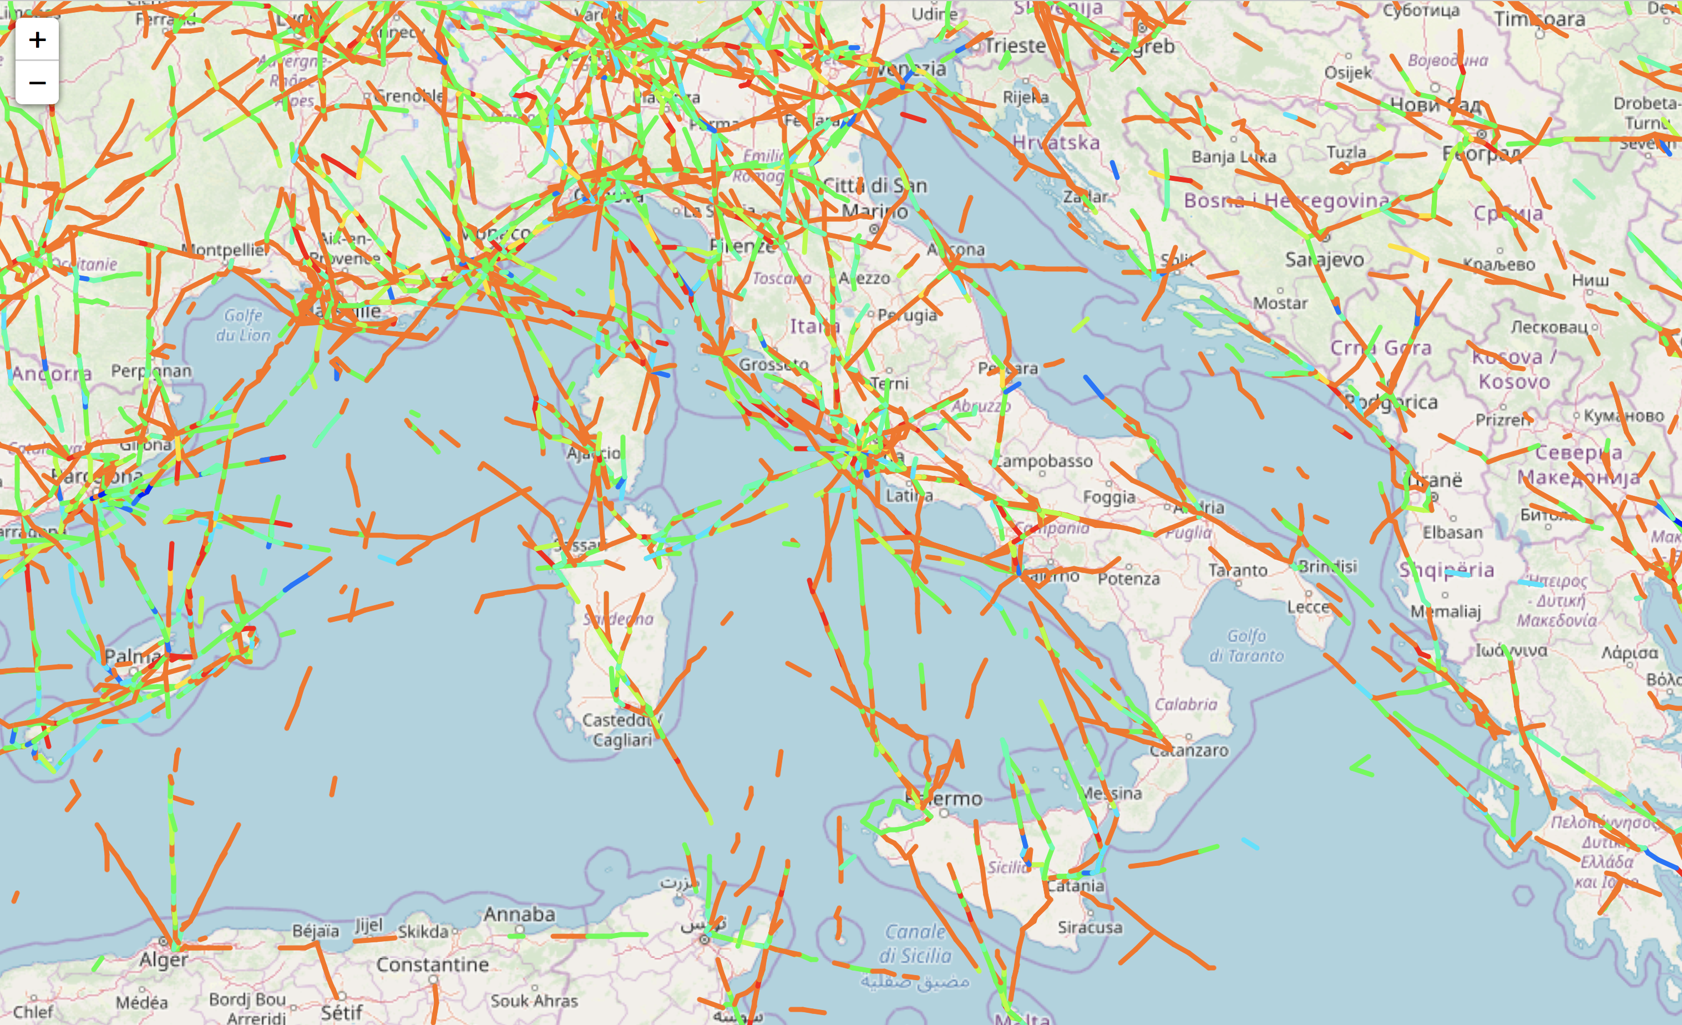

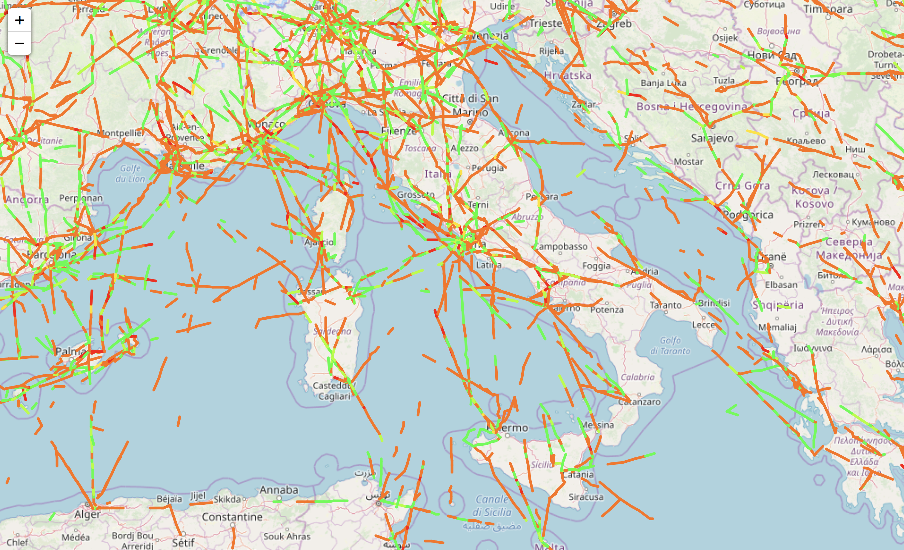
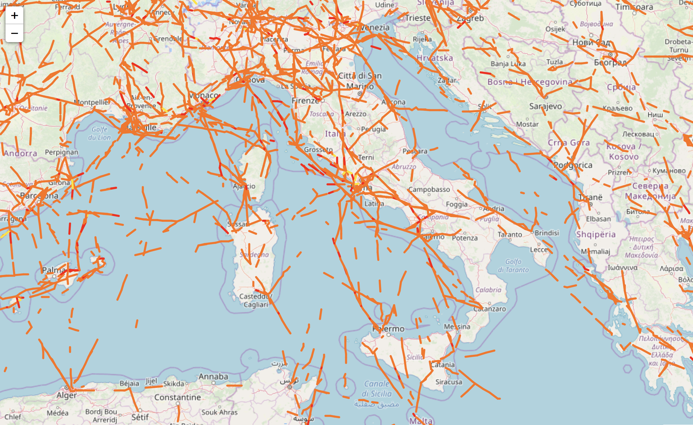
A percolation approach in air traffic
12/09/2014 <30.63 km 13:00 q=0. (all links)
12/09/2014 <30.63 km 13:00 q=0.2
12/09/2014 <30.63 km 13:00 q=0.5
12/09/2014 <30.63 km 13:00 q=0.9

Slide 31
A percolation approach in air traffic
Percolation
Size of network: 21159
Size of largest: 7354 (35%)
Size of second largest: 532 (2%)
12/09/2014 <23.29 km 13:00 q=0. (all links)
No Percolation
Size of network: 22418
Size of largest: 12082 (54%)
Size of second largest: 1475 (7%)
12/09/2014 <30.63 km 13:00 q=0. (all links)

Slide 32
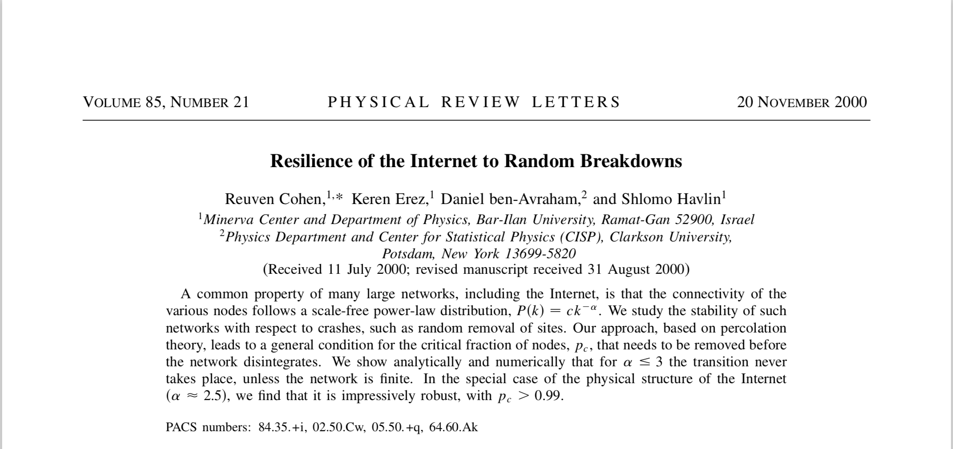
A percolation approach in air traffic
Where do we go from here 1 ?
Understand theoretically the role of long-range links and the interplay between long-range-ness and initial fragmentation.
Can we reproduce percolation & long-range links role at the level of:
  Erdos-Reny random networks?
  Preferential attachment networks?
  Core-periphery networks?
Can this help in understanding what is going on?
As a physicist I would be happy: lot of work for the months to come, … !!!!

Slide 33
A percolation approach in air traffic
Where do we go from here 2 ?
We now have to think about the operational
consequencies of our results.
The most elementary operational units in ATM are Air traffic sectors
Air Traffic Sectors are characterized by Capacity
Sectors’ capacity is nowadays the most relevant issue when talking about the future of ATM.
Everybody is looking for a way to increase capacity, i.e a way to accomodate as many as possible aicraft in a certain airspace
Can we transpose percolation at the level of
AIR TRAFFIC SECTORS?

Slide 34
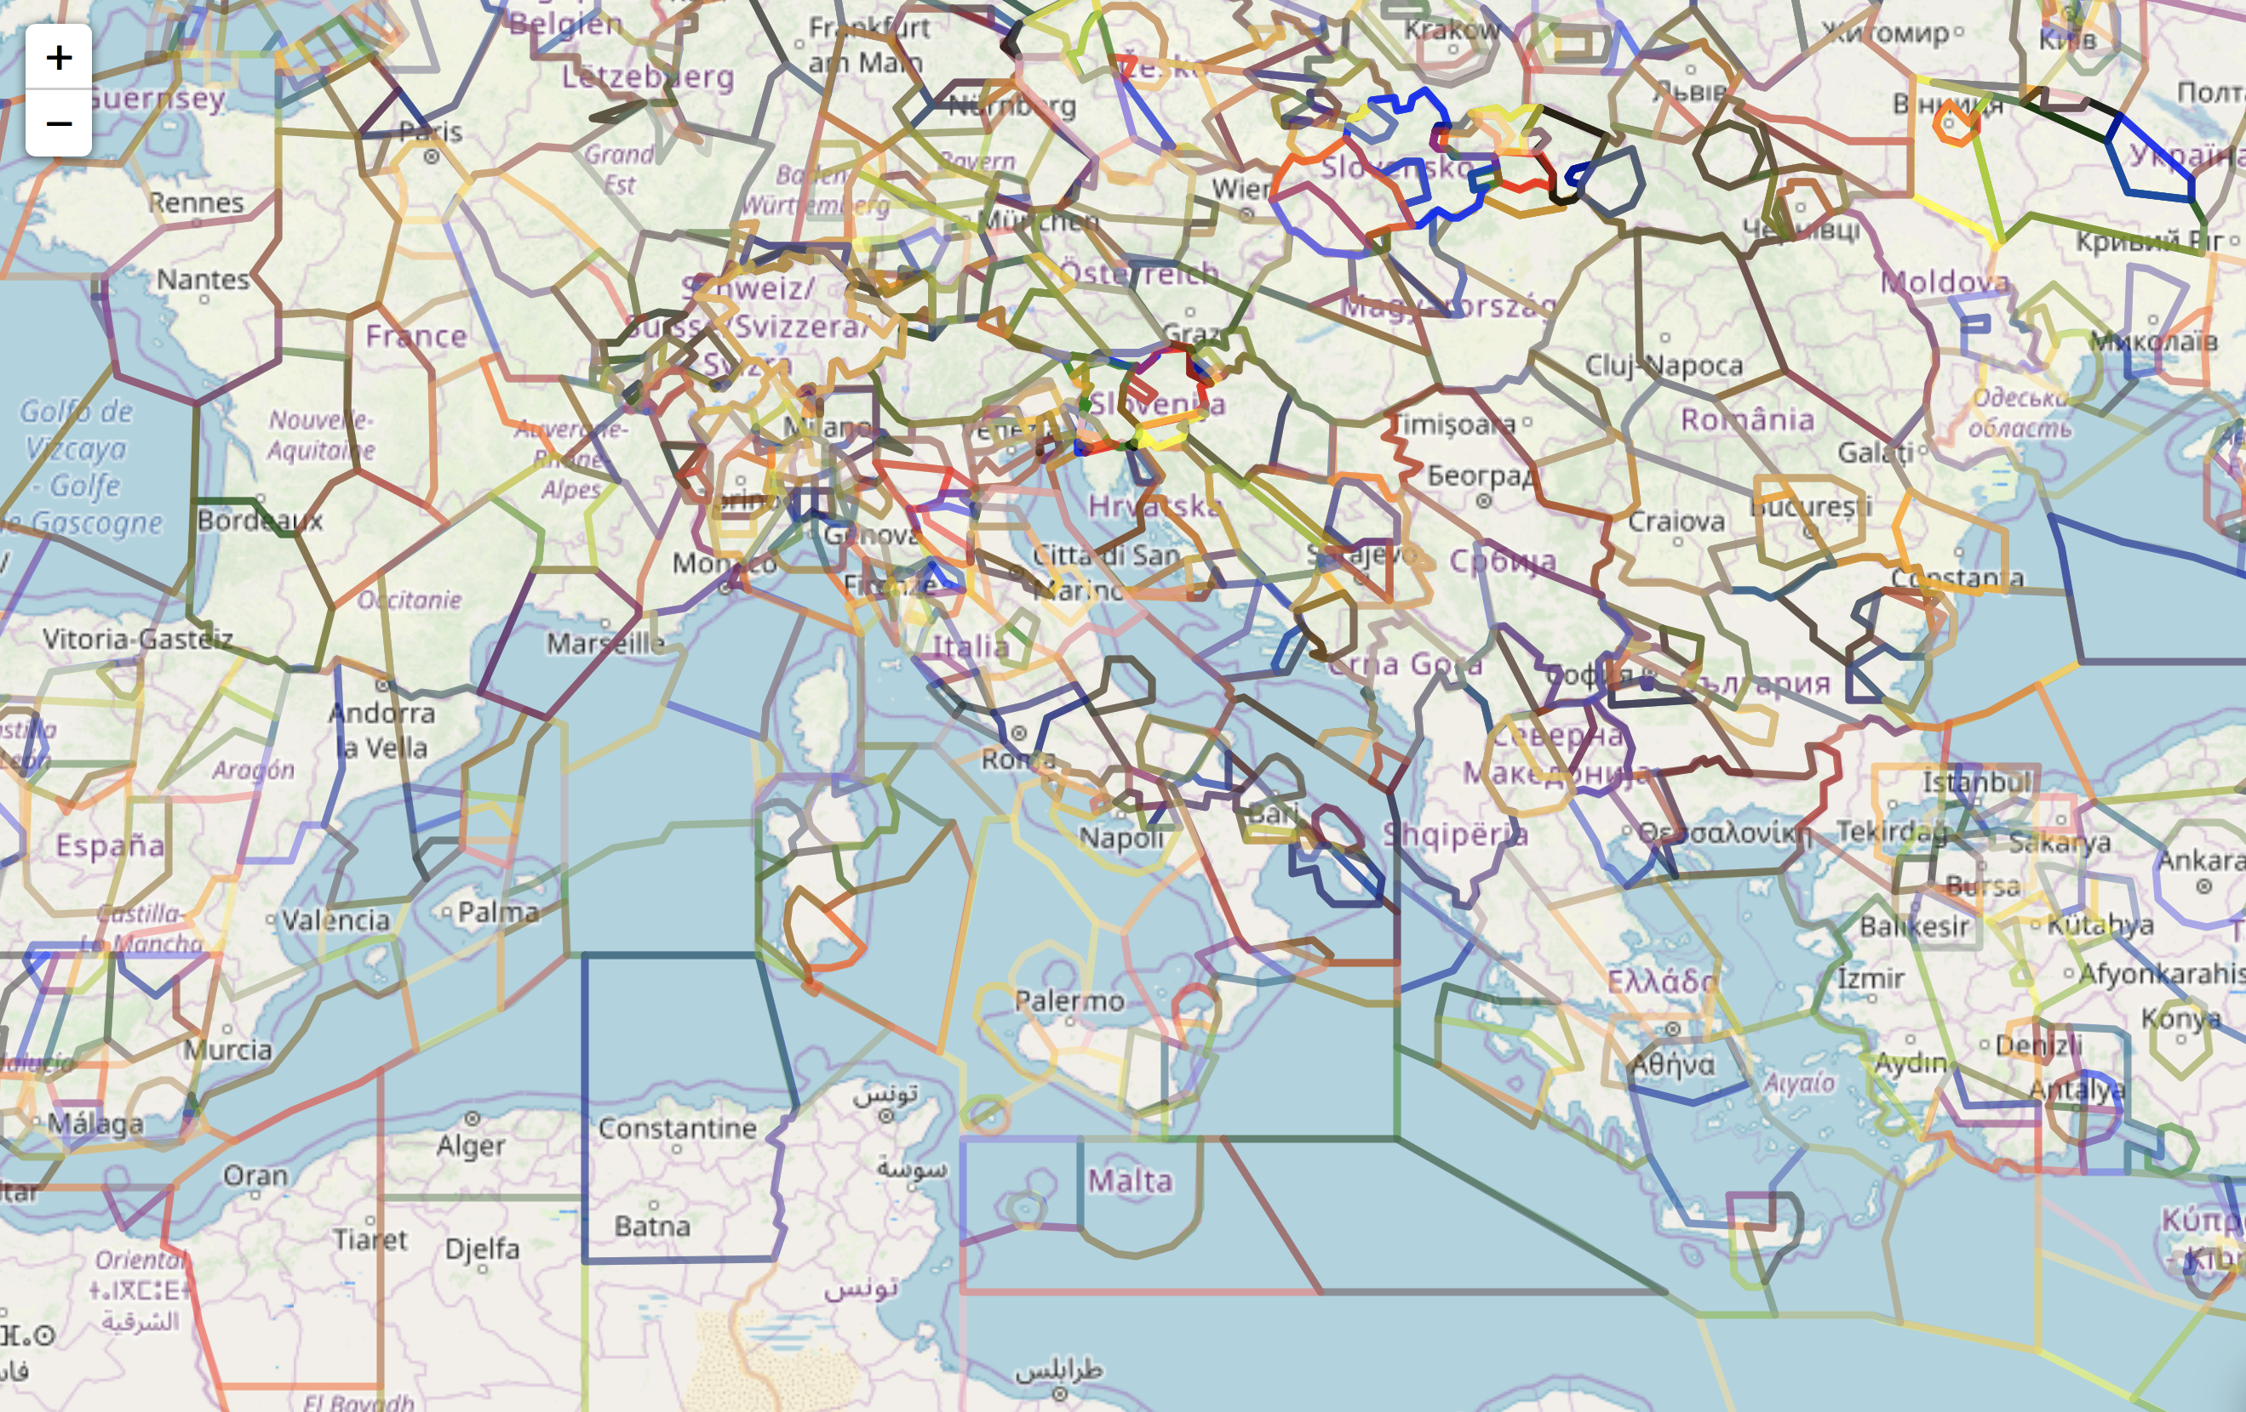
A percolation approach in air traffic - sectors

Slide 35
A percolation approach in air traffic - sectors
We need a resonable sectorization linked to the operational level
Node percolation?
Link percolation?
Work to be done

Slide 36
Conclusions
A percolation approach in air traffic networks
Long-range links play an important role
percolation is a local effect
Interplay with initial fragmentation
understand why initial fragmntation does not necessarily imply percolation
We need to theoretically understand these issues
toy models with different network generating mechanisms
Percolation at the level of Air Traffic Sectors
node percolation vs link percolation - operational importance

Slide 37
The End
salvatore.micciche@unipa.it

Slide 38
Advertisement
We will have soon two open positions (expected in June 2019):
RTD-a FIS/07 – temporary lecturer
Complex Systems
Assegno di Ricerca – postdoc 18 months
funded by PRIN 2018
Stochastic forecasting in complex systems

Slide 39



Advertisement
4.1 Econophysics
Econophysics is a “recently” established discipline whose main aim is that of modeling some of the stylized facts empirically observed in the study of financial markets.
Why Physicists are interested in Financial Markets
Financial market can be considered as model complex systems
Many Agents/Factors
interactions are not always clear/known (NO equations, Hamiltonians, … )
We have a rich set of different databases.
G. Parisi cond-mat/0205297 Complex Systems: a Physicist's ViewPoint: “A system is complex if its behaviour crucially depends on the details of the system”

Slide 40


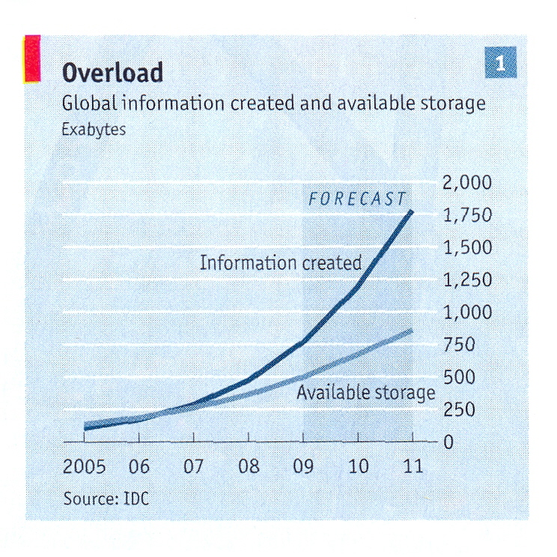
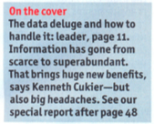
Advertisement
Methods of Statistical Physics and Network Theory can be applied :
Stochastic Processes (Brownian motion, superdiffusivity, power-law tails, long-range correlation,...)
scaling
Network theory, clustering techniques, random matrix, ...
Agent-based models, ...
...
Last but not least: There is a huge amount of data!

Slide 41
Advertisement
4.2 BioStatistics
4.3 Socio-Technical Systems
Gene Ontology
Inverted Repeats
MicroRNA
Complex Diseases
Air Traffic Management
today’s talk
4.4 Social Systems
Aged people in Europe
Criminal/Suspects in Sweden
Finnish Elections
News
Mobile phone communications
Personality traits of alexythimic patients
Characterization of Mafia communities
4.5 Methods
Stochastic Processes in Classical and Quantum Systems
Correlation-based Networks (MST, PMFG, ….)
Statistically Validated Networks
Community (Cluster) Detection and Characterization
Agent-based Models

