Slide 1
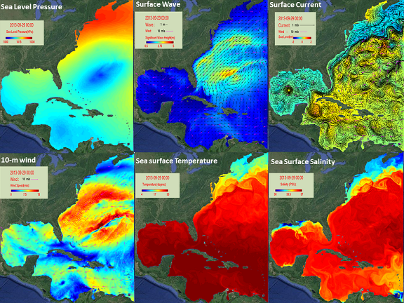

Overview of ROMS
Regional Ocean Modeling System
NC State Atmosphere-Ocean-Wave Coupled Model Prediction
for the Northwest Atlantic Ocean

Slide 2
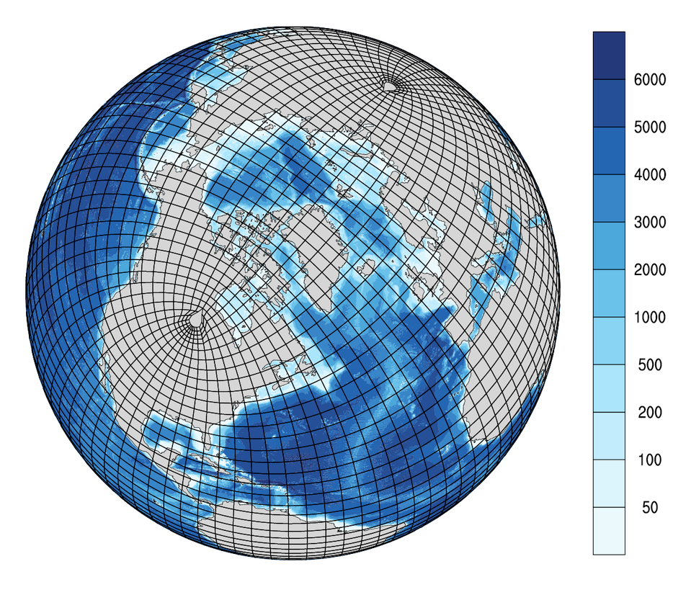
Ocean (vs Atmospheric) models
Ocean modellers have it both easy and hard compared to their atmospheric
counterparts:
• the ocean is (nearly) incompressible: water in ~ water out
• the ocean is strongly stratified: horizontal processes dominate over
vertical ones
• no change of state of seawater: just form ice when T < -1.8ºC
BUT
• domain geometry is complex
• lateral boundary conditions are required and poorly constrained
• ocean eddies are smaller than atmospheric vortices
• the spin-up time is longer
• there are far fewer observations for validation

Slide 3
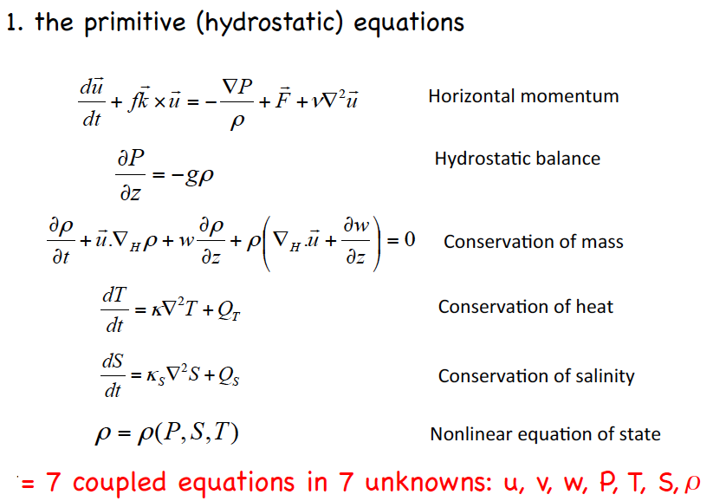
Ingredients (I):
Primitive hydrostatic equations

Slide 4
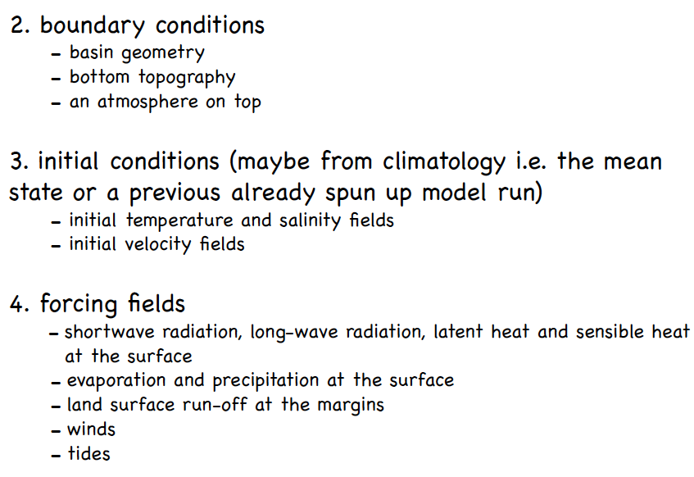
Ingredients (II):

Slide 5
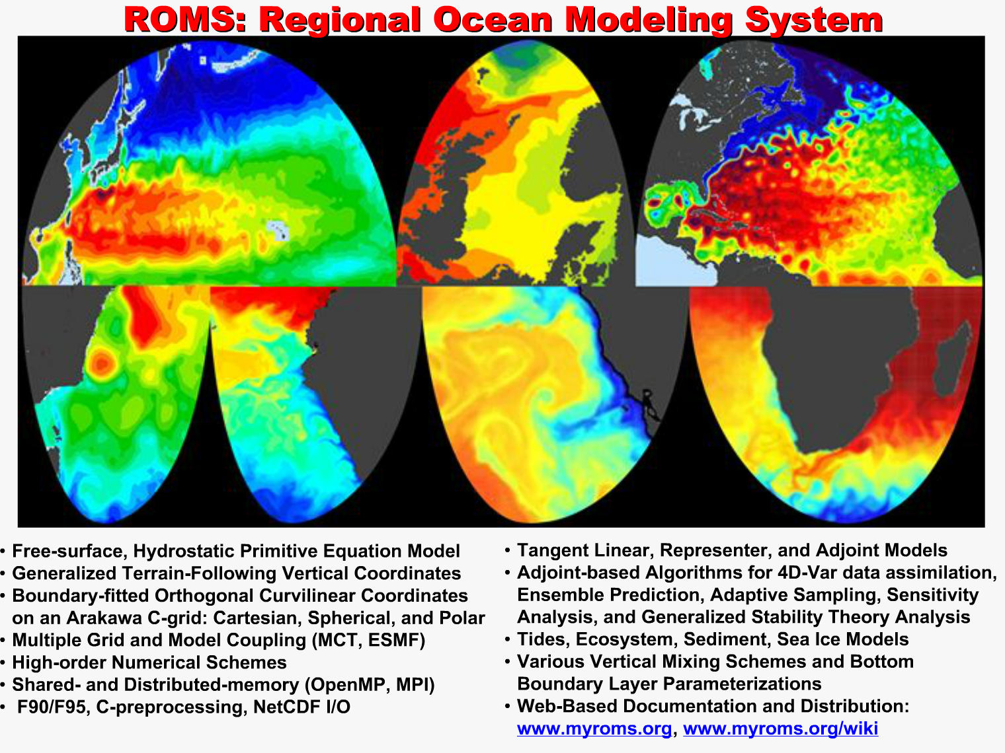
SLIDE from Hernan Arango, Rutgers

Slide 6
Overview of ROMS
Three-dimensional, time-dependent hydrodynamic model.
  Solves the conservation of mass and momentum equations.
  Includes transport equations for temperature and salinity.
Community model
  Open source.
  Wide user community, > 4000 registered users.
In addition to hydrodynamics:
  Modules for sediment transport (Warner et al. 2008; bedload and suspended load), biogeochemistry (NPZD), ice.
  Can be run as nested model and there is a large data assimilation community.
  Two-way coupled to wave model (SWAN), wind model (WRF).

Slide 7
Overview of ROMS, cont.
Features of the code:
  Written in Fortran-90, 95
  Parallel (MPI).
  Includes sets of options: advection schemes, turbulence closures, bottom boundary layer treatments.
  Output: NetCDF “history” file, ocean_his_*.nc.
  Input: format is a somewhat flexible: mix of NetCDF, text files, and some hard-wiring.

Slide 8
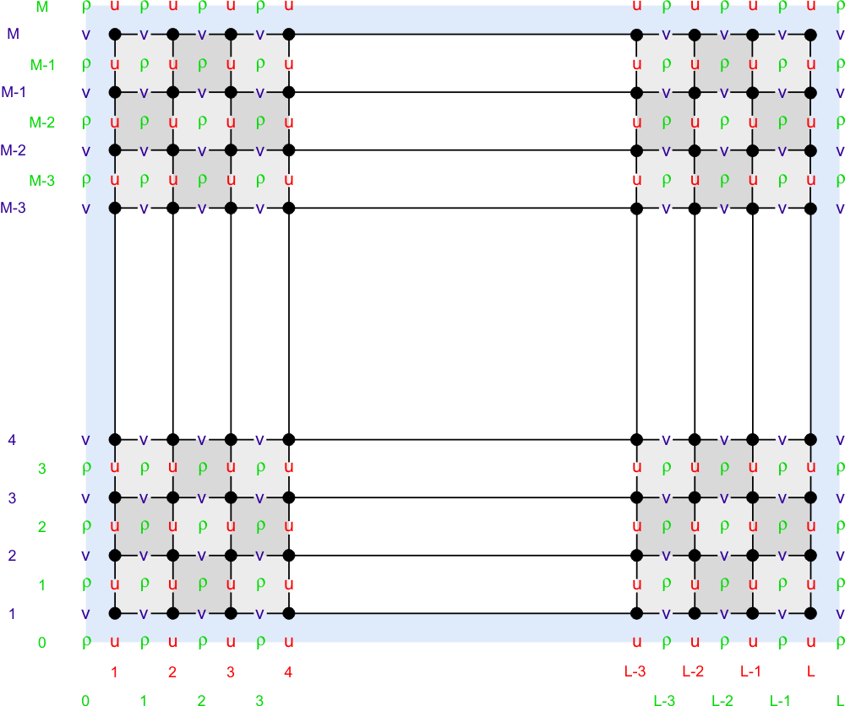
ROMS’
Horizontal Grid
Orthogonal curvilinear grid.
Arakawa-C grids often used in coastal models..
U, v, w, and ρ are represented at different locations within the model grid.
The u-, v-, and ρ-grids are different.
The u-, v-, and ρ-grids have different *sizes*
Figures from ROMS wiki.
Fringer, McWilliams, and Street, 2006.

Slide 9
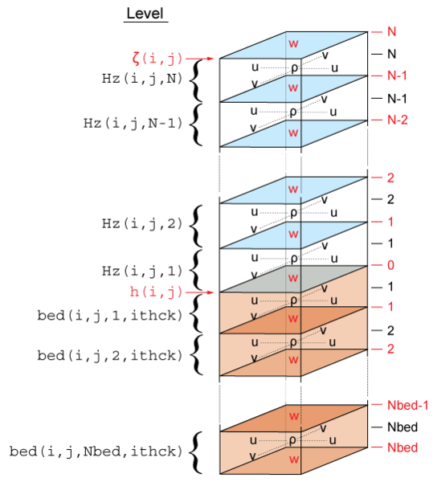
ROMS Vertical Grid
Figure from Warner et al. 2008
The vertical grid has two parts:
Water column shown in blue. “N” layers.
Sediment bed shown in brown. “Nbed” layers.

Slide 10
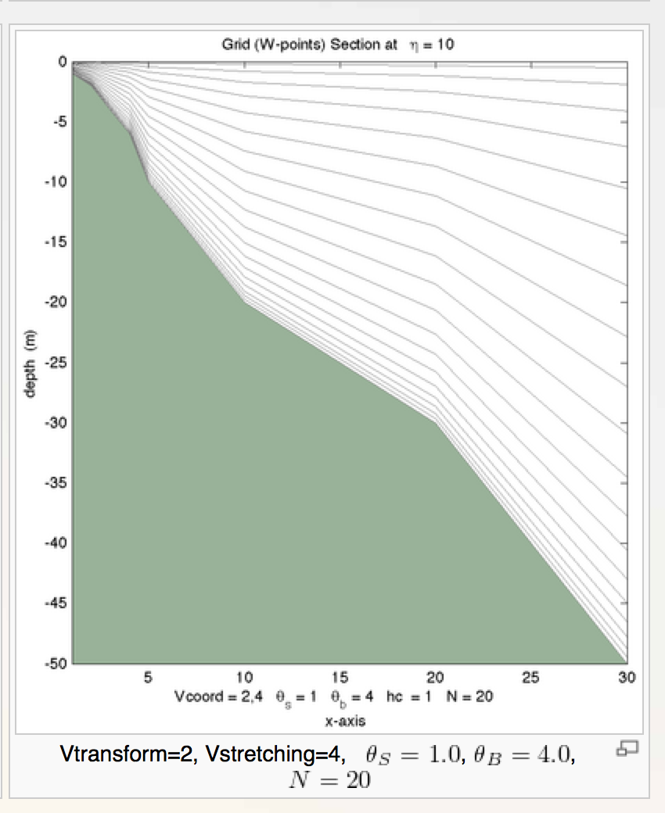
ROMS’
Vertical Grid
Terrain following.
Number of vertical grids is constant.
Stretched.
Implications:
Can maintain thin layers at surface and near bed.
Need post-processing to calculate vertical water depths.
Example figure from ROMS wiki

Slide 11
Key References
The ROMS manual and model background
https://www.myroms.org/wiki/Regional_Ocean_Modeling_System_(ROMS)
Shchepetkin, A. F., and J. C. McWilliams, 2005: The Regional Ocean Modeling System: A split-explicit, free-surface, topography following coordinates ocean model, Ocean Modelling, 9, 347-404.
Modeling Surface Trapped Sediment Plumes: a Sensitivity Study. Hyatt,J., Signell, R., Estuarine and Coastal Modeling (1999), New Orleans, LA, November 3-5.

Slide 12



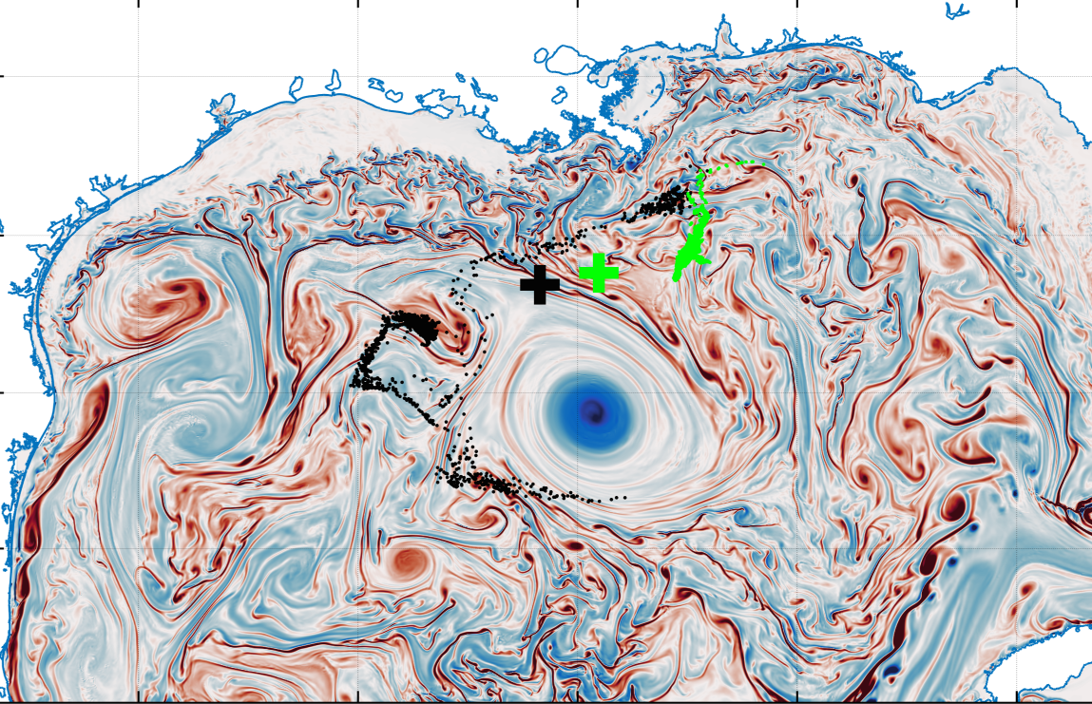
Ocean eddies, submesoscale turbulence and vertical transport
Annalisa Bracco
School of Earth and Atmospheric Sciences
TOR VERGATA| March 19th, 2019

Slide 13
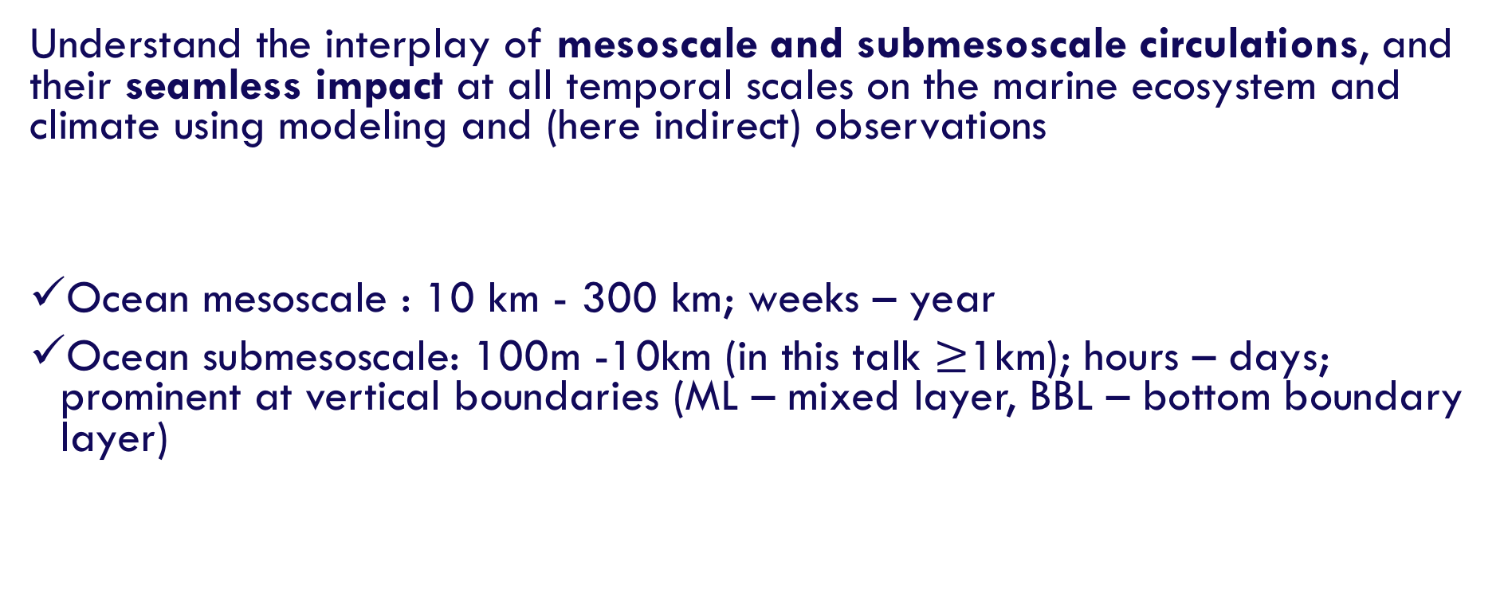
Underlying Research Theme
Understand the interplay of mesoscale and submesoscale circulations, and their seamless impact at all temporal scales on the marine ecosystem and climate using modeling and (here indirect) observations
Ocean mesoscale : 10 km - 300 km; weeks – year
Ocean submesoscale: 100m -10km (in this talk $≥$1km); hours – days; prominent at vertical boundaries (ML – mixed layer, BBL – bottom boundary layer)

Slide 14
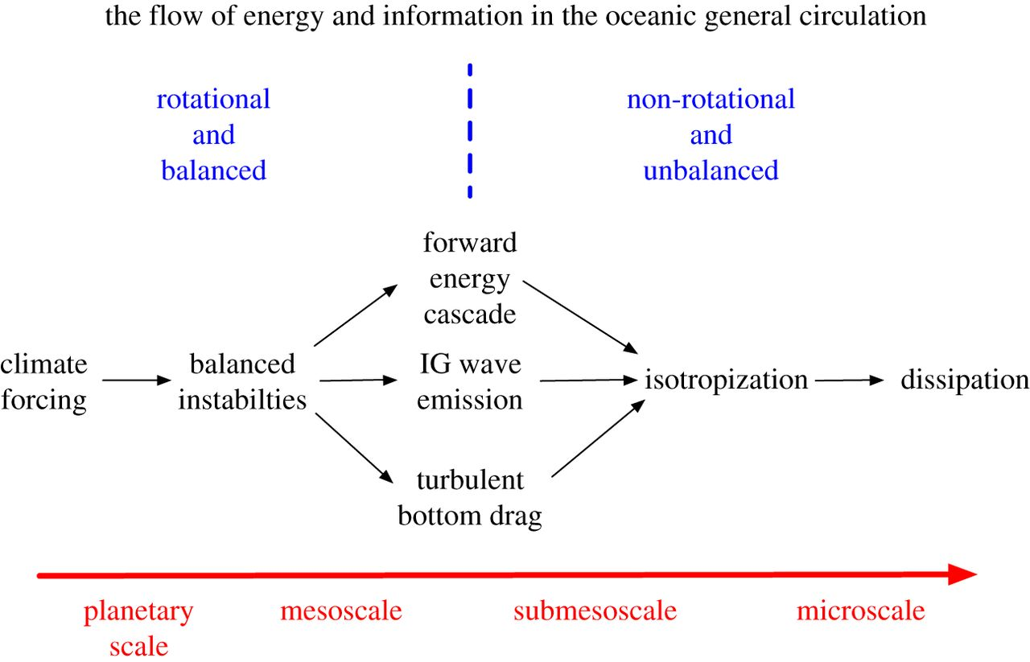
The flow of energy in the Ocean
McWilliams,
Proc. Royal Soc. A
2016
Below ~3 km rotation and stratification are still important but are not asymptotically overwhelming
Ageostrophic motions cannot be neglected near vertical boundaries (surface, bottom)

Slide 15
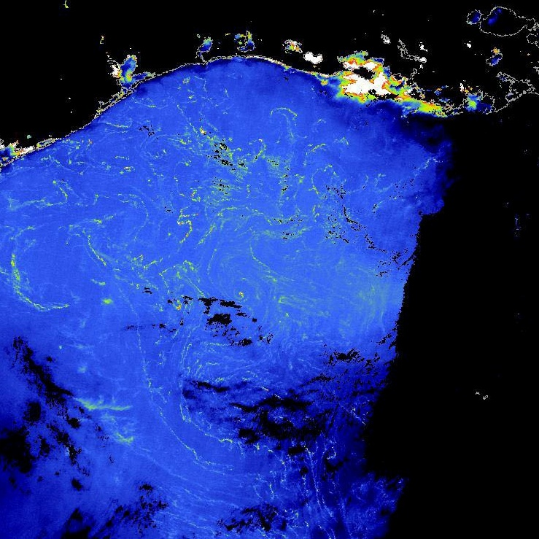
Observations in the Gulf of Mexico
MERCI MCI (Max. Chl Intensity)
Sargassum lines in 2005
(Gower et al., 2006)

Slide 16
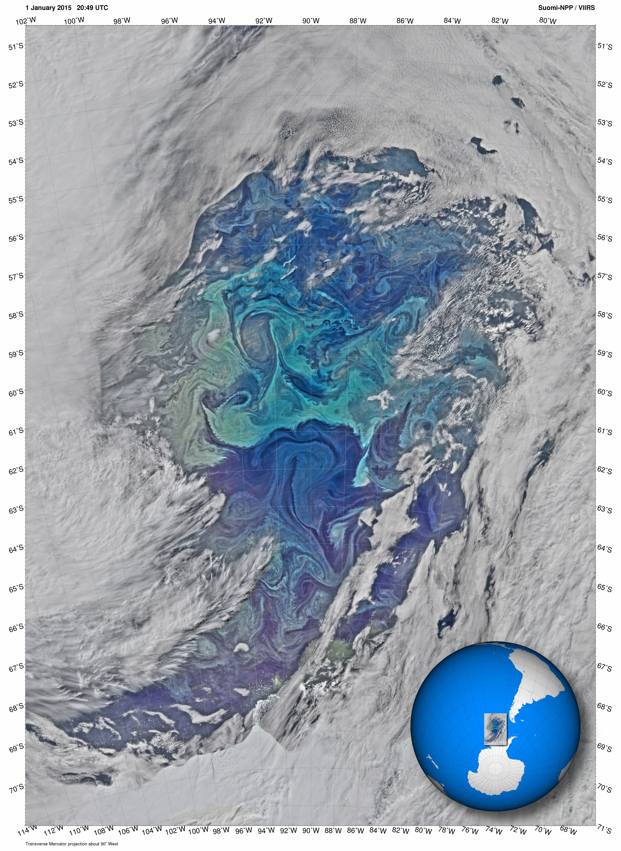
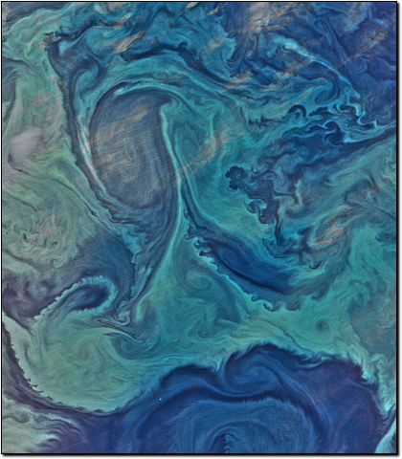
Phytoplankton bloom around Antarctica
January 15, 2015. Modis AQUA

Slide 17
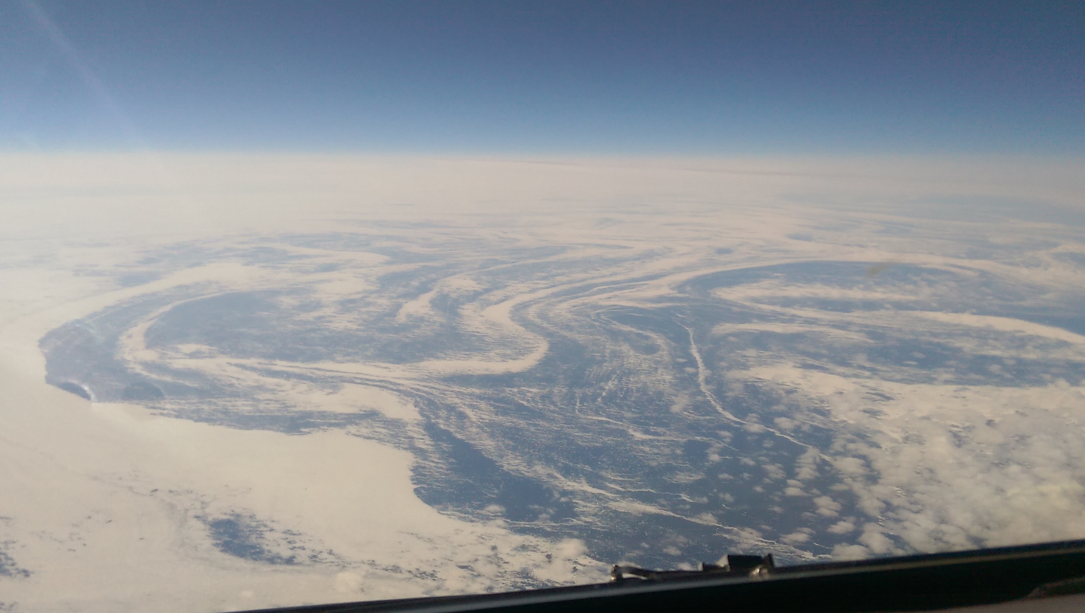
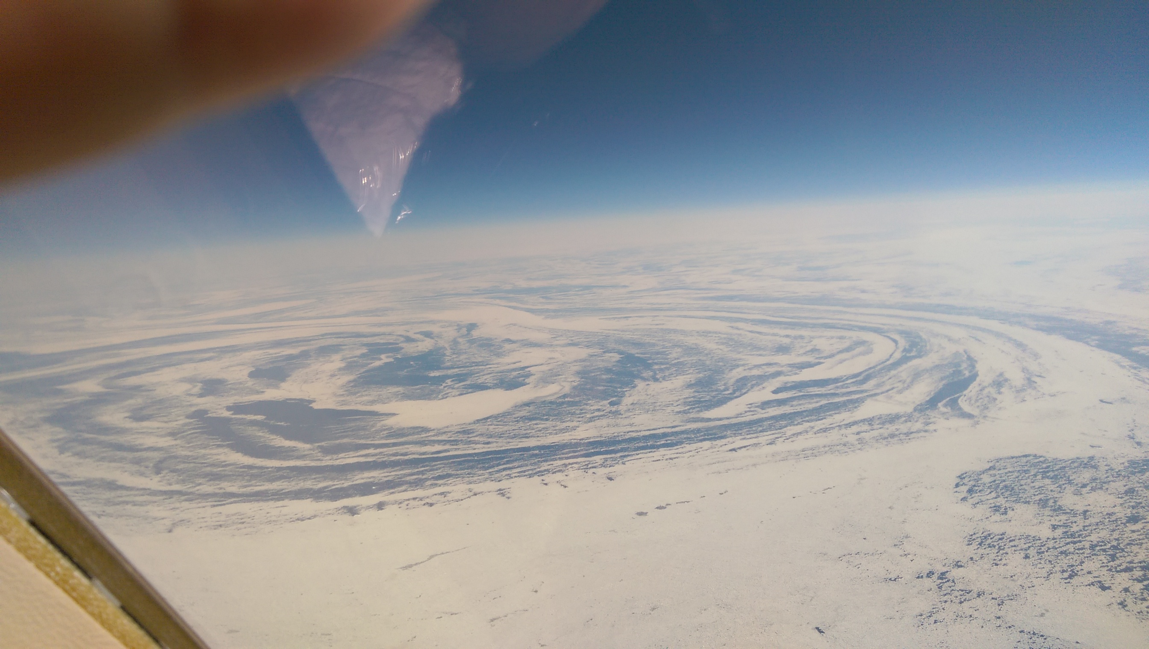
Photos taken by a commercial
airline pilot between
Canada and Greenland in
early April, 2015
The large eddy has a diameter of ~ 200 km

Slide 18
Limited measurements (in the Gulf of Mexico: Carthe – carthe.org – drifter experiments; Poje et al., 2014; D’Asaro et al., 2018 PNAS)
Most progress through modeling using nested techniques to investigate finer and finer scales
Approaching the limits of hydrostatic ocean models (Boussinesq approx., discretized in sigma-layers, split third-order upwind scheme, harmonic viscosity, linear bottom drag and KPP for vertical mixing parameterization)

Slide 19
Why Submesoscale dynamics are prominent near the ocean vertical boundaries?
Ocean interior: when a mesoscale circulation induces locally convergence through density gradients an overturning circulation develops to smooth the density gradients and restore the geostrophic balance
Ocean vertical boundaries (surface and bottom): at convergence regions where waters with different densities meet, the overturning circulation is purely horizontal the convergence of density surfaces accelerates frontogenesis occurs, R_{o} grows, upwelling and downwelling velocities on the sides of the front grow, submesoscale instabilities can develop
See Levy et al., GRL 2012

Slide 20
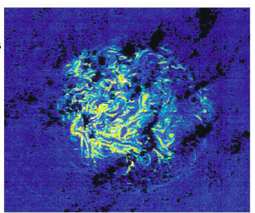
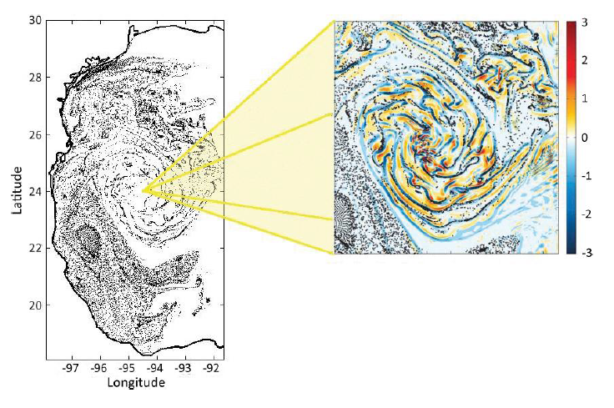
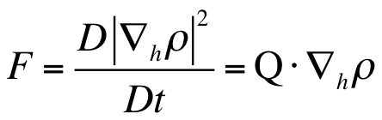
1. PATTERN FORMATION AND SUBMESOSCALES: horizontal mixing and oil dispersion
At the surface only. Immediately below Ekman term (due to wind forcing), ageostrophic contributions, stretching and tilting terms reach their max values (Koszalka, Bracco et al., JGR 2009)
max lateral convergence:
frontogenesis – but needs density gradients
10⁻⁵s⁻¹
Zhong et al., 2012

Slide 21
SEASONAL DEPENDENCE

Slide 22
Instabilities
Four classes of instabilities generally implicated, often developing at fronts:
Mixed-layer instability (MLI): ageostrophic baroclinic instability that acts to constantly re-stratify the mixed-layer and develops at the scale of the local deformation radius. APE is needed, strong seasonal cycling (parameterization available)
Gravitational instability: may occur whenever the buoyancy frequency N² changes sign
Symmetric instability (SI): a change in sign of Ertel potential vorticity (EPV) is needed
ageostrophic anticyclonic instability (AAI): a change in sign of (A-S) where A is absolute vorticity defined as A=f+ζ and S is strain rate is required

Slide 23
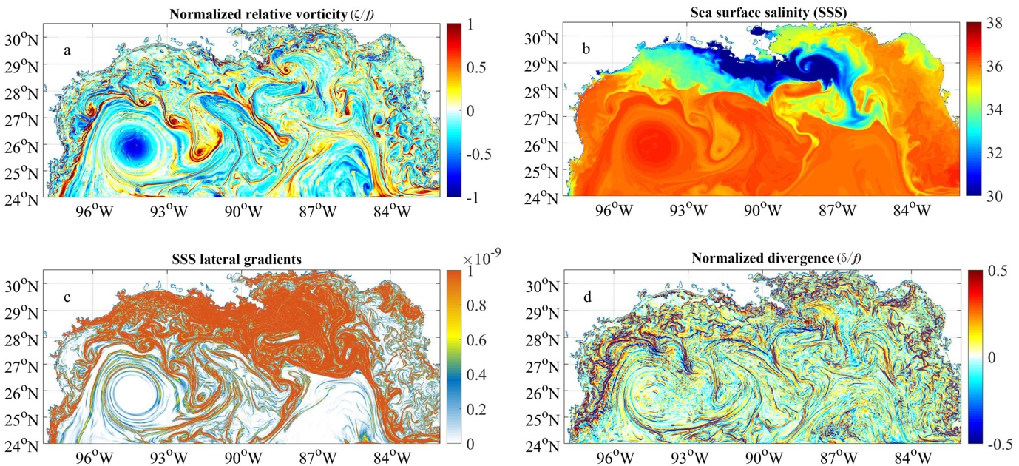
DENSITY GRADIENTS DEPENDENCE

Slide 24
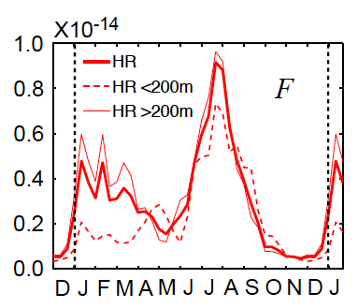
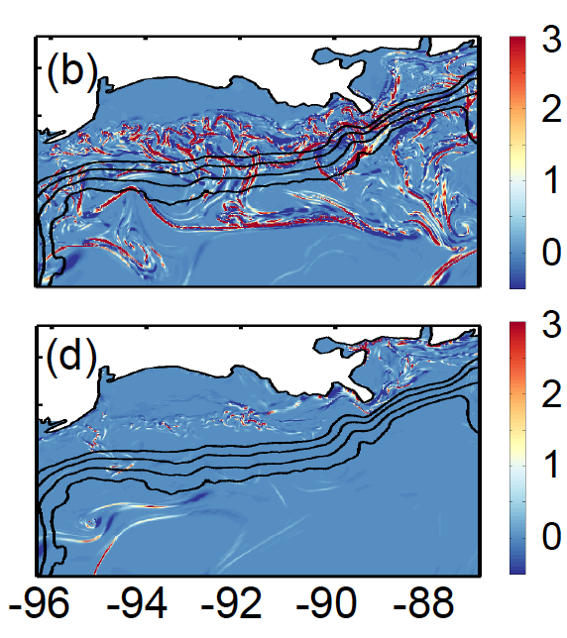
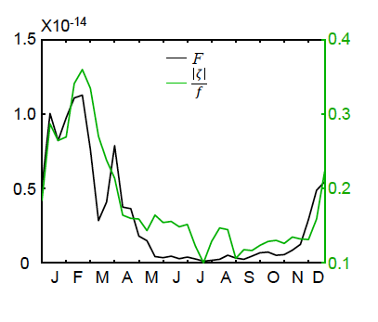
IN THE ABSENCE OF RIVER INPUT
F
AUG 2010 with river input
AUG 2010 without river input
Luo et al., 2016 (see also Barkan et al., 2017)
10⁻¹⁴ kg² m⁻⁸ s⁻¹

Slide 25
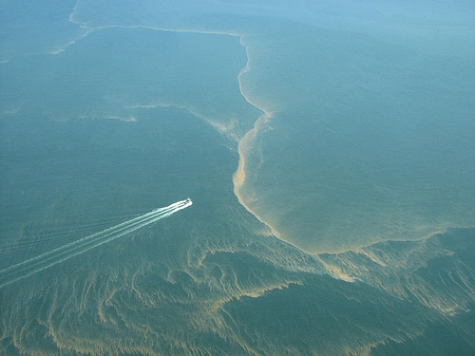
The 2010 Deepwater Horizon oil spill

Slide 26
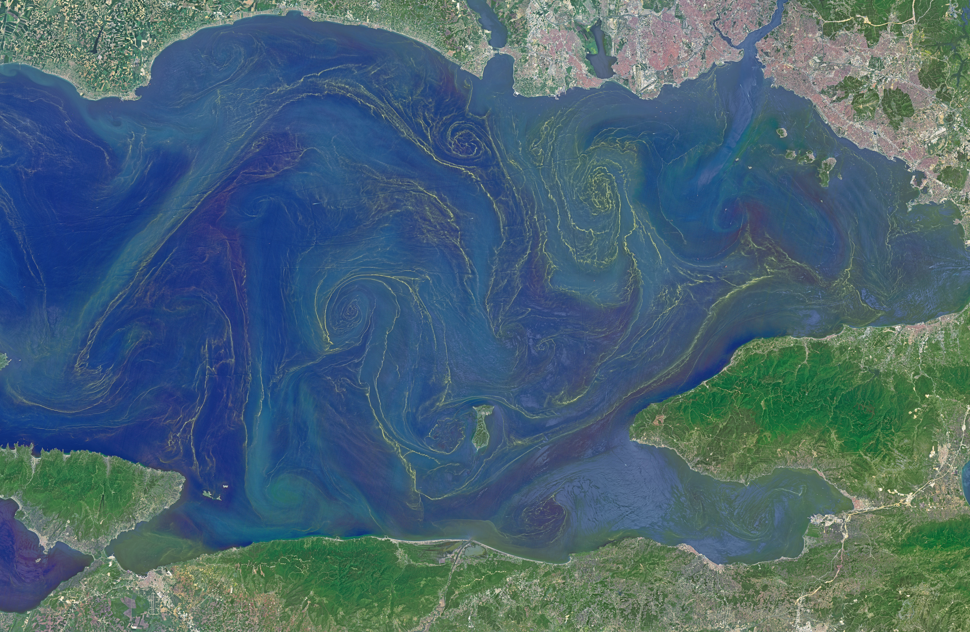
Sea of Marmara, Operational Land Imager on the Landsat 8
Phytoplankton bloom on May 17, 2015

Slide 27
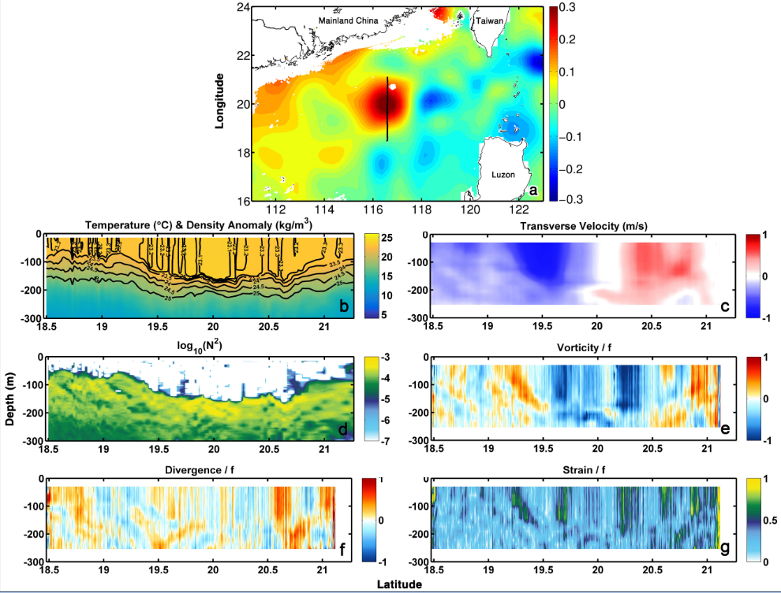
2. PATTERN FORMATION AND SUBMESOSCALES:
Implications for vertical transport and carbon cycling
Zhong, Bracco et al, Scientific Reports, 2017

Slide 28
Modeling
ROMS-Agrif at three different horizontal resolutions, 10 km, 5 km (all SCS) and 1 km (nested over 113°E–122°E, 17°N–25°N)
6-hourly realistic forcing 2000-2008 (QSCAT/NCEP blended satellite wind and NCEP heat and fresh water fluxes 2000-2008); 20 yrs spin-up
We find an eddy similar to that observed in January 2001

Slide 29
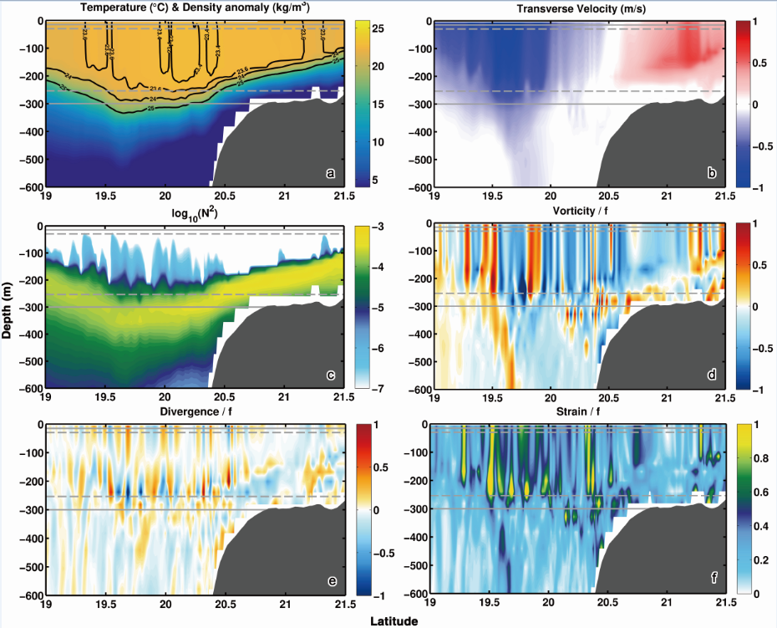
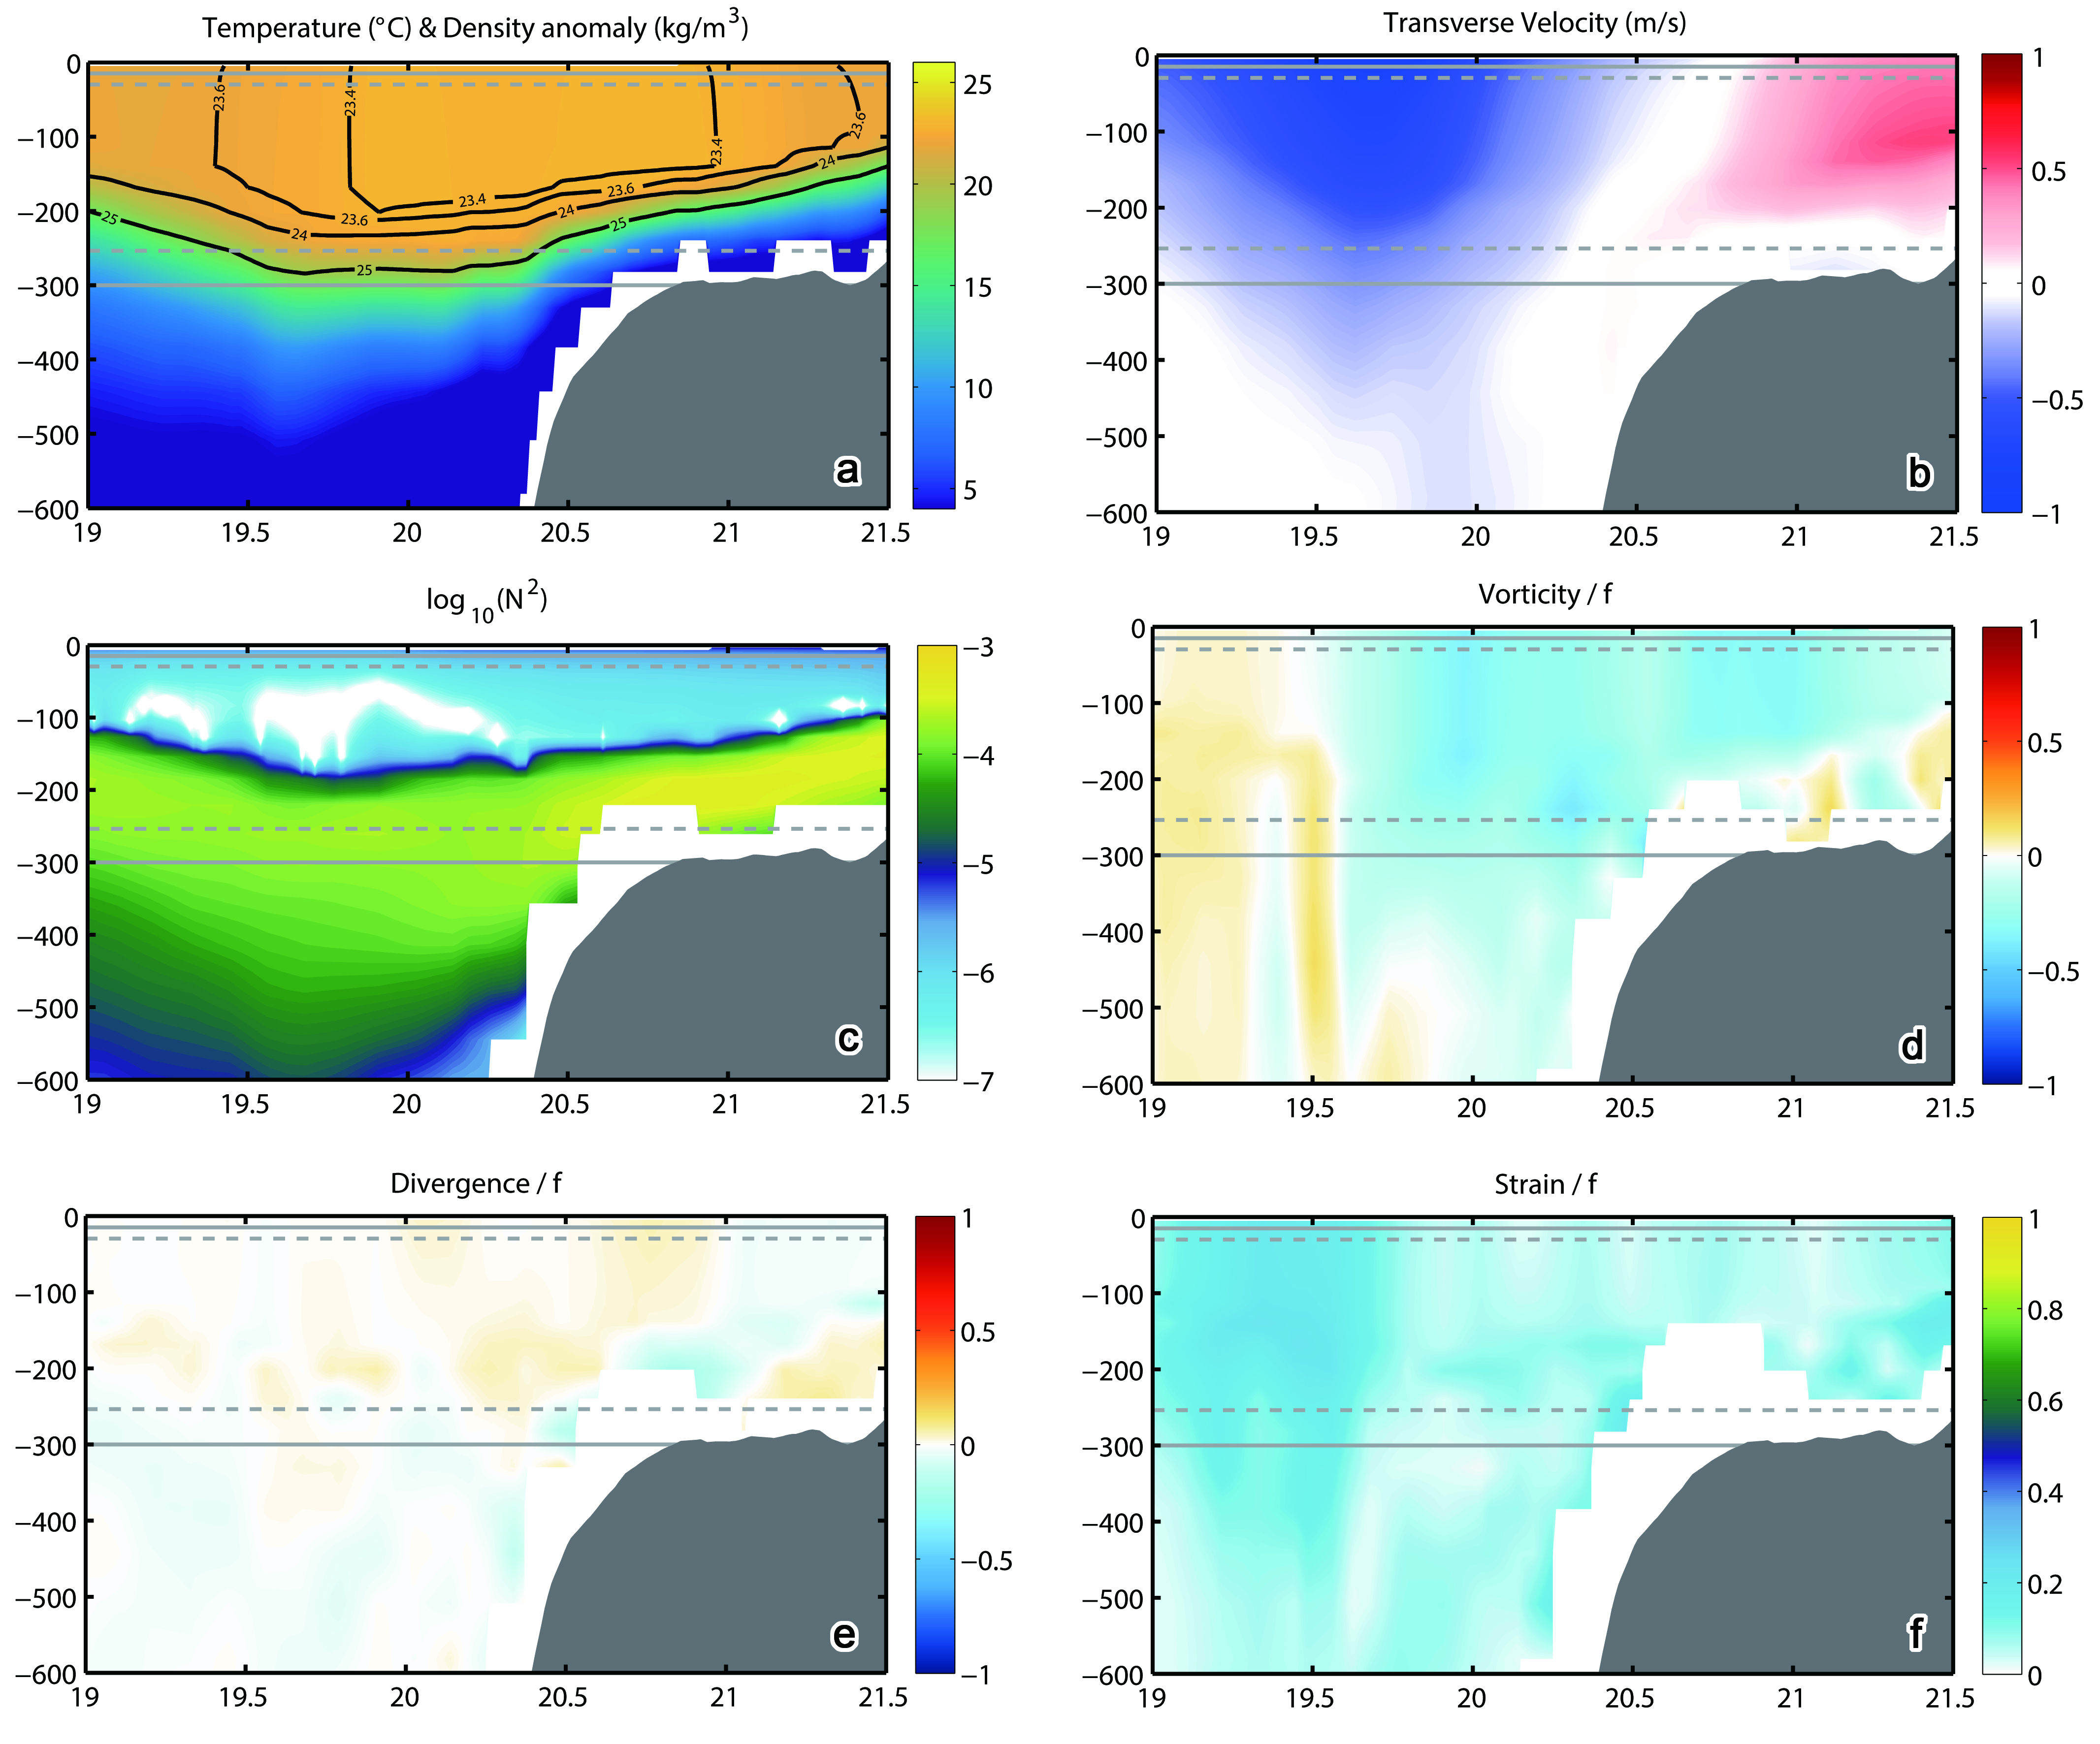
1km run
10km run
max for next high res. climate models
Zhong, Bracco et al, Scientific Reports, 2017

Slide 30
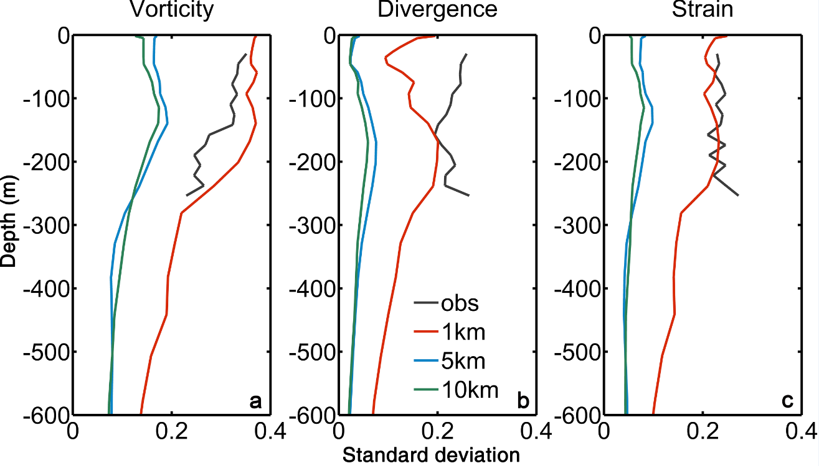
Standard deviation: modeled vs observed
Zhong, Bracco et al, Scientific Reports, 2017

Slide 31
Bracco, Liu & Sun, Chaos, Fractals and Solitons, 2019

Slide 32
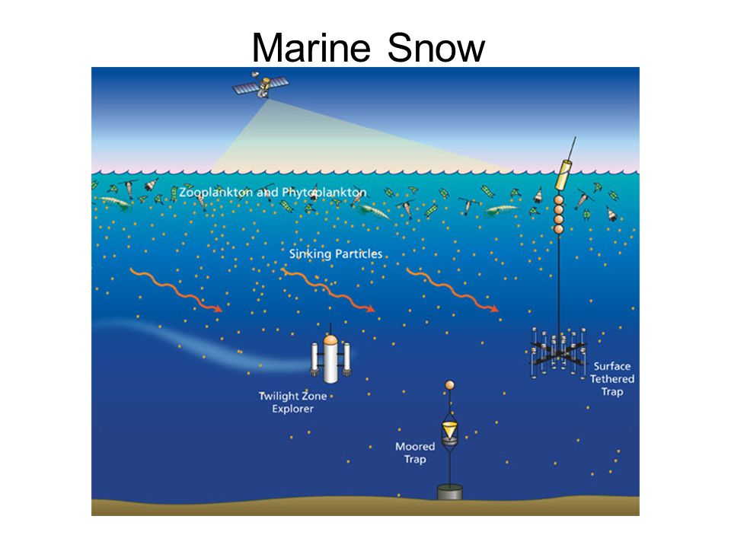
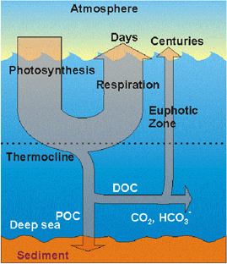
Omand, D’Asaro et al., Science 2015 for observational evidence at high latitudes of POC export at eddy periphery. Estimated to contribute as much as ½ POC export in spring.
Marine snow image from ECOGIG video by G. Finch Production

Slide 33
Implications for carbon cycling
Main point:
Large difference in POC flux between GC600
and AT357
Bathymetry of the domain, black: GC600; green: AT357
Time series of POC flux collected from 2 sediment traps (black, GC600; green, AT357); Pink boxes indicate modeling periods, i.e., April/May; Sept/October 2012
Liu, Bracco, Passow, Elementa: Science of the Anthropocene, 2018

Slide 34
TOP: Sea surface height patterns from the Gulf of Mexico Coastal Ocean Observing System (GCOOS)
MIDDLE: Modeled sea surface height patterns
BOTTOM: modeled surface salinity field
GC600 (black) and AT357 (green) sites
are indicated. Major circulation features such as Loop Current and the (anticyclonic) Loop eddies are indicated

Slide 35
ζ/f, averaged over the time over which the particles with various sinking velocities were at the surface.
See also: Omand, D’Asaro et al., Science 2015 for observational evidence at high latitudes of POC export at eddy’s periphery. Estimated to contribute as much as ½ POC export in spring.

Slide 36
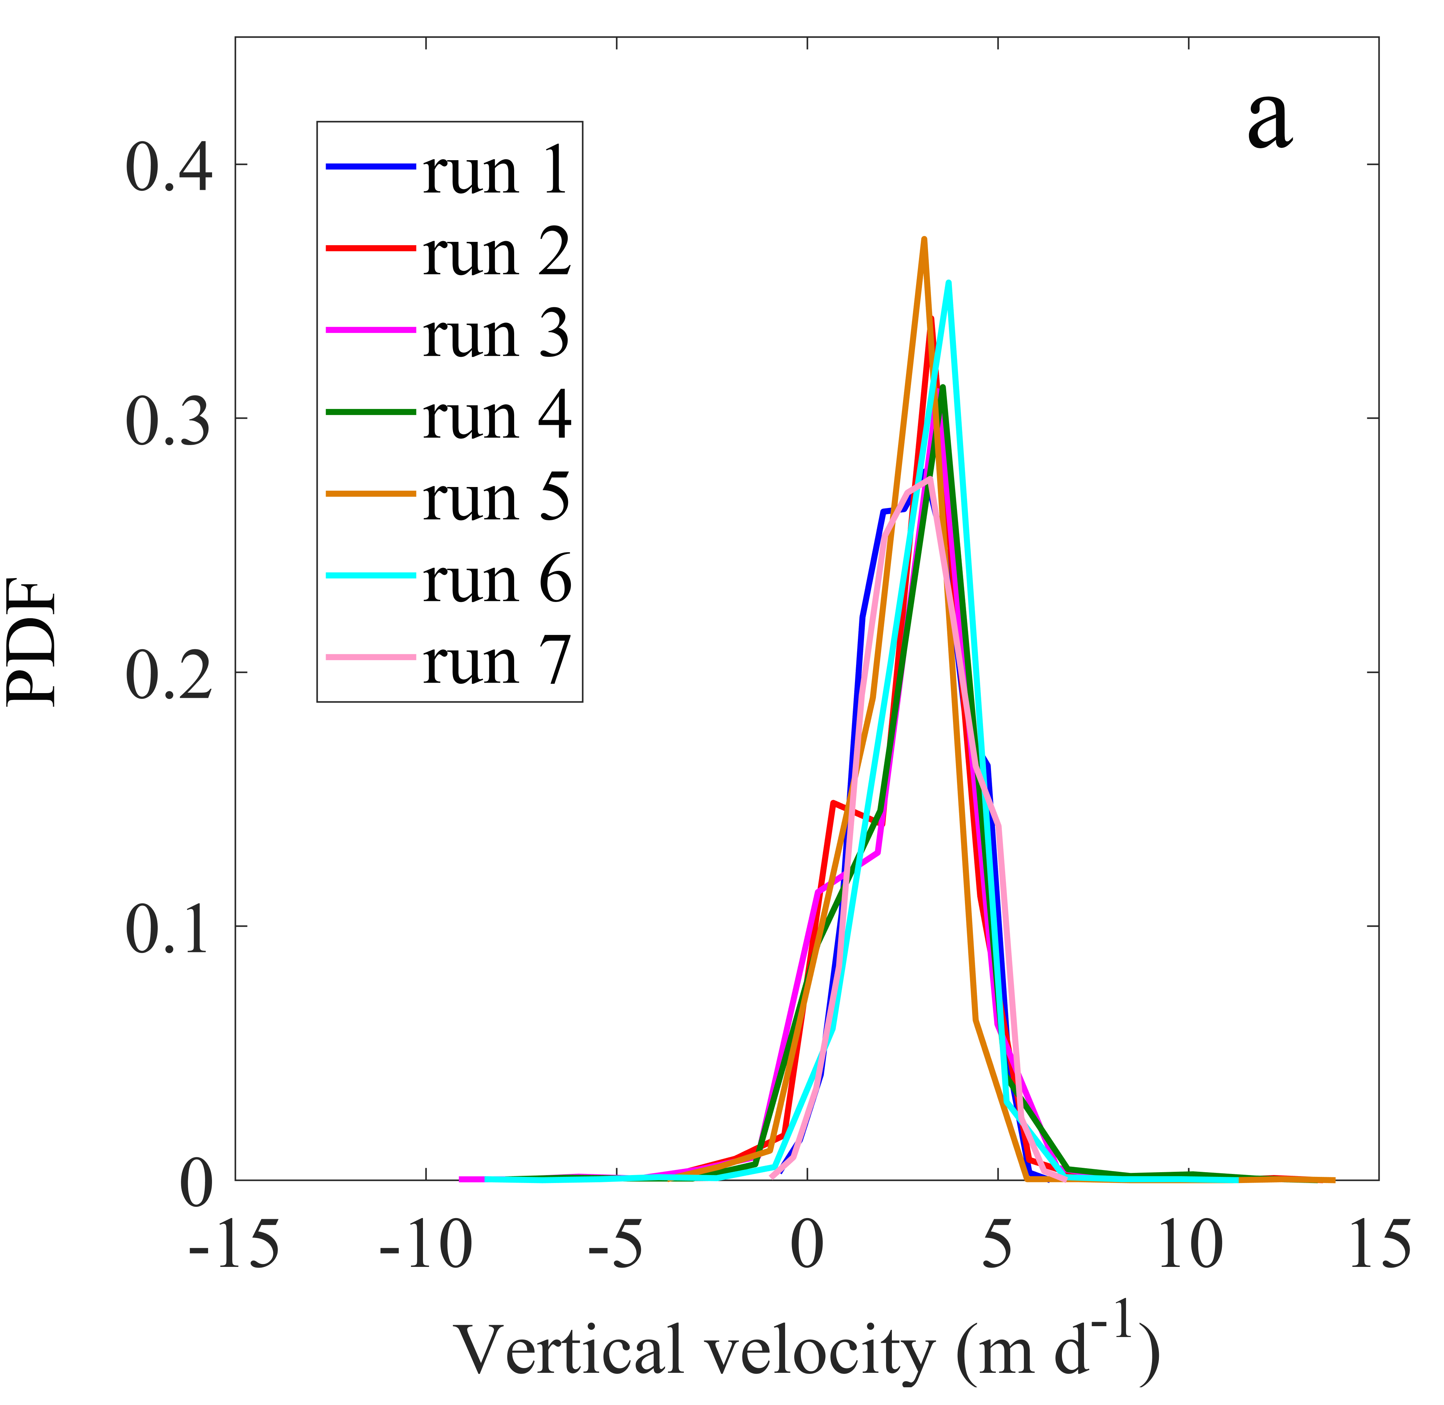
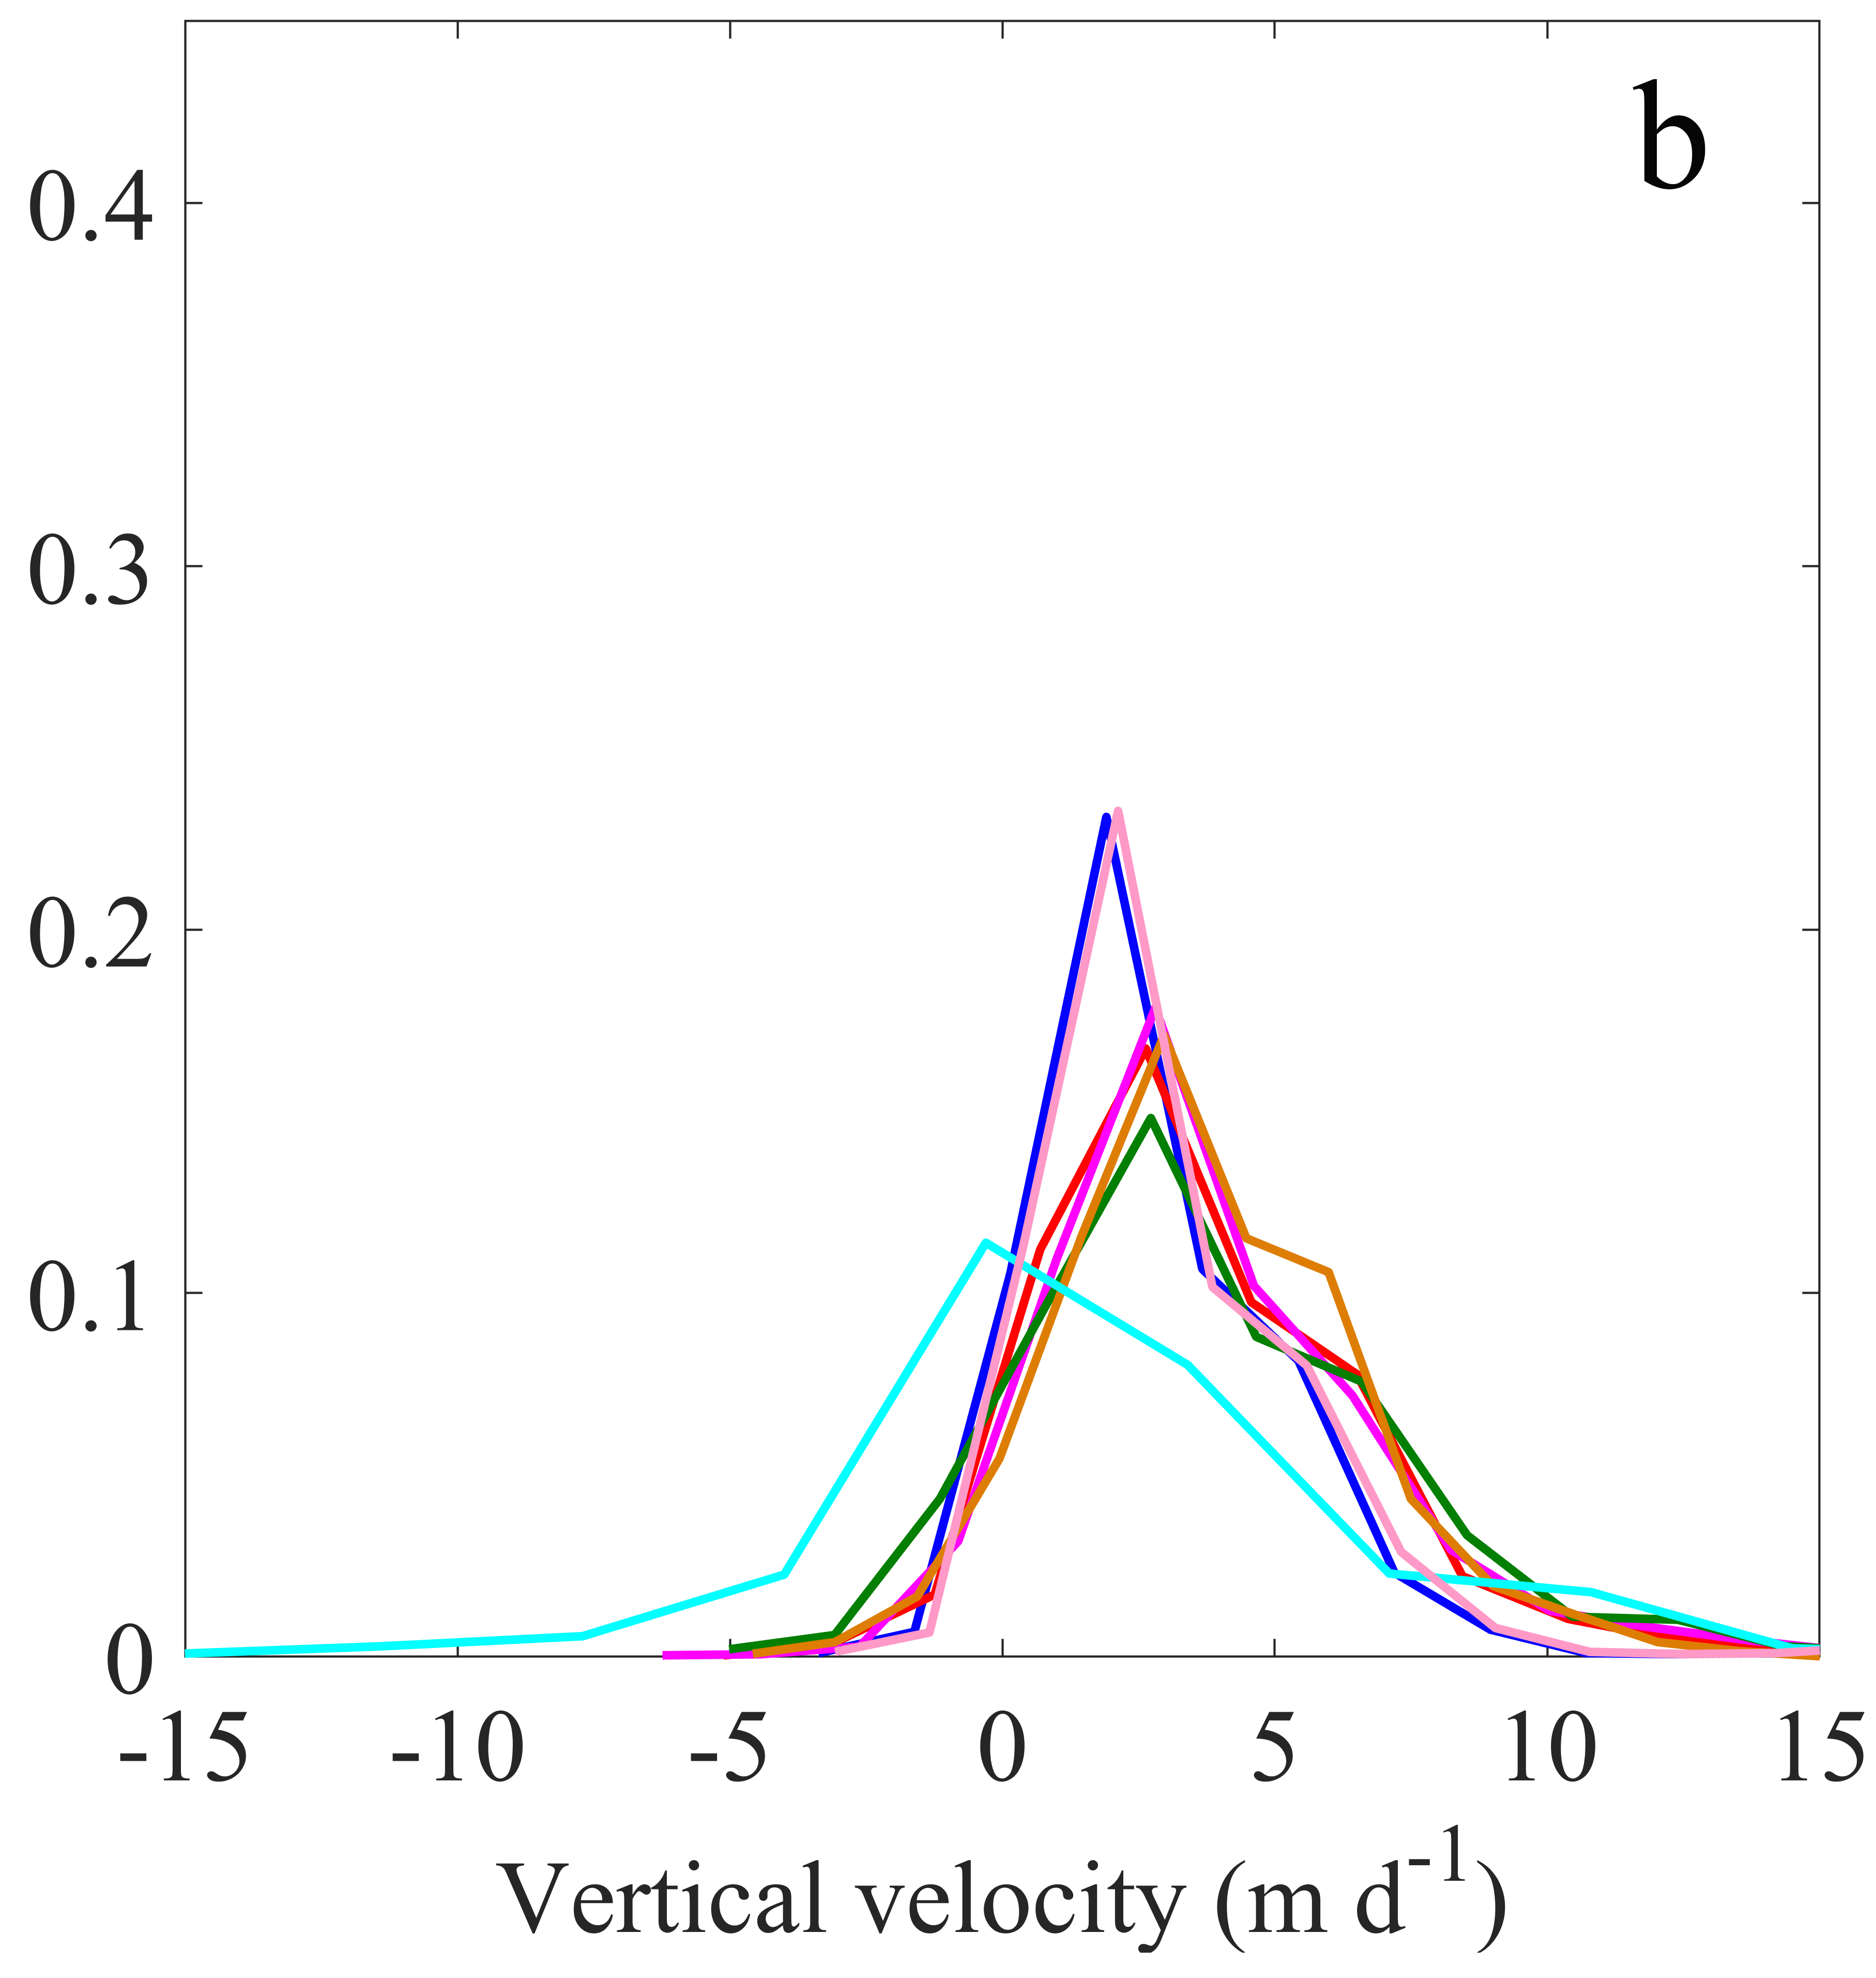

Sinking time: Submesoscale convergence impacts
PDFs of the particles’ resident time in the water column. averaged on all ensemble members. Time required to reach traps along a straight line through sinking alone indicated by vertical lines.
PDF of flow vertical velocities at particles’ locations in upper 200 m for 30 md⁻¹ case
Sinking time

Slide 37
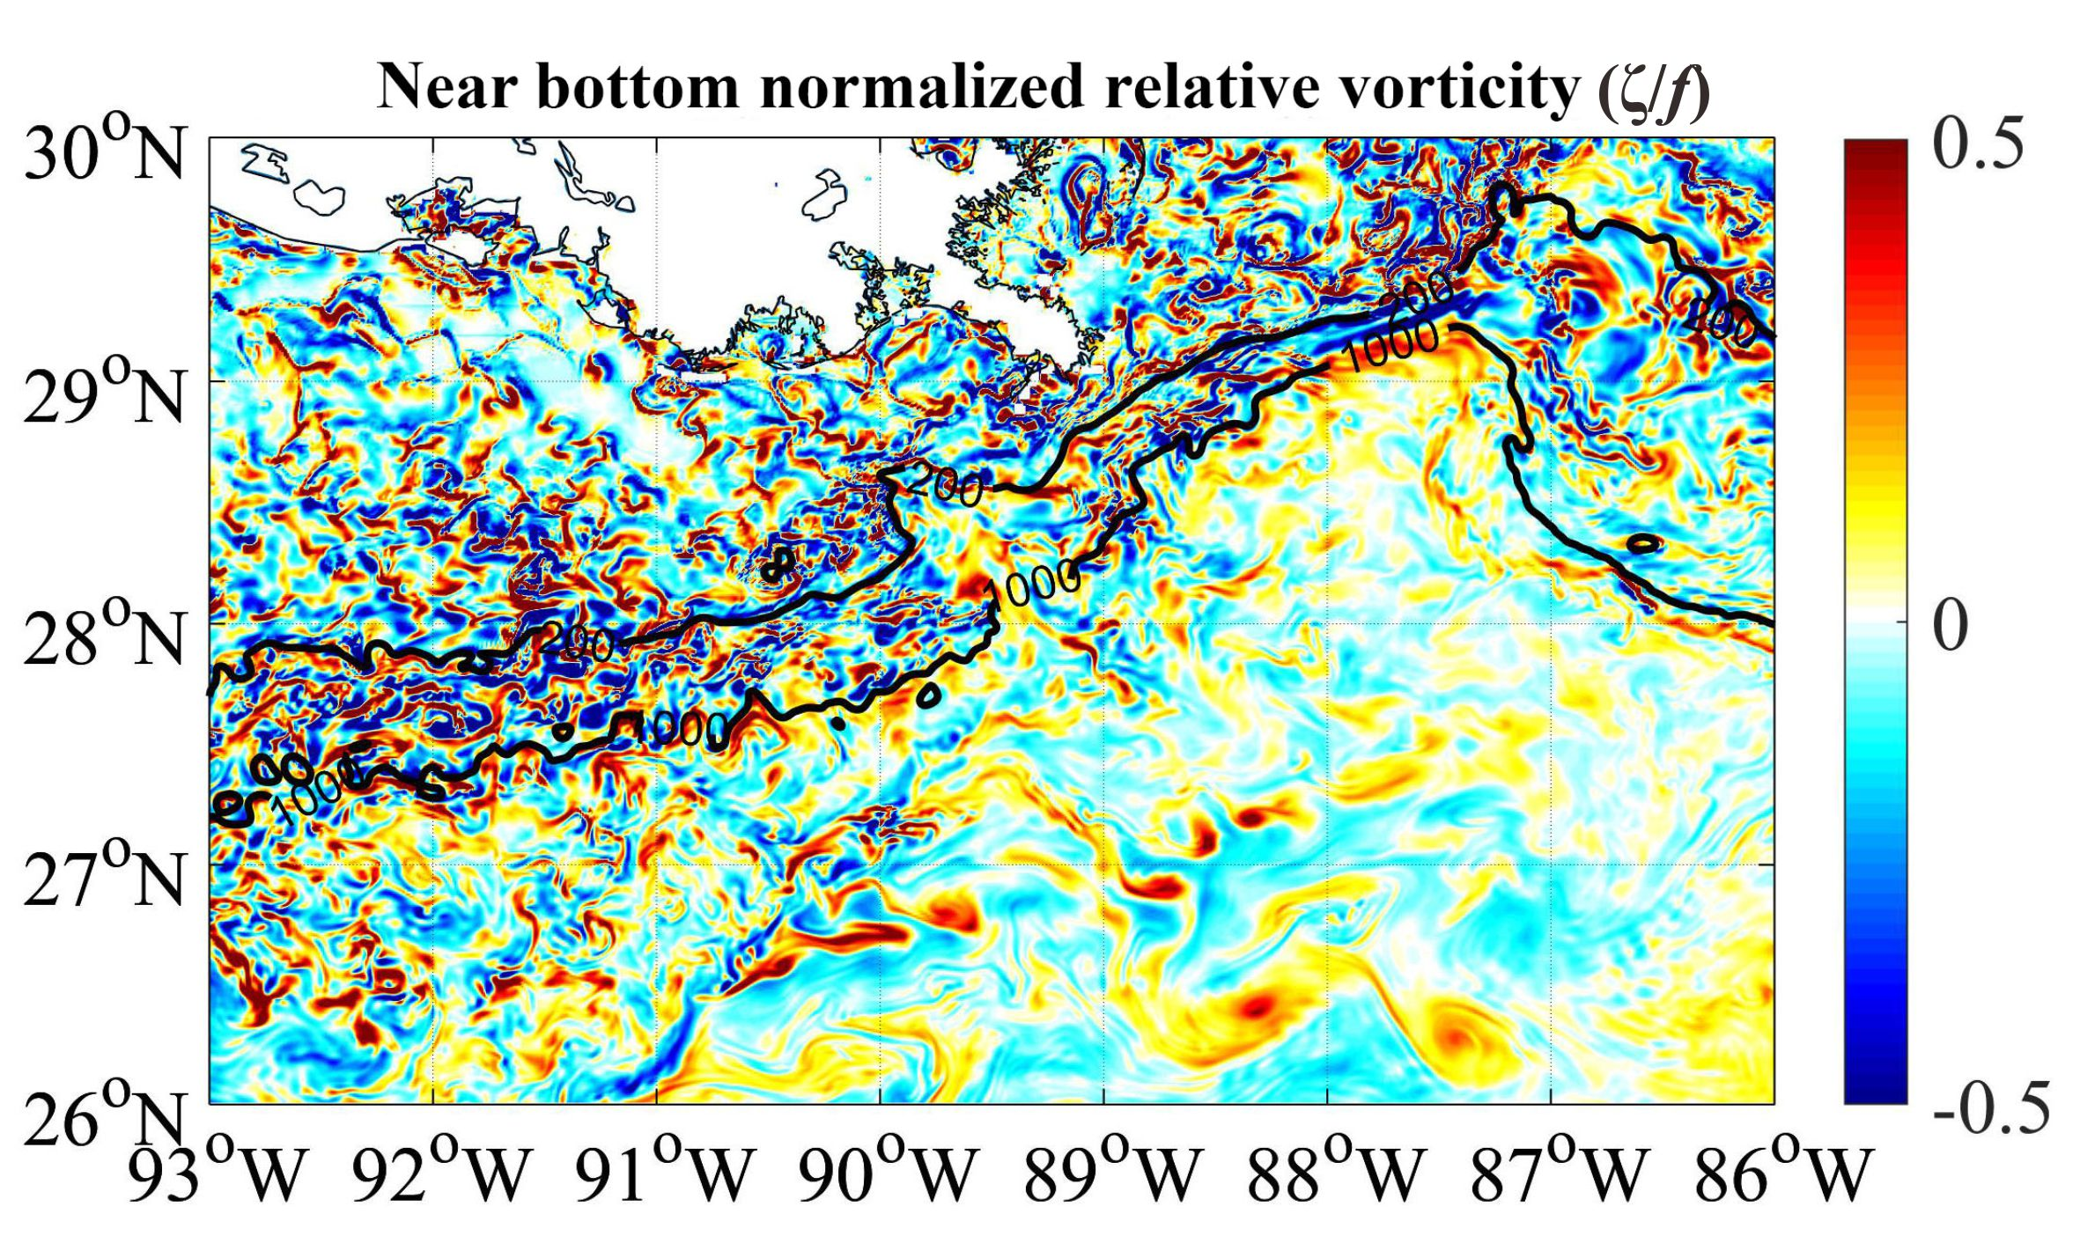
3. PATTERN FORMATION AND SUBMESOSCALES:
Transport near the ocean bottom
Normalized near-bottom
relative vorticity, ζ/f.
Instantaneous field
Bracco et al. Ocean Modelling 2016, 2018

Slide 38
GENERATION OF SUBMESOSCALE EDDIES
ALONG CONTINENTAL SLOPES
Vertical velocities have to go to zero at the bottom -> horizontal shear layer near the bottom
Juxtaposition of along-slope frontal currents that are highly variable in speed and direction (very common in the Gulf of Mexico) -> lateral shear layers
The width of the layer depends on bathymetric slope; mostly unresolved at >= 5km horizontal resolution and partially resolved at ~ 1 km
Whenever high values of vorticity are achieved (ζ/f >> 0.1) small scales eddies and filaments are generated through partially unbalanced instabilities
Bracco et al. Ocean Modelling 2016, 2018

Slide 39
Juxtaposition of along-slope frontal currents that are highly variable in speed and direction -> lateral shear layers
mean u (cm/s)
instantaneous u (cm/s)
ζ/f
Vertical velocities have to be zero at the bottom -> horizontal shear layer near the bottom
instantaneous
u (cm/s)
ζ/f
Bracco et al. Ocean Modelling 2016

Slide 40
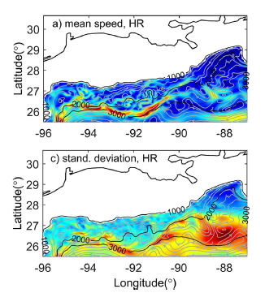
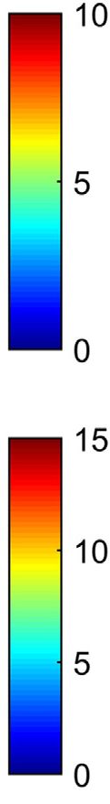
Important differences in transport
properties to the east and west
of Mississippi Fan
Mean near bottom lateral speed
STD of near bottom lateral speed
cms⁻¹
Depth-integrated concentration of the tracer deployed at MC297 (black star) and GC600 3, 6 and 12 months after deployment. Note the different color scales! Implications for methane consumption confirmed by in-situ measurements
over 6 years (Rogener, Bracco et al., Elementa 2018)

Slide 41
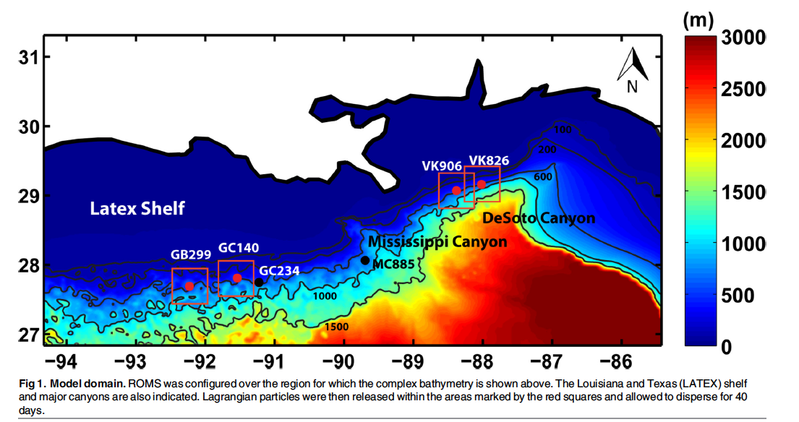
Transport near the ocean bottom, coral connectivity and evolution
red dots:
Leiopathes
glaberrima
observed
colonies
Deep, cold water corals live at depths up to ~2,000 m. They are foundation species of the deep-sea benthos
Cardona, Ruiz-Ramos, Baums, Bracco, PLOS One 2016

Slide 42
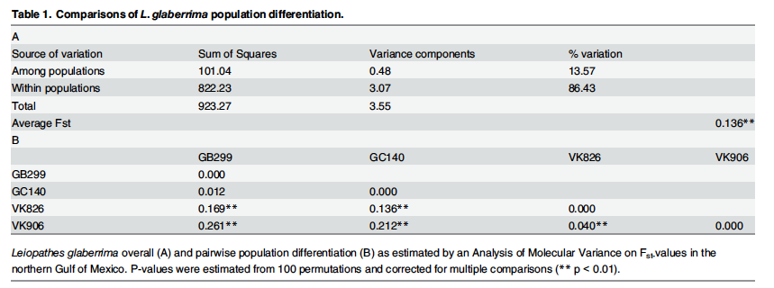
Leiopathes glaberrima: Genetic analysis over 10,000 generations: two sympatric lineages with restricted realized gene flow
Cardona, Ruiz-Ramos, Baums, Bracco, PLOS One 2016

Slide 43
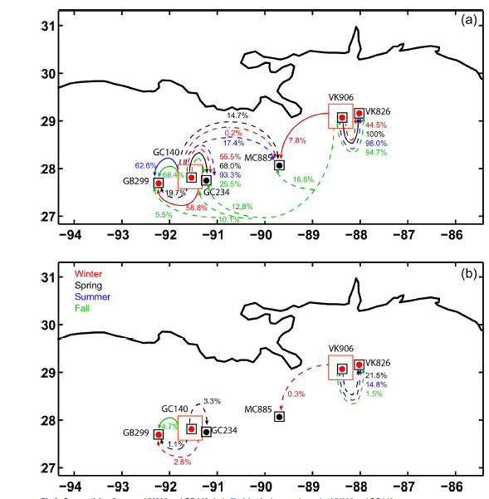
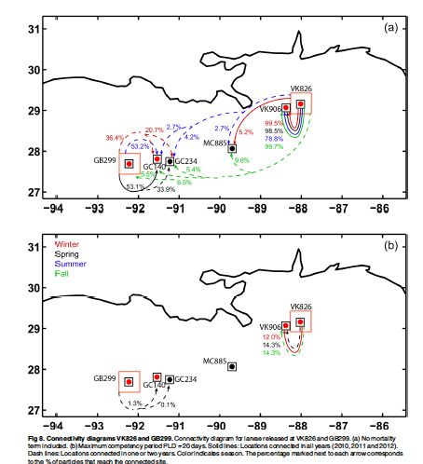
Example of modeled connectivity
for coral larvae of Liopathes Glaberrima at the four locations after 40 days and no mortality (TOP)
and with a pelagic larval duration (PLD) of 20 days (BOTTOM)
Simulations help determining upper and lower limits of Leiopathes glaberrima larvae competency time - likely ≈/> 30 days; definitively more than 10 days which is ~ larvae lifespan. This supports period of low metabolic activity (Graham et al., Coral Reefs, 2013)

Slide 44
Potential connectivity of Callogorgia delta in the Northern Gulf of Mexico:
the depth differentiation hypothesis

Slide 45
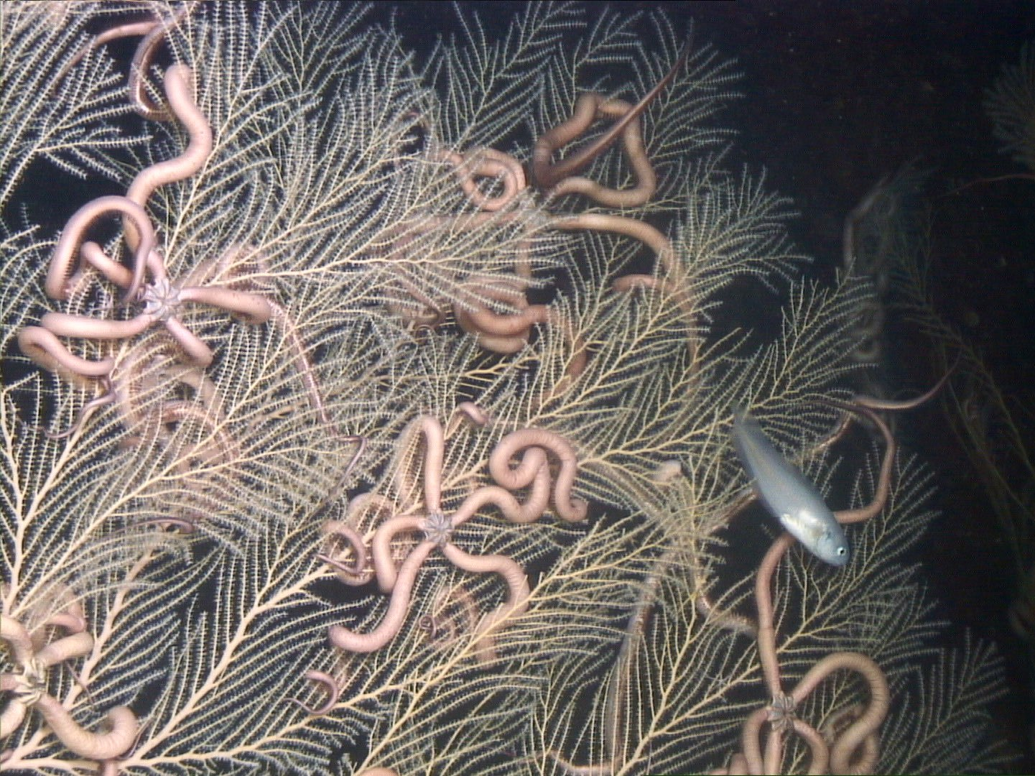
Vertical
dispersal
Callogorgia delta
PLD = 40 Days

Slide 46
Modeled connectivity

Slide 47
Genetic structuring
with distance
Callogorgia delta
61,179 loci
Fst 0.0115-0.0691

Slide 48
Summary
Submesoscale circulations take different shape and form depending on mixed-layer depth, source of density gradients, near bottom circulation.
In the Gulf of Mexico they contributed to the oil convergence in 2010 + to the deep, narrow plume that formed at ~1,200 m depth, and to extremely patchy distribution of marine snow (impacts on corals). SHORT TIME SCALES: HOURS TO MONTH
Luo, H., A. Bracco, Y. Cardona and J.C. McWilliams The submesoscale circulation in the Northern Gulf of Mexico: Surface processes and the impact of the freshwater river input Ocean Modelling, 101, 68-82 (2016)
Bracco, A., J. Choi, K. Joshi, H. Luo and J.C. McWilliams The submesoscale circulation in the Northern Gulf of Mexico: Deep phenomena and dispersion over the continental slope. Ocean Modelling, 101, 43-58 (2016)
Choi, J., A. Bracco, R. Barkan, A. F. Shchepetkin, J.C. McWilliams, J. Molemaker Submesoscale dynamics in the northern Gulf of Mexico. Part III: Lagrangian implications J. Phys. Ocean., 47, 2361-2376 (2017)
Bracco A., J. Choi, J. Kurian, P. Chang Vertical and horizontal resolution dependency in the model representation of tracer dispersion along the continental slope in the northern Gulf of Mexico Ocean Modelling, 122, 13-25 (2018)

Slide 49
Submesoscale induced vertical transport in eddies is much stronger if ageostrophic motions are accounted. With surface convergence has implications for ocean carbon and heat storage. POC sinking time can be significantly shorter than estimated by sinking velocities alone.
Different submesoscale regimes in nearby regions along the continental slopes impact advection at the bottom
TIME-SCALE: YEARS TO DECADES
Zhong, Y., A. Bracco , J. Tian, J. Dong, W., Zhao, Z. Zhang Observed and simulated vertical pump of an anticyclonic eddy in the South China Sea. Scientific Reports (2017)
Liu, G., A. Bracco, S. Giering, U. Passow, The influence of mesoscale and submesoscale circulation on sinking particles in the northern Gulf of Mexico Elementa: Science of the Anthropocene (2018).
Rogener, M.K., A. Bracco, K. Hunter, M. Saxton, S. Joye, Impact of the Deepwater Horizon oil well blowout on methane oxidation dynamics in the Northern Gulf of Mexico. Elementa: Science of the Anthropocene (revised July 2018).

Slide 50
Mesoscale/submesoscale mixing have contributed to the different evolution history of deep-water corals - and likely deep-water mussels (Faure et al., 2015) - along the continental slope in the Gulf of Mexico. No cosmopolitan distributions in this small, enclosed basin! Likely true for many coldwater mesophotic corals
TIME SCALE: THOUSANDS OF YEARS
Cardona, Y., D.V. Ruiz-Ramos, I.B. Baums, A. Bracco Potential connectivity of coldwater black coral communities in the northern Gulf of Mexico; PLOS ONE, 11(5): e0156257 (2016)
Bracco A, G. Liu, M. Galaska, A. Quattrini, S. Herrera Integrating submesoscale circulation models and genomic approaches to understand depth-differentiation of Callogorgia delta in the northern Gulf of Mexico. J. Mar. Science, Submitted

Slide 51




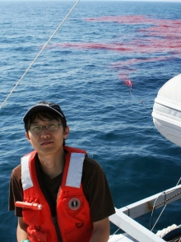

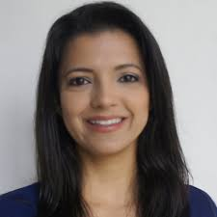
Thank you
Guangpeng Liu, GT Jun Choi (now KIOST) Yisen Zhong (now SJTU) Yuley Cardona (now U. Medellin)
and collaborators at Penn State (Iliana Baums), UCSB (Uta Passow), UCLA (Jim McWilliams, Roy Barkan), Texas A&M (Ping Chang, Tracy Villareal, Jaison Kurian), LeHigh Un. (Santiago Herrera), Harvey Mudd College (Andrea Quattrini), and GT (Joe Montoya)

